Slide 1
Space Weather Discussion
David A. Vallado* and Sarthak Srivastava**
*Center for Space Standards and Innovation COMSPOC, **Ansys Corp
October 18, 2023

Slide 2
Overview
Overall COMSPOC needs from SPW
Products
Timelines
ODTK Plugin for WAM

Slide 3
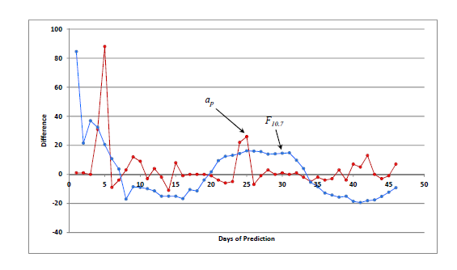
Overall Needs
Produce highest quality ephemerides
Conjunction calculations of O/O vs secondaries
Requires accurate atmospheric models and Space Weather indices
Prediction is most important
Generally ~7 days
Time required for:
Accurate solutions to be obtained
Additional observations to be taken
Decisions to be made
Up-link of commanded maneuvers (if needed) to be made
Maneuver to take effect and move satellite out of the way

Slide 4
Specific Products
Most traditional atmospheric models require
NRLMSISE-00, DTM-12, J71, JR-71, etc.
Solar Flux, F10.7
Geomagnetic indices
Density\density corrections are also acceptable
WAM
Other

Slide 5
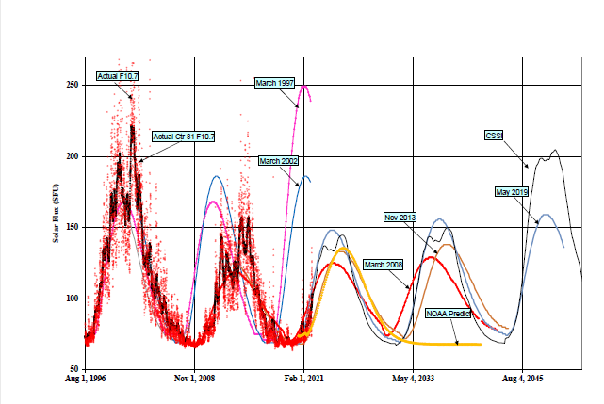
Timing
Need continuous file of data to support
Like Celestrak
http://celestrak.org/SpaceData/
Past operations (calibration etc)
Current status (where is the satellite now?)
Future locations
Most important as predicted conjunctions must be accurate and avoided if necessary

Slide 6
Results
Initial Plugin developed for STK/ODTK
(Sarthak Srivastava of Ansys)
Upload density data files
Interpolate to get the density at an altitude
Return the density for use in orbital propagation

Slide 7
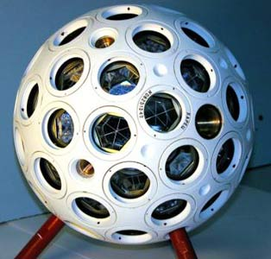
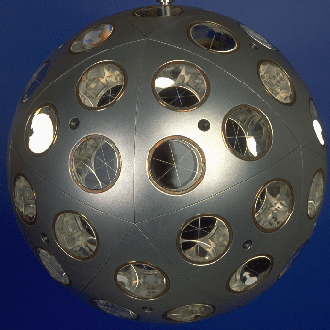
Geomagnetic Storm case: 23-26 March, 2023
Stormy conditions:
Kp ~ 8
Dst ~ -150 nT
Opportunity to study density differences in orbit propagation
Precise estimates of real trajectory available from Satellite Laser Ranging of calibration satellites
LARETS
STELLA/ STARLETTE
(https://space.skyrocket.de/)

Slide 8
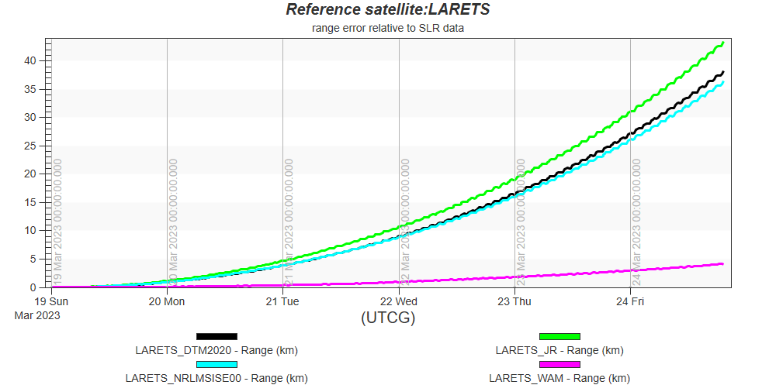
Orbit Propagation error for LARETS (~700 km)
Orbit propagation with STK HPOP for 6 days
Propagation using WAM-IPE density (~5 km) seen to match SLR data much better than other models (~40 km error)

Slide 9
Orbit Propagation error for STELLA (~800 km)
Orbit propagation with STK HPOP for 6 days
Propagation using WAM-IPE density (~1 km) seen to match SLR data much better than other models (~8 km error)

Slide 10
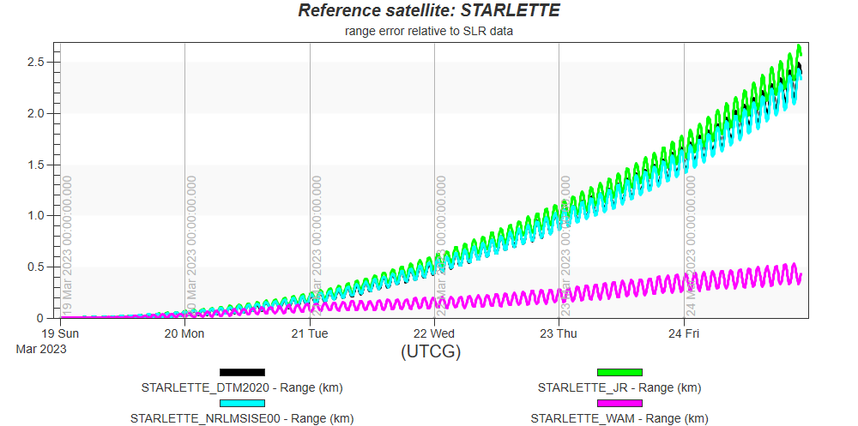
Orbit Propagation error for STARLETTE (~1000 km)
Orbit propagation with STK HPOP for 6 days
Propagation using WAM-IPE density (~0.5 km) seen to match SLR data much better than other models (~2.5 km error)

