Slide 1
Probabilistic Satellite Drag Forecasting for Operations
Piyush M. Mehta
West Virginia University

Slide 2
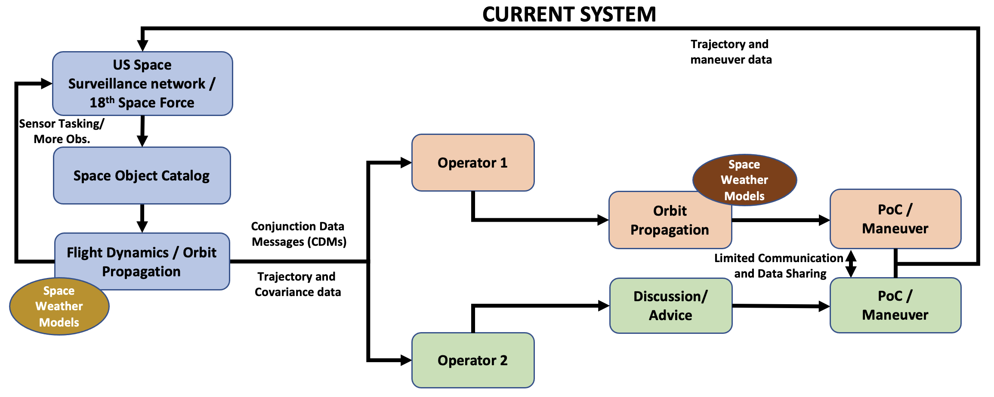
Thermosphere Density Modeling and Forecasting
Existing models lack fidelity and accuracy
Model or framework will ideally have the following properties
Common benchmark; e.g. consistent operations
High-fidelity and physical; e.g not optimized for a particular impact
Computationally efficient; e.g. for on-board operations
User-friendly; e.g. in-house usability
Versatility; e.g. deployed on different computational platforms/architectures
Robust and reliable (R&R) uncertainty quantification
1

Slide 3
Current Operations and Proposed Framework
HASDM and Commercial Operations
Space Weather Drivers
Density Model
Orbit Determination and Propagation
Not accurate
and deterministic
Not accurate
and deterministic
Unrealistic State
Covariance
Proposed Framework
Driver Uncertainty
Initial State and Model Uncertainty
Space Weather
Drivers
Density Model
Orbit Determination and Propagation
Higher Accuracy/Fidelity
and Probabilistic
Higher Accuracy/Fidelity
and Probabilistic
Realistic State
Covariance
2

Slide 4
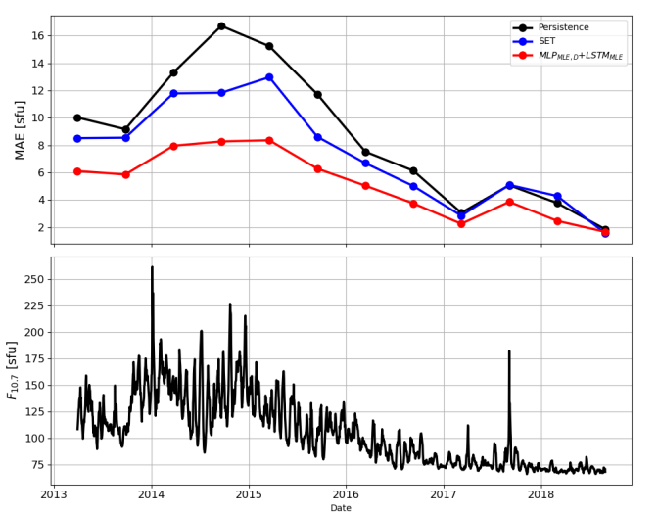
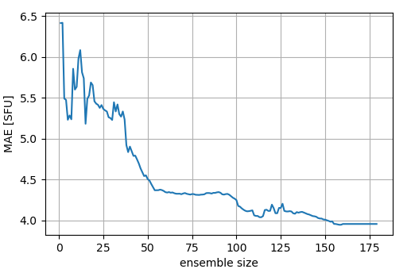
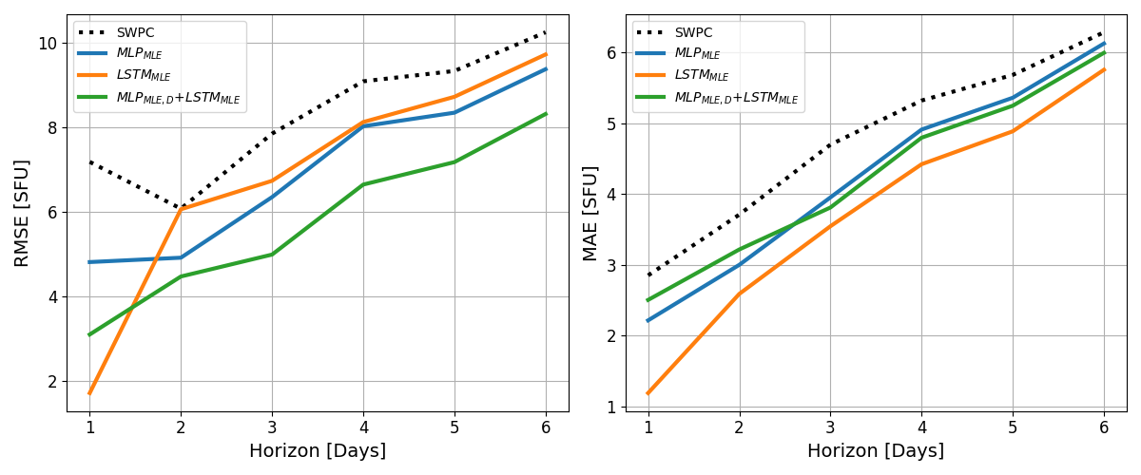
Probabilistic Forecasting: F10.7 Forecasting Results
MLP: Multi-Layer Perceptron
LSTM: Long-Short Term Memory
MLE: Multi Lookback Ensemble
By using models of varying lookbacks, we created a set of models which were combined to provide an overall forecast of F10, for 6 days.
The ensemble method achieved significant improvement over the operational method (SET) which currently supplies HASDM input forecasts; as well as persistence.
The ensemble error metrics, relative to persistence, showed as much as a 25% improvement over the SET method for root mean squared error (RMSE).
NN ensembles also showed a general improvement when compared to the SWPC (Space Weather Prediction Center) forecasts.
180-day moving average Mean Absolute Error (MAE) indicates better performance than the operational HASDM method (SET) and persistence
An increase in the number of neural network models averaged dramatically lowers the error
3

Slide 5
Probabilistic Density Modeling/Forecasting
First-of-its-kind probabilistic density models
3-dimensional data as a time series (SET HASDM density database) – HASDM ML (Space Weather, 2022)
Global model using in-situ measurements – CHAMP ML (Nature Scientific Reports, 2022)
Enhancing existing models (using in-situ measurements) – MSIS UQ (Space Weather, 2023)
Reduced order model or Emulator development – TIE-GCM ROPE (Space Weather, 2023)
Techniques for uncertainty quantification (depending on model kind)
MC Dropout, Direct Estimation of PDF
Customizing the optimization loss: Negative Log Probability Density (NLPD) v/s MSE
Model Ensemble
We measure Robustness and Reliability (R&R) of the uncertainty estimates using the Calibration Error Score (CES)
4

Slide 6
Model Comparison
5

Slide 7
Back-up Slides
6

Slide 8
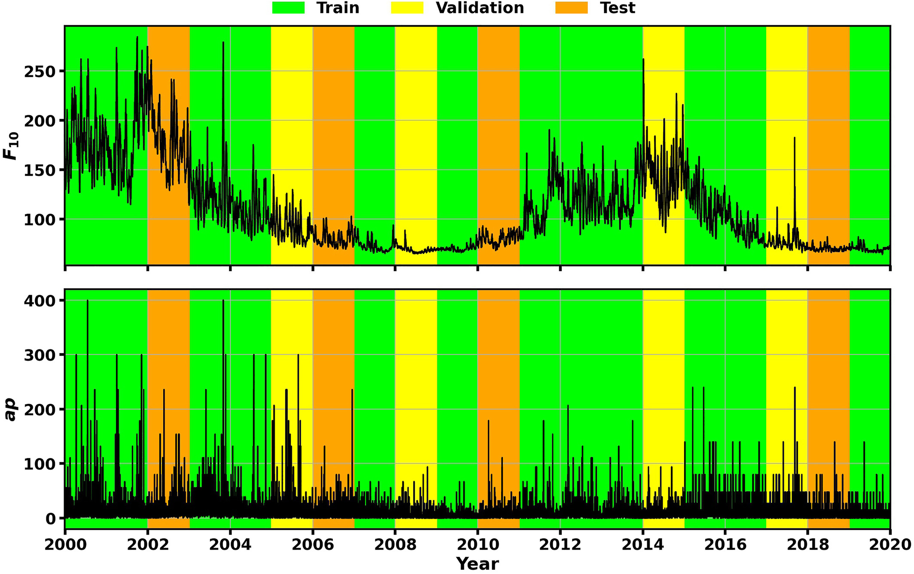
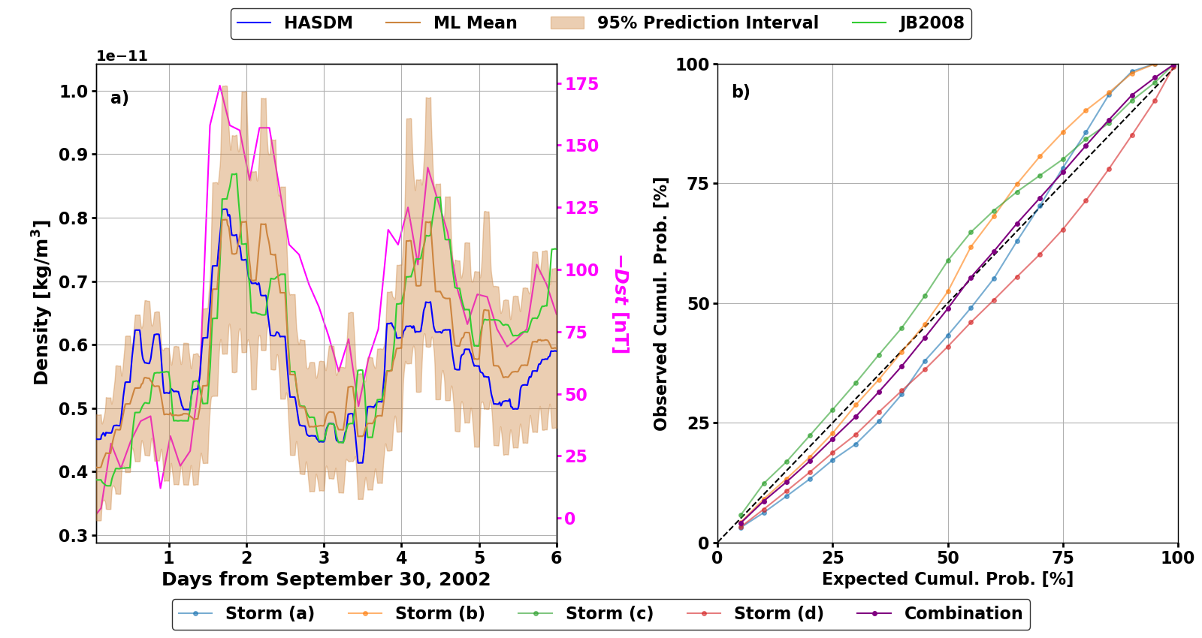
HASDM-ML
HASDM-ML (Licata et. al., Space Weather 2022)
Based on 20-years of 3D HASDM data cubes (SET HASDM Database – SwX, 2021)
First step is to compress the 3-D spatial data
This is achieved with principal component analysis (PCA)
The next step is to effectively and efficiently split data into training/validation/test sets.
The final step develops a nonlinear neural network model that can provide R&R uncertainty estimates
This has been done two different ways, MC dropout and directly probability prediction
Both methods provide similar results (MSE and CES), however, direct probability prediction is computationally superior.
7

Slide 9
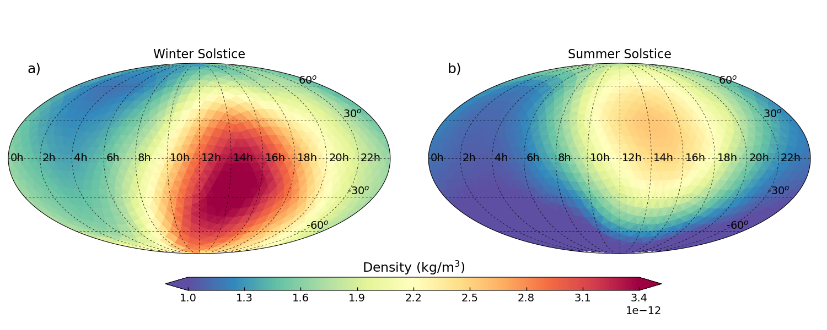
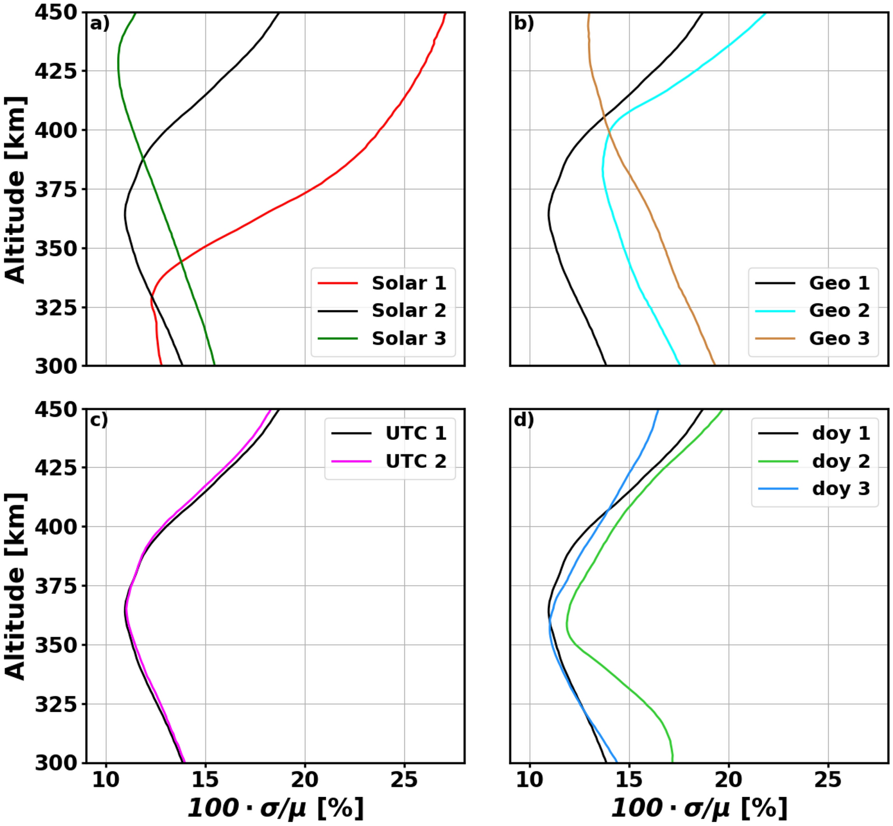
CHAMP-ML
For data-driven modeling, the ideal scenario is to have data everywhere all the time
WE DO NOT HAVE THIS!
We demonstrate global model development with localized in-situ CHAMP densities
Evaluate the ability of the model to capture dynamics
We had to be innovative with data sampling
The CHAMP dataset does not cover a full solar cycle
We do iteratively sampling where 8 weeks of data is used for training, the next week is used for validation and the following week for test. This is repeated for the whole dataset.
Nonlinear model with R&R uncertainty estimates
Ideal for global investigation of small-scale variations
8

Slide 10
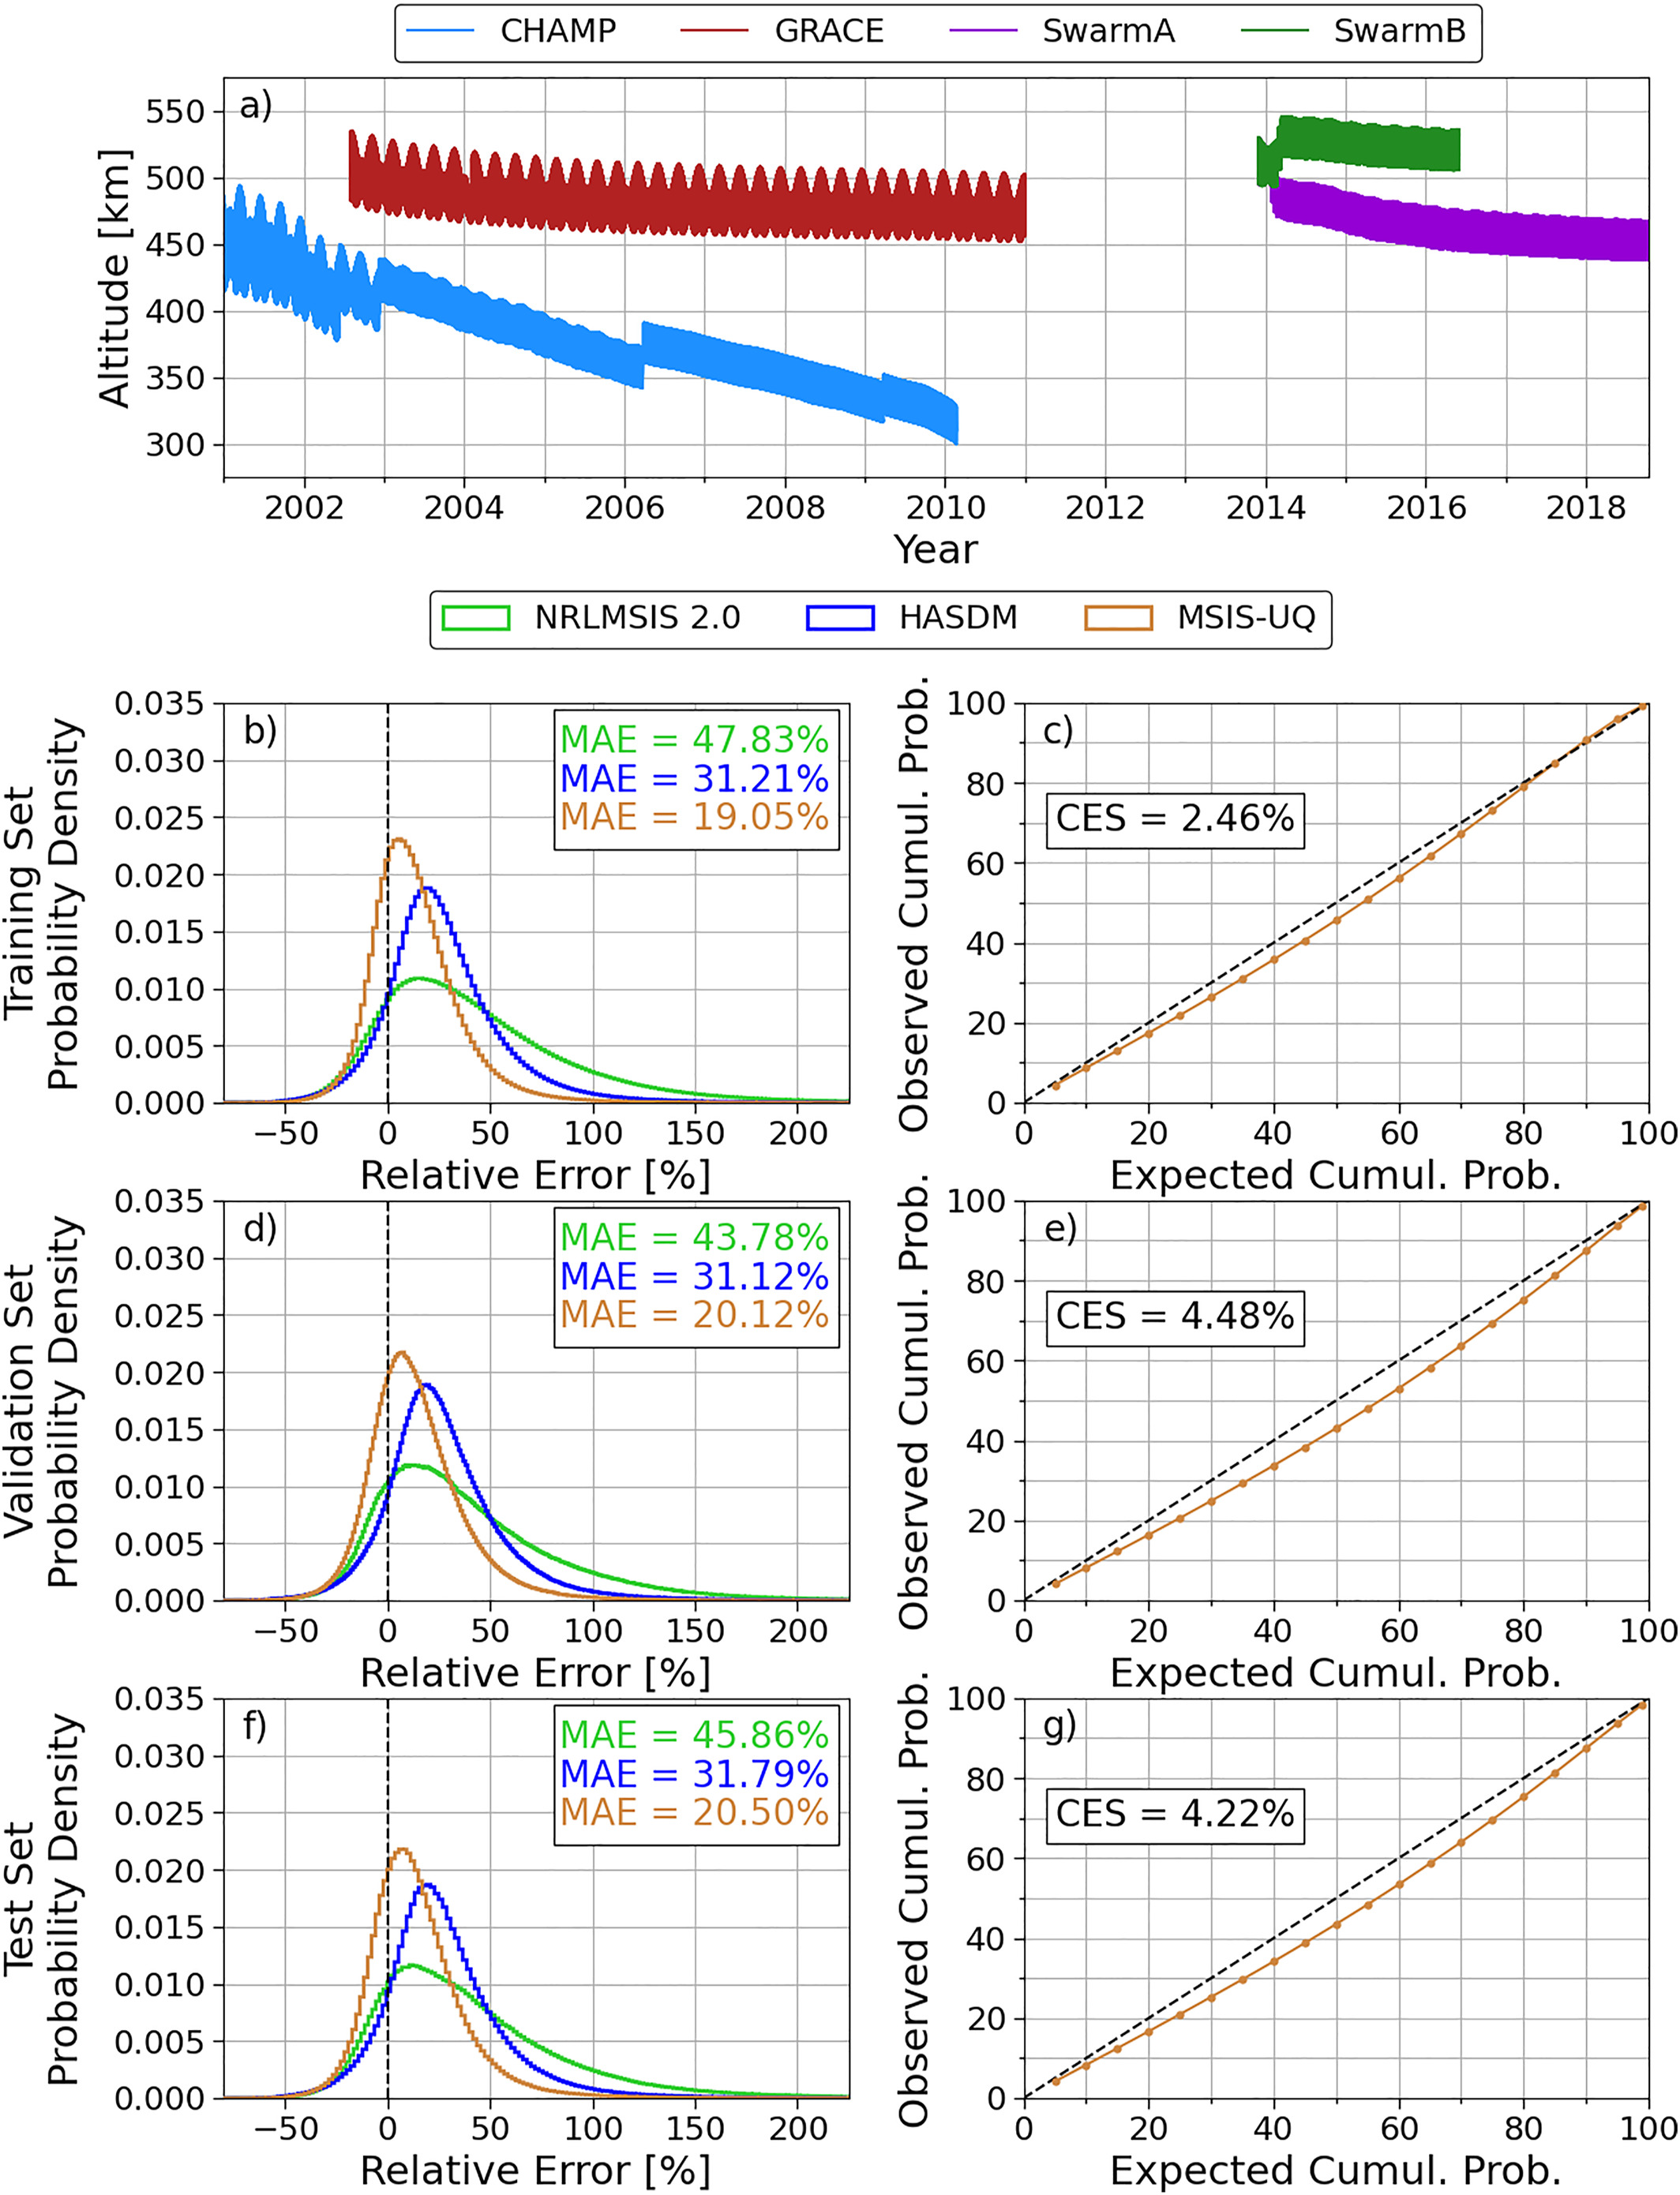
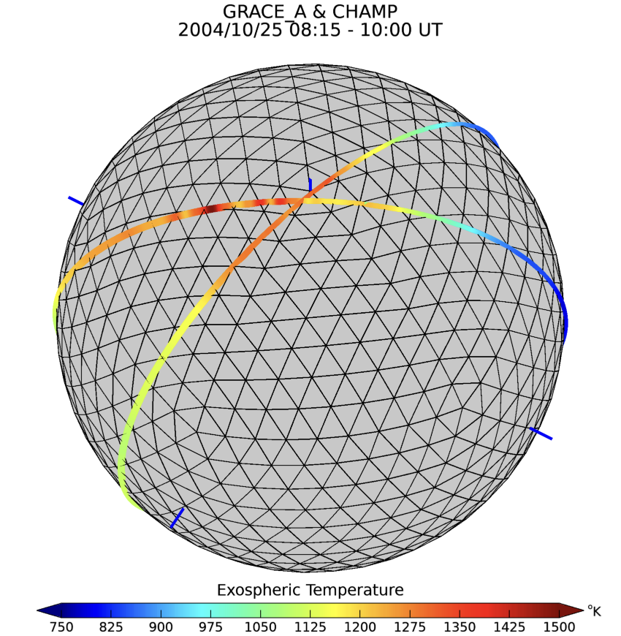
MSIS-UQ
Based on the methodology of EXTEMPLAR (Weimer et. al., 2016, 2020): Estimation of MSIS 2.0 exospheric temperatures using CHAMP/GRACE/Swarm densities
EXospheric TEMperatures on a PoLyhedrAl gRid
Does not use EXTEMPLAR grid, develops nonlinear global model for exospheric temperature using localized measurements, and provides R&R uncertainty estimates
9

Slide 11
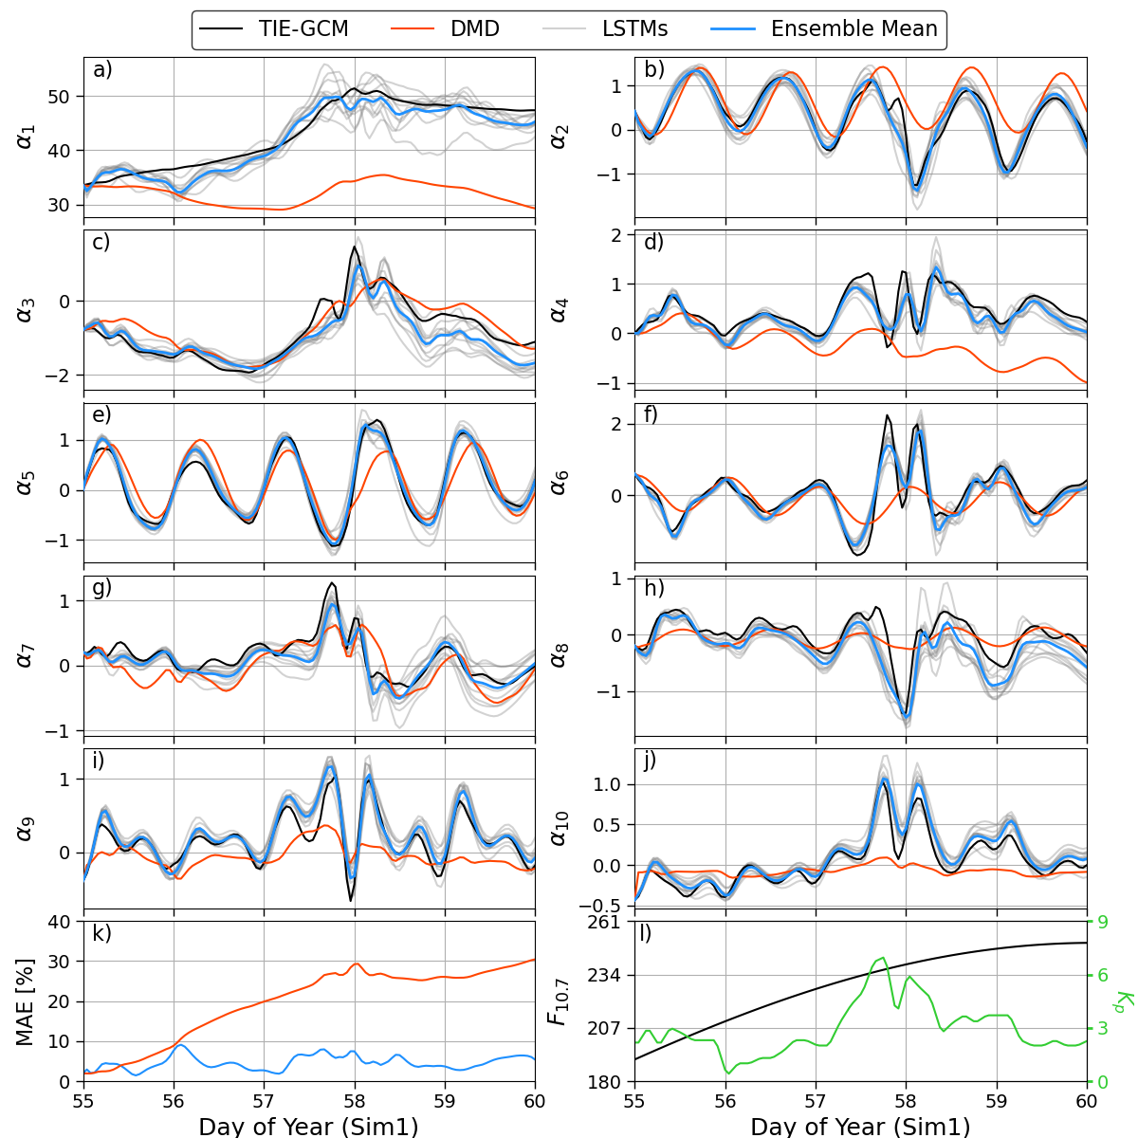
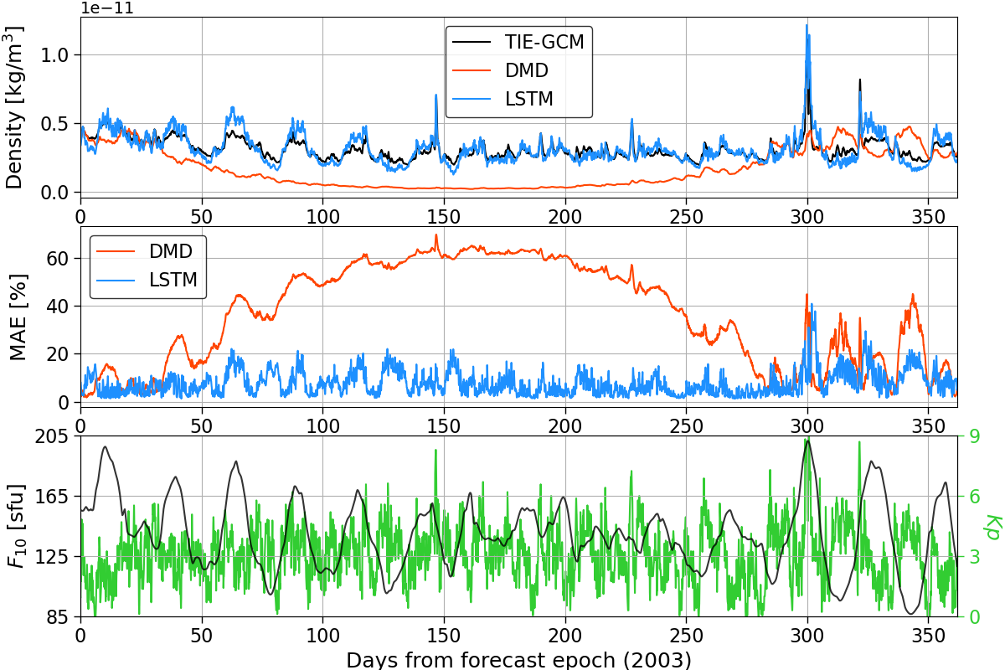
TIE-GCM ROPE
Emulator based on half a solar cycle of TIE-GCM Simulation Data
Dimensionality reduction followed by dynamic modeling in reduced state space
Uncertainty quantification with ensemble approach
Dimensionality Reduction
Dynamic Model
Principal Component Analysis | Linear state-space model
Autoencoders | LSTM
Linear
$α_{t+1}=Aα_{t}+BI_{t}+ε_{t}$
Mehta et al., Space Weather, 2018.
$α_{t+1}=F\left(α_{t},…,α_{t−m},I_{t},…,I_{t−m}\right)+ε_{t}$
Nonlinear
Licata and Mehta, Space Weather, 2023.
10

