Slide 1
NOAA/NESDIS
Commercial Data Program (CDP)
for the
Space Weather Prediction Testbed Experiment
Marc Gasbarro, Program Support
Patricia Weir, Program Manager
Martin McHugh & Gerard Peltzer, Program Support
NESDIS/Systems Architecture and Engineering (SAE)
Oct. 26, 2023

Slide 2
Agenda
CDP Background, General Information and Overview
IDIQ Contracts
Commercial Weather Data Pilot Process and Projects
RFI / Pilot Process and Pilot History
Space Weather Data Pilot
Ocean Surface Winds Data Pilot

Slide 3
NOAA Commercial Data Program Background
Purpose: Manage NESDIS' space-based commercial weather pilot and data purchase projects. Assess and acquire value-added space-based commercial environmental observation data to augment existing data streams in support of NOAA’s operations and research.
The Commercial Data Program contains two lines of effort:
Commercial Weather Data Pilot:
Demonstrates the quality and impact of commercial data on weather forecast models
Commercial Data Purchase:
Supports operational weather forecasting
Commercial Data Program Information:
https://www.space.commerce.gov/business-with-noaa/commercial-weather-data-pilot-cwdp/

Slide 4
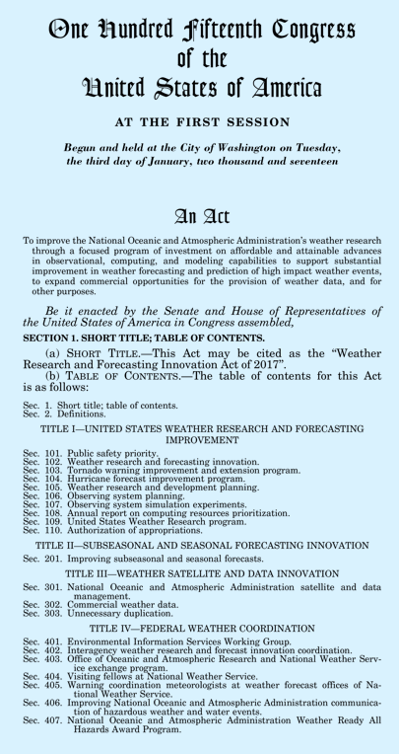
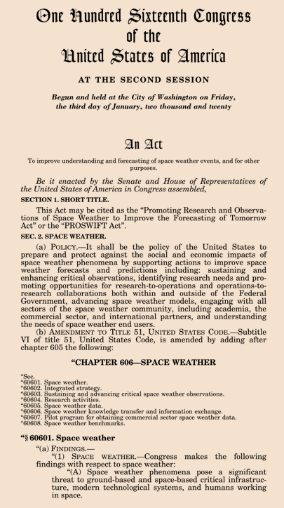
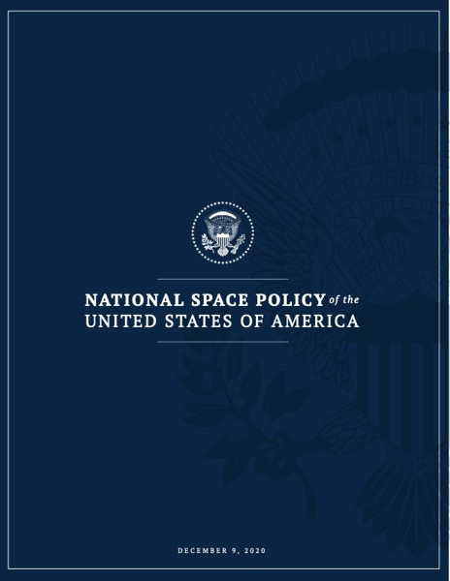
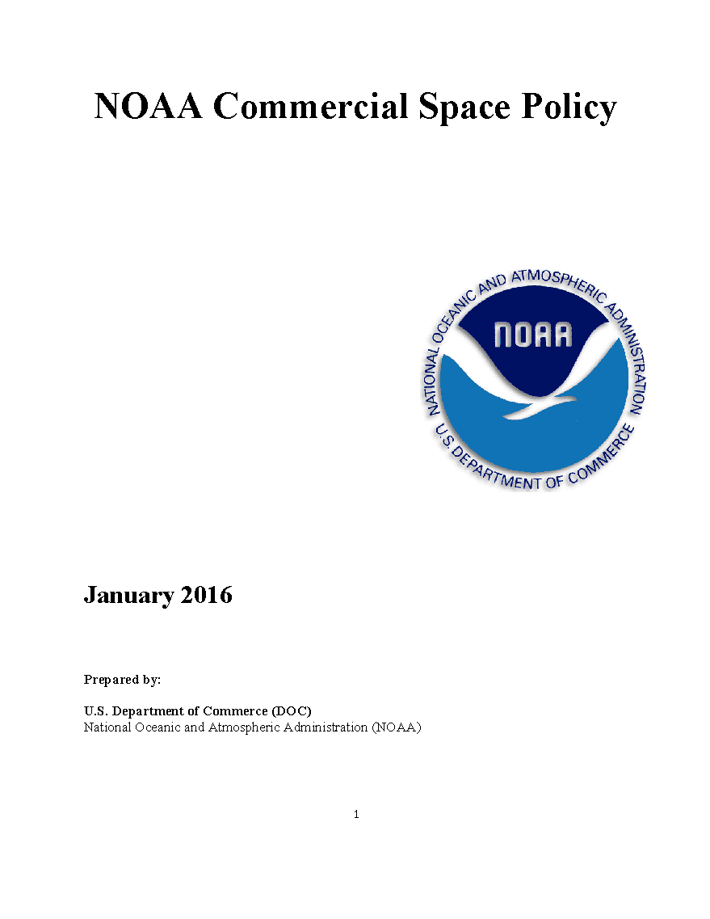
NOAA Commercial Data Program Background
In 2016, NOAA issued its Commercial Space Policy, which set a broad framework for use of commercial space-based data.
In 2016, NOAA/NESDIS initiated the Commercial Weather Data Pilot (CWDP) process to evaluate commercial satellite-based data, including Radio Occultation (RO) data collected from Global Navigation Satellite Systems (GNSS), for use in weather models and other systems.
At that time, a NOAA study recommended a government backbone of 5,000 radio occultations per day, augmented by commercial data purchases of up to 20,000 occultations per day.
In 2020, NOAA/NESDIS concluded the commercial sector was ready to provide operational RO data and initiated the Commercial Data Program (CDP) to manage the acquisition, ingestion, use and dissemination of commercially sourced data, including RO data.

Slide 5
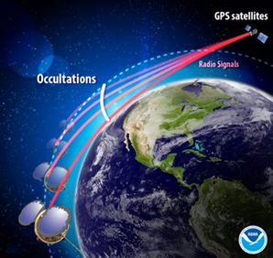
NOAA Commercial Data Program Background
In Nov 2020, NOAA/NESDIS awarded their 1st Commercial Data Buy (RODB-1) to Spire Global and GeoOptics for 2 years.
On Mar 27, 2023, NOAA/NESDIS awarded the 2nd Commercial Data Buy (RODB-2) to Spire Global and PlanetiQ for 5 years.
License: Unlimited distribution rights
Today, NOAA uses commercially available RO data to respond to the ever-growing demand for environmental information and satisfy observational requirements, potentially at a lower cost than government alternatives.
RO data is used to derive Neutral Atmosphere and Ionospheric products.
Neutral Atmosphere products include: Bending Angle, Refractivity, Temperature, Winds, Heights and Water Vapor
Ionospheric products include: Total Electron Content (TEC), Electron Density Profiles and Scintillation Indices
GNSS-RO receivers observe distortion of GNSS signals as they transit the atmosphere. NOAA produces quasi-vertical RO soundings based on bending angles from satellite-based RO open-loop measurements made during a GNSS occultation event.
Notes:
Neutral Atmosphere products include: Bending Angle, Refractivity, Temperature, Water Vapor
Ionospheric products include: Total Electron Content (TEC), Electron Density Profiles (EDP), and Scintillation Indices (Phase, Amplitude)
An RO sounding is a time series of satellite-based RO open loop measurements made during a GNSS occultation event from which NOAA can produce a quasi-vertical series of
bending angles. An ionospheric track is a time series of satellite-based GNSS dual-frequency pseudorange, carrier phase, and SNR measurements from which NOAA can produce
geolocated ionospheric products for space weather applications and research purposes.

Slide 6
Commercial Data Authorization and Appropriation
Weather Research and Forecasting Innovation Act of 2017 (Weather Act):
Authorizes NOAA’s space-based commercial weather pilot programs and data purchases
For successful pilots, transition to operational use where appropriate, cost-effective and feasible
Continue to meet international meteorological agreements
Avoid unnecessary duplication between public and private data sources
Promoting Research and Observations of Space Weather to Improve the Forecasting of Tomorrow (PROSWIFT) Act of 2020:
Allows NOAA to establish a pilot program to enter into commercial space weather contracts to provide space weather data, and allows NOAA to evaluate the data for use in space weather research and forecasting models of NOAA, the Department of Defense, or both.
Enacted
Appropriations:
*President's Budget
** FY22 Consolidated
Appropriations Act
increase targeted for
Space Weather
***$10M from FY23
Supplemental Funds
f
Fiscal Year | 2016 | 2017 | 2018 | 2019 | 2020 | 2021 | 2022 | 2023 | 2024* planned
CWDP (Pilot) | $3M | $5M | $6M | $6M | $3M | $3M | $8M** | $8M | $8M
Commercial Data Purchase | - | - | - | - | $5M | $9M | $9M | $19M*** | $25M
Notes:
Notes: $10M of supplemental funding was added to the $9M enactment for Commercial Data - Purchase. The source of the $10M is the FY 2023 supplemental funds in Division N of the FY 2023 Consolidated Appropriation.

Slide 7
Commercial Data Program Timeline
Today
2016 | 2017 | 2018 | 2019 | 2020 | 2021 | 2022 | 2023 | 2024 | 2025
CWDP Authorized
Dec 17, 2015
MW
SpWx
Delivery
Eval
Pilot 1 (RO)
Pilot 2 (RO)
SpWx Pilot
OSW Pilot (FY23-24)
RODB 1
Two-year IDIQ
Request for Information
Sources Sought
Request for Proposals
MW = Microwave
OSW = Ocean Surface Winds
RO = Radio Occultation
RODB = RO Data Buy
SpWx = Space Weather
TBD Pilot (notional)
1 2 3 4 5
Delivery Orders
RODB 2
5-Year IDIQ
1 2 3 4…n
Delivery Orders

Slide 8
CDP Radio Occultation (RO) Data Buys
First RO Data Buy (RODB-1): Dec 2020 to July 2023
Approach:
2-year, multi-award, Indefinite Delivery Indefinite Quantity (IDIQ) contract with $23M total ceiling.
Delivery Orders issued which specified quantity, sharing license, and duration
Data Specifications:
Level 0 and Level 1 RO data from which NOAA derives neutral atmospheric and ionospheric products.
Latency < 140-min; signal to noise ratio > 200; coverage ~ global
Execution:
IDIQ awards issued to GeoOptics and Spire Global
Total of 5 Delivery Orders were executed, spanning Dec 2020 to July 2023
Second RO Data Buy (RODB-2): March 2023 to March 2028+
Changes/modifications relative to RODB-1:
$59M ceiling, 5-year period of performance.
Added options for purchasing targeted space weather data
Specified stipulation to provide unique, non-duplicate data
Added onramp mechanism for emerging vendors
Preference for unlimited data sharing license
Execution:
IDIQ awards issued to PlanetiQ and Spire Global
Total of 2 Delivery Orders issued to date

Slide 9
CDP Commercial RO Purchases
Delivery Order | Vendor | RO Profiles per day | Period of Performance | Data Sharing License
1.1 (Test) | GeoOptics Spire | 500 500 | 15 Dec 2020 – 15 Jan 2021 (1 month) | US Gov.
1.2 | GeoOptics | 1300 | 18 Mar 2021 – 15 Sep 2021 (6 months) | US Gov.
1.3 | Spire | 3000 | 16 Sep 2021 – 15 Mar 2022 (6 months) | US Gov, WMO and CGMS Centers
1.4 | GeoOptics Spire | 500 5500 | 16 Mar 2022 – 18 Jan 2023 (10 months) | US Gov, WMO and CGMS Centers
1.5 | Spire | 3300 | 19 Jan 2023 – 18 Jul 2023 (6 months) | Unrestricted
2.1 (Test) | PlanetiQ Spire | 500 500 | 6 Apr 2023 – 4 May 2023 (1 month) | Unrestricted
2.2 | PlanetiQ | 3100 | 18 Jul 2023 – 18 Jan 2024 (6 months) | Unrestricted
2.3 | TBD | TBD | 18 Jan 2024 – TBD (TBD) | TBD

Slide 10
RO Commercial Data Product Users
US Gov’t users:
Receiving products that UCAR processes:
NWS Space Weather Prediction Center (SWPC)
NWS NCEP Central Operations (NCO) and NCEP Environmental Modeling Center (EMC)
NESDIS STAR
Navy Fleet Numerical Meteorology & Oceanography Center
Navy Research Labs (NRL)
USAF 557th Weather Wing
NASA Goddard Space Flight Center / Global Modeling & Assimilation Office
Joint Center for Satellite Data Assimilation (JCSDA)
International Partner users:
Product Distribution and Access system (PDA) is preferred dissemination means for existing PDA users
NWS Telecommunications Gateway (via GTS) point-to-point distribution is the alternate path
GTS: Global Telecommunication System
Researchers:
NCEI and UCAR’s COSMIC Data Analysis and Archive Center (CDAAC) portal

Slide 11
Int’l Partner Agencies Currently Receiving Data
Country/Region | Agency | Membership
Australia | Bureau of Meteorology (BOM) | WMO
Canada | Environment & Climate Change Canada (ECCC) Canadian Meteorological Center (CMC) | WMO
China | China Meteorological Administration (CMA) | WMO & CGMS
Europe | European Organisation for the Exploitation of Meteorological Satellites (EUMETSAT) | CGMS
Europe | European Centre for Medium-Range Weather Forecasts (ECMWF) | WMO
France | Centre National d’Etudes Spatiales (CNES) | CGMS
Germany | Deutscher Wetterdienst (DWD) | WMO
Hong Kong | Hong Kong Observatory (Weather Forecasting Office) | WMO
India | India Meteorological Department | WMO & CGMS
India | Indian Space Research Agency (ISRO) | CGMS
Japan | Japan Meteorological Agency (JMA) | WMO & CGMS
Korea | Korea Meteorological Administration (KMA) | WMO & CGMS
New Zealand | Meteorological Service of New Zealand (MetService) | WMO
United Kingdom | The Met Office (UKMO) | WMO

Slide 12
RO Data Operationally Assimilated by NOAA
as of quarter ending: 6/30/2023
Mission | Daily Occs. | % of Total Operational
COSMIC-2 | 4,593 | 42%
SPIRE (EUMETSAT & NOAA) | 4,988 | 45%
METOP-B | 588 | 5%
METOP-C | 617 | 6%
TERRA | 58 | 0.5%
KOMPSAT-5 | 33 | 0.3%
TANDEM | 67 | 0.6%
PAZRO | 111 | 1%
Total Operational June 30, 2023 | 11,055 | 100%
GRACE-C | 108 | 1% of Total Daily
GRACE-D | 119 | 1% of Total Daily
SENTINEL-6A | 894 | 8% of Total Daily
Total Daily June 30, 2023 | 12,176

Slide 13
Commercial Weather Data Pilot (CWDP) Process
Market Research
Pulse community: Issue Request for Information or Sources Sought Notice to identify potential data types of interest
Evaluate responses against NOAA goals, requirements, resources and schedules
Pilot Planning
Organize team and allocate resources
Develop requirements, engaging user community and experts
Release draft “Statement of Work”
Issue solicitation (“Request for Proposals”)
Evaluate proposals
Award contracts as appropriate
Pilot Execution
Plan for data ingest, processing, dissemination and archive
Conduct data delivery period
Evaluate data quality and impact
Report results to leadership and community at large
Recommend data type for operational purchase when appropriate

Slide 14
Commercial Weather Data Pilot (CWDP) Studies
CWDP FY16 and FY18 Pilots (GNSS RO):
Began in 2016 to assess the operational readiness of radio occultation (RO) data.
CDP conducted two successful pilots in 2016 and 2018 for neutral atmosphere RO data.
After the second pilot, NOAA concluded that RO data was ready for operational use.
Resulted in RODB-1 IDIQ
CWDP FY22 Pilot (Space Weather):
As directed by Congress, per the PROSWIFT Act, NESDIS conducted market research into the availability of commercial Space Weather data for a pilot study.
In Dec 2021, Market Research revealed multiple companies capable of providing GNSS-RO measurements of the ionosphere suitable for pilot studies.
NESDIS released an RFP in May 2022, soliciting Space Weather GNSS-RO observations; Pilot awarded.
CWDP FY24 Pilot (Ocean Surface Winds):
Recently awarded a pilot to deliver GNSS Reflectometry (GNSS-R) data to derive ocean wind speed products.

Slide 15
Space Weather Data Pilot Overview
Objective: Derive ionospheric products that meet current and anticipated operational space weather model and application needs.
Total Electron Content (TEC)
TEC observations help specify the electron density structure in the ionosphere/plasmasphere
From TEC, can derive vertical electron density profiles; useful for radio wave propagation and satellite navigation applications
Scintillation Phase and Amplitude - High rate data (> 50 Hz)
Scintillation refers to rapid, localized, intense fluctuations in the ionospheric state
Scintillation affects the power and phase of radio signals propagating through the ionosphere; also affects satellite navigation
Max daily median latency 30 minutes
On July 14, 2022, NOAA awarded contracts to three companies:
GeoOptics Inc. (Pasadena, CA)
Space Sciences and Engineering LLC, dba PlanetiQ (Golden, CO)
Spire Global Subsidiary, Inc (San Francisco, CA)
Began Aug 1, 2022 for one year
License sharing - Limited to U.S. Gov, National/WMO Met centers, CGMS members for non-commercial use only
Based on post-award developments, GeoOptics effort bilaterally concluded Nov 2022
Notes:
NOTE: PlanetiQ began 15 Aug (Data Delivery from 16 Nov - 15 May; Eval from 16 May to 1 Aug)

Slide 16
Space Weather Data Pilot Schedule
Today
May
Jun
Jul
Aug
Sep
Oct
Nov
Dec
Jan
Feb
Mar
Apr
May
Jun
Jul
Aug
Sep
Oct
Nov
Dec
Jan
2022
2023
2024
RFP
Award
Preparation
Evaluation
Data Delivery Period
Evaluation
Gov Partners: Archive, Assess, Evaluate, Report
Contract Period of Performance
Final Space Weather Pilot Evaluation estimated completion for Spring 2024.

Slide 17
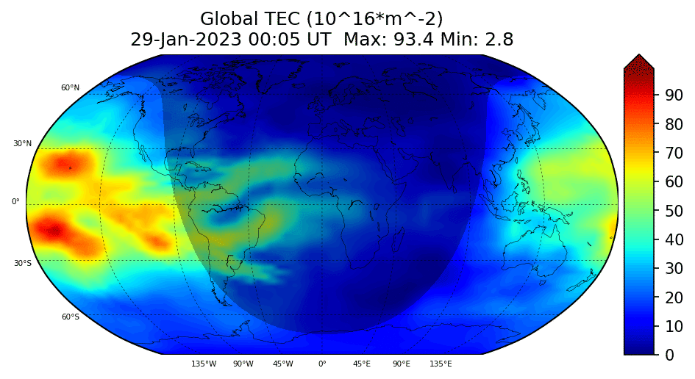
Space Weather Data Pilot: Preliminary Results
Data and vendor evaluation
Data delivery by both vendors exceeded 500 compliant observations per day
Electron density & total electron content (TEC) demonstrated good accuracy
Low-latitude TEC and scintillation data validates well with existing data sources
Commercial TEC and scintillation data coverage complements COSMIC-2 data very well
Contributes to global coverage of data, especially away from ground stations
Lessons Learned
Onboard algorithm to identify scintillation events (to trigger download) needs updating for high latitudes
Differential code bias processing differences need resolving
High-latitude geolocation methods are under development
RFI detection metrics need improving
First comprehensive analysis/research on measuring high-latitude scintillation with RO data
GloTEC Total Electron Content (TEC) (ground+Spire+PlanetiQ)

Slide 18
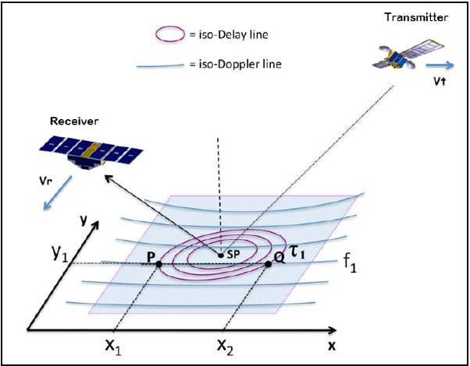
Ocean Surface Winds (OSW) Pilot Overview
Objective: To conduct studies to improve upon GNSS-Reflectometry (GNSS-R) derived ocean wind speed products previously developed by NOAA and investigate the utility of wind speed products developed by vendors. Also to assess the quality and impact of commercial GNSS-R observations for add’l environmental measurements.
Provide L1 & L2 grazing angle GNSS-R observations for sea ice and altimetry measurements.
Produce calibrated Delay Doppler Maps and Specular reflection point location estimates.
NESDIS & NWS will compare the commercial GNSS-R measurements with other more traditional sat measurements.
Leverage past reflectometry research with NASA-led Cyclone GNSS (CYGNSS) mission.
Investigate insights into other parameters (e.g. sea ice, soil moisture, flood mapping).
On Sep 18, 2023, NOAA awarded a contract to Spire.
Began Oct 25, 2023 for one year
Notes:
Use NASA-led CYGNSS program for validation. Use delay doppler maps.

Slide 19
Ocean Surface Winds (OSW) Pilot Schedule
Today
Aug
Sep
Oct
Nov
Dec
Jan
Feb
Mar
Apr
May
Jun
Jul
Aug
Sep
Oct
Nov
Dec
2023
2024
RFP
Award(s)
Preparation
Evaluation
Data Delivery Period
CDP Team: Data Intro & Prep.
Evaluation
CDP Team: Data Monitoring & Assessing
CDP Team: Data Assessment, Evaluation & Reporting
U.S. Gov Team
Pilot Contract (Spire)

Slide 20
Questions?
Patricia Weir, CDP PM: patricia.weir@noaa.gov
Marc Gasbarro, CDP Support: marc.gasbarro@noaa.gov
Martin McHugh, CDP Support: martin.mchugh@noaa.gov
Gerry Peltzer, CDP Support: gerard.peltzer@noaa.gov

