Slide 1
REACH and Flowcharts for the LEO Radiation Environment
Alexander Boyd
2023 SWPT
26 October 2023
Approved for public release. OTR-2023-01213.

Slide 2
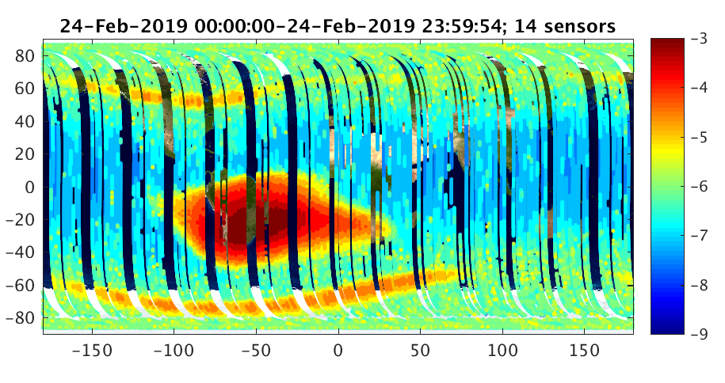
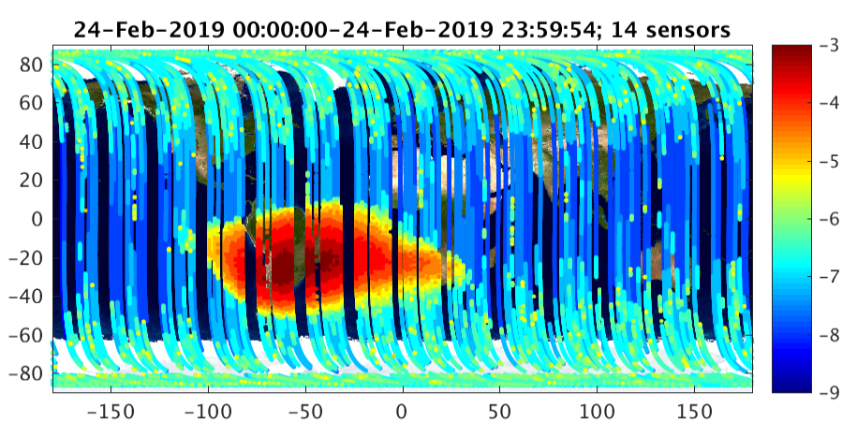
REACH
Responsive Environmental Assessment Commercially Hosted constellation
REACH is a hosted space weather payload on the Iridium-NEXT constellation in LEO (780 km)
32 REACH payloads in 6 orbital planes
Each payload has 2 micro-dosimeters – 64 total sensors
6 different “flavors” each cover different energy range for electrons and protons
Offers unprecedented temporal coverage of the LEO radiation environment, able to continuously monitor polar cap, trapped radiation belts, drift loss cone
First 2.5 years of REACH data (2017-2019) available on Zenodo: 10.5281/zenodo.5988170
As of October 2022, receiving new data in real time
Working on public release of recent data
REACH Belt Indices routinely uploaded to Unified Data Library (IUDL)
Flavor X
e⁻>360keV and p⁺>12 MeV
Flavor W
Only p+>12 MeV

Slide 3
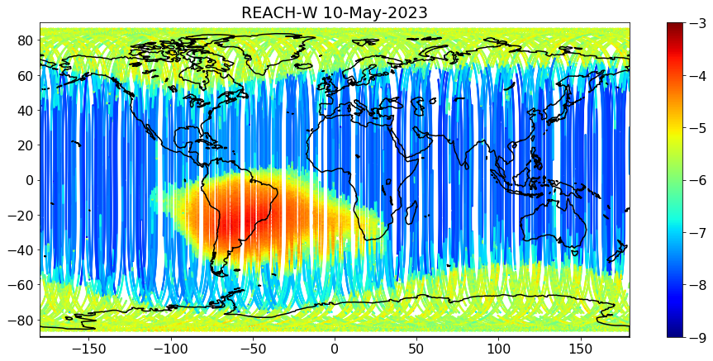
REACH
SEP Monitoring
REACH provides continuous monitoring in the polar cap
During solar particle events, REACH can quickly determine the evolution of the geomagnetic cutoff
Real-time monitoring and modeling of the cutoff will help with forecast, nowcast, and anomaly forensics
REACH observations can be utilized in a framework like SPAM (Solar Particle Access Model, [J.C. Green et. al. 2021])

Slide 4
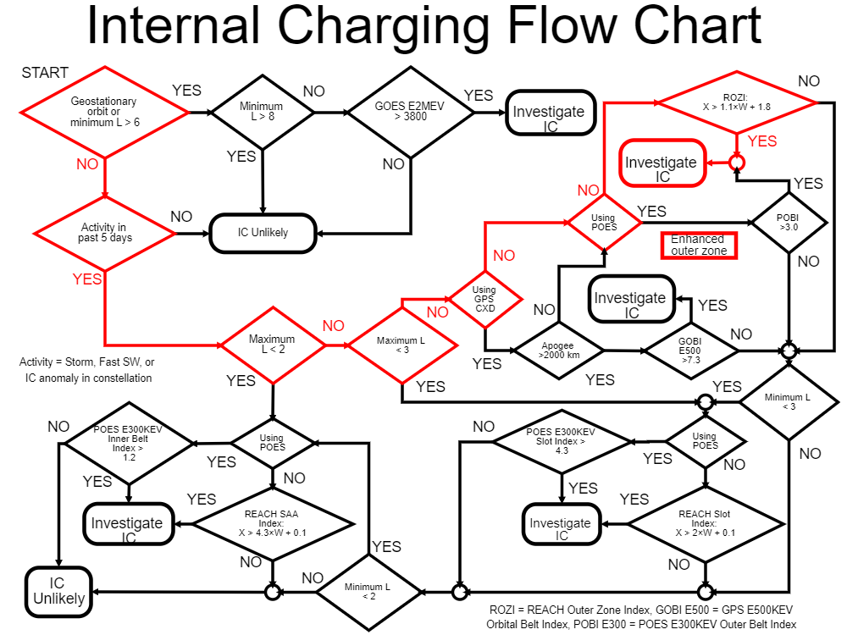
ECP Flowcharts
ECP flowcharts are a decision tool for providing first look anomaly assessment
Recently designed a web tool to automatically collect the relevant data, run through the flowcharts for a given satellite and anomaly time
Provides rapid, explainable results to an operator
Investigate/Unlikely assessment for each of the 4 hazard categories
Highlighted flowchart to show decision path leading to assessment result
Table of supporting data
Graphic showing satellite position, hazard regions
If “Investigate”, can then be followed up by a more thorough investigation

Slide 5
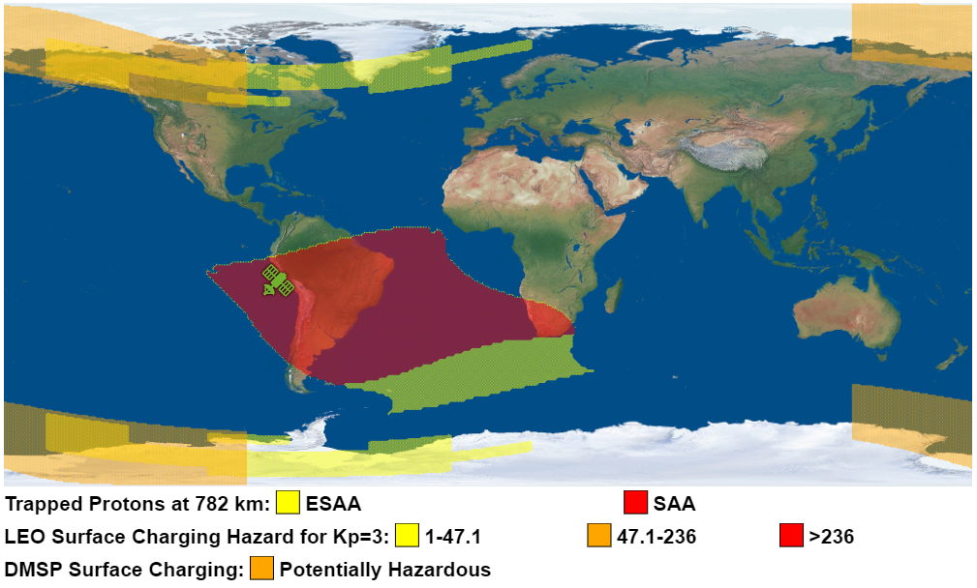
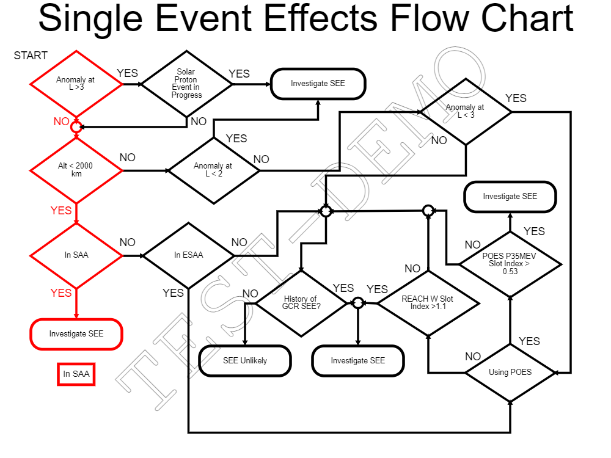
Flowchart Example
IRIDIUM-180 SAA

Slide 6
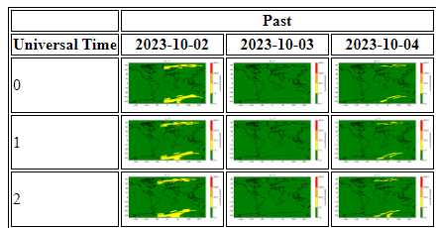
LEAF-HQ
Long Term Environment and Anomaly Forecast
LEAF Combines a set of ≥7 day forecast of the internal & surface charging hazard
Built to provide actionable hazard quotient forecast (based on on-orbit anomalies) rather than simple space weather observables:
$$z(t)=\frac{\text{Instantaneous} \text{Anomaly} \text{Rate}}{\text{Long} \text{Term} \text{Average} \text{Anomaly} \text{Rate}}∝\text{Probability} \text{of} \text{an} \text{anomaly}$$
Internal charging hazard based on forecast of POES belt indices
Hourly surface charging hazard maps based on Kp
Forecast SC Hazard Timeseries for specific satellite

Slide 7
Backup

Slide 8
REACH Flavors
Flavor | Electrons | Protons | # Satellites
U | >4.97 MeV | >57 MeV | 5
V | >3.41 MeV | >47 MeV | 7
W | - | >12 MeV | 14
X | >360 keV | >12 MeV | 20
Y | >1.6 MeV | >31 MeV | 12
Z | >50 keV | >200 keV | 6

Slide 9
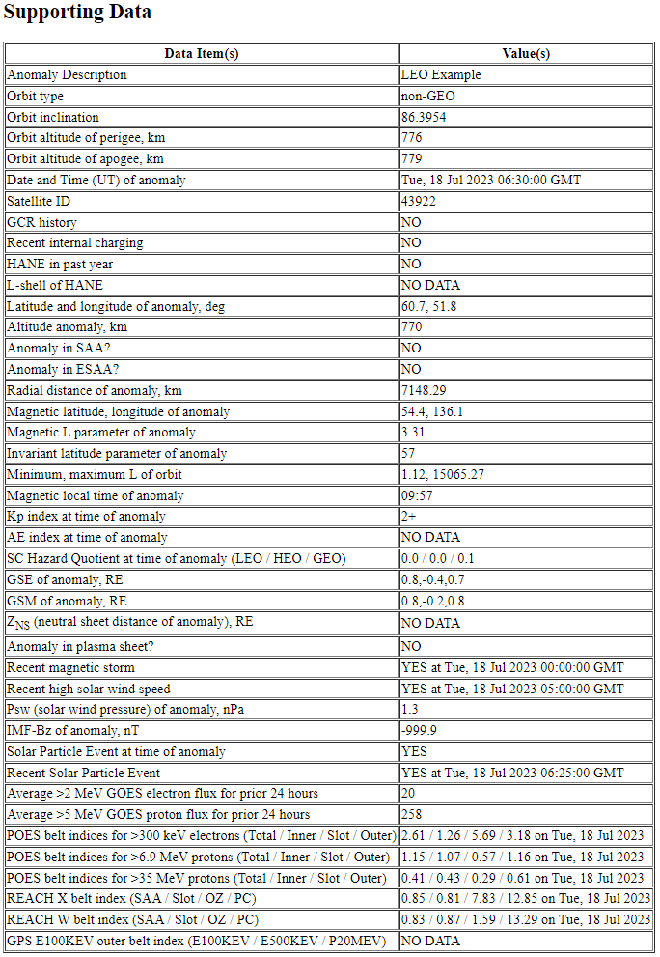
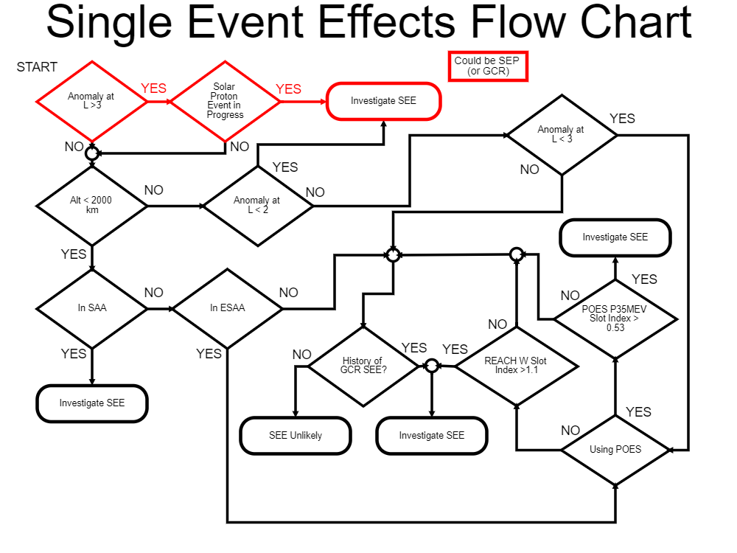
Flowchart IC/SEE Example
IRIDIUM-180 (during July 2023 SPE)

Slide 10
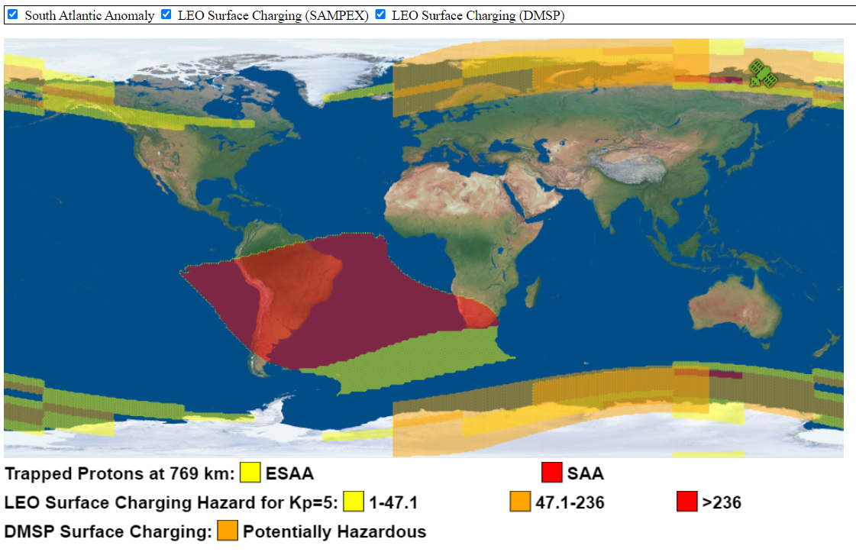
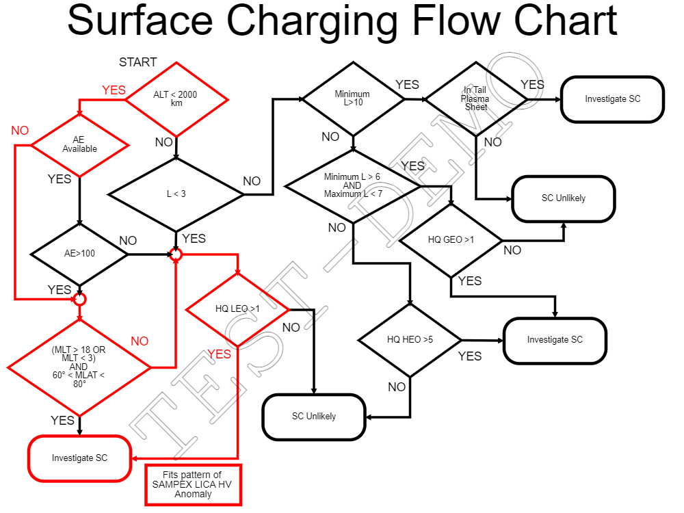
Flowchart Example
IRIDIUM-180 SC

Slide 11
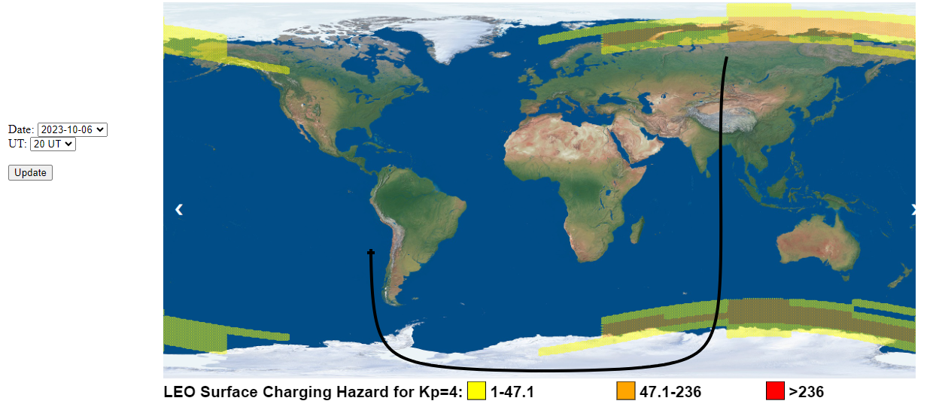
LEAF-HQ
If user input a specific satellite TLE, can provide predicted time series of SC hazard

