Slide 1
Current radiation products LEO radiation overview and effects
Justin Likar
26 October 2023
justin.likar@jhuapl.edu | jlikar1@jhu.edu | 240.592.1090 | 240.583.9375

Slide 2
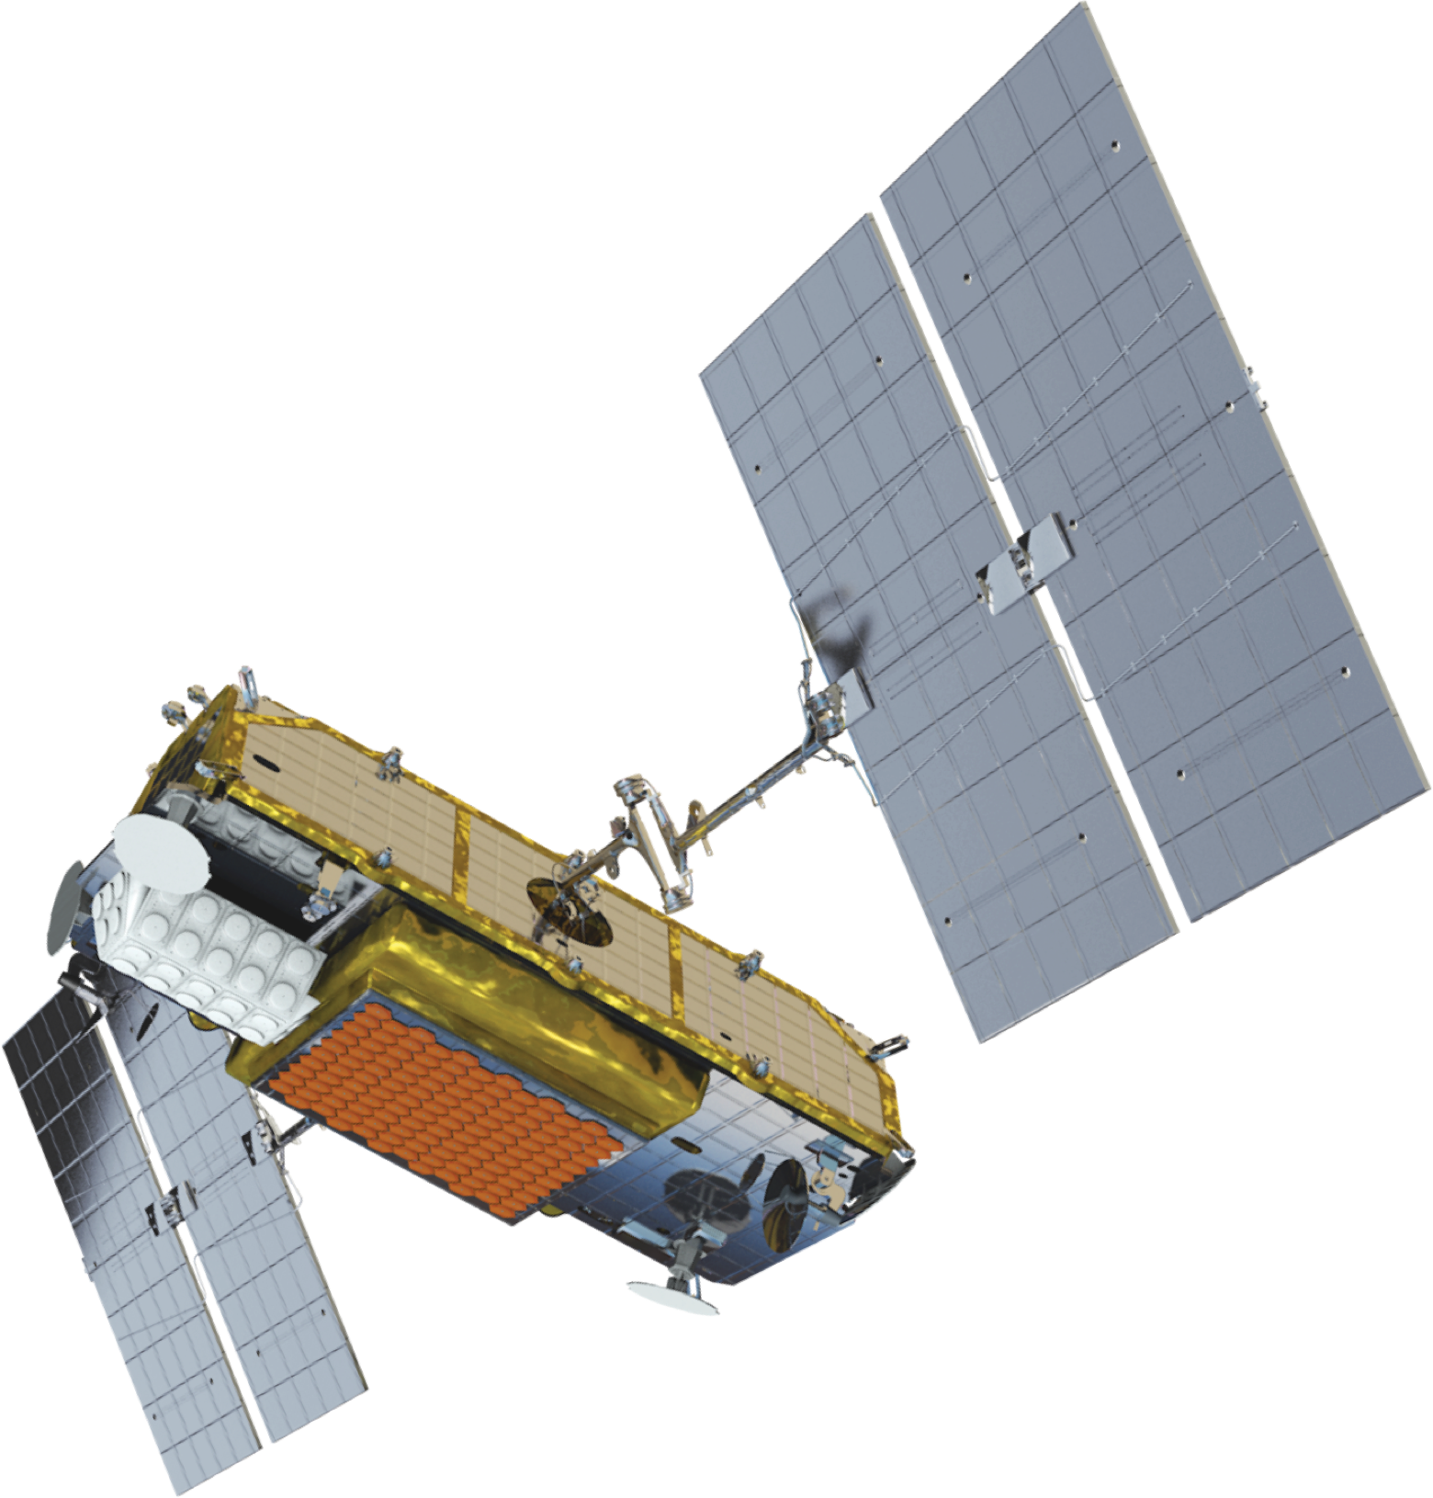
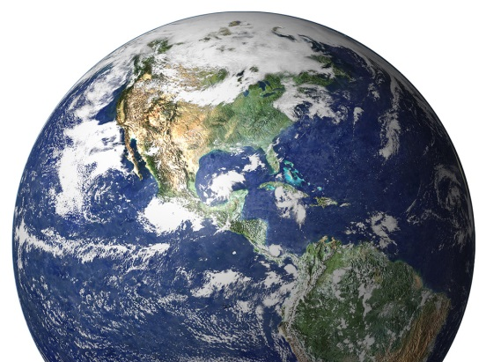
Overview (reminder) of space environment hazards / threats
Displacement Damage (DD) dose
in solar cells (power decrease)
Degraded transmission in CG
Degraded performance in detectors
Degraded performance in lenses, opto-couplers, LEDs, fiber, …
Charging induced Electrostatic Discharges (ESD &
Electromagnetic Interference (EMI)
EM pulse (radiation emissions)
External to / internal to spacecraft
Surface charging & spacecraft
floating potential fluctuations
Plasma effects on solar array
Collection current (losses)
Electrostatic discharges
Single Event Effects in microelectronics
Destructive and / or non-destructive
Event rates & fault propagation
Deep / internal charging of dielectrics & ungrounded metal
Discharges & EM pluses
Total Ionizing Dose (TID) & Total Non-Ionizing Dose (TNID) on microelectronics & materials
System performance degradation against predicts (e.g. WCCA)
RF / signal scintillation
Drag
… …
Combined surface dose, UV, AO & MMOD degrades materials properties
Thermo-optical, electrical & mechanical
Also results from EP plumes, outgassing, …
Image: newspace.im/constellations/iridium

Slide 3
LEO invites innovation
NASA (NPR 8705.4A); also TOR-2011 (8591)
Characteristic | Class A | Class B | Class C | Class D
Risk acceptance | Minimum practical | Low | Moderate | High(er)
Priority | Very high | High | Medium | Low
Acquisition costs | High | Med to High | Medium | Med to Low
Complexity | Very high | High | Medium | Med to Low
Mission life | Long (>5 yr) | Medium (3-5 yr) | Short (1-3 yr) | Brief (<1 yr)
Examples | Flagship missions (JWST) | Discovery missions | Explorer / MIDEX missions | SMEX missions
ESA (ECSS)
Class I | Class II | Class III | Class IV | Class V | Characteristic
Extremely high priority | High priority | Med priority | Low priority | Educational purposes | Mission objectives
Extremely high | High | Medium | Low | Educational purposes | Criticality to agency strategy
>700 M€ | 200-700 M€ | 50-200 M€ | 1-50 M€ | <1 M€ | Cost
High | High to Med | Medium | Med to Low | Low | Mission complexity
>10 yr | 5-10 yr | 2-5 yr | 2 yr to 3 mo | <3 mo | Mission lifetime
JUICE | PROBA III, FLEX | FORUM, CHEOPS | AWS, SCOUTS |  | Examples
Part quality | Level 1 | Level 2 | Level 3 | Per PMP
RHA levels | RDM 2x¹ – 4x² SEE ${LET}_{th}$ <75³ | RDM 2x¹ – 4x² SEE ${LET}_{th}$ <75³ | RDM 2x SEE ${LET}_{th}$ <37³ | Tailored for criticality
Radiation transport | Slant rays M-C | Tailorable | Tailorable | Tailorable
RLAT | Margin | Margin | Data evaluation | Tailored for criticality
Class 1 | Class 2 fully acceptable | Class 3 fully acceptable | Lower grade acceptable | N/A | Part quality
Fully applicable | Fully applicable | >1x⁵ | >1⁵ | N/A | RDM
Fully applicable | Fully applicable | Fully applicable | Limited; criticality based | Limited; criticality based | Radiation analysis
Fully applicable | Fully applicable | Rec. for <5 krad Req >5 krad | Rec. for <5 krad Req >5 krad | <5 krad not req >5 krad rec | TID testing (RLAT)
Notes ¹Lot specific RLAT. ²Non-lot specific data. ³Units on LET MeV-cm2/mg. ⁴Refers to ECSS parts quality levels (Class 1 = Space; Class 2 = Mil Active; Class 3 = Mil Active & Hybrid). ⁵RDM between 1.0x and 2.0x depending on lot-to-lot traceability.
J. Likar (2023)

Slide 4
Current state
Radiation related risks are, comparatively, low(ish)
Barrier to entry (cost to orbit) is low
Desire to innovate is high
Capability increases introduce evaluation challenges
Trends towards –
Tailorable RHA for Class D (Class V) “programmatically constrained” missions
RHA testing / mitigation at functional level
Uncertainties associated w/ parts performance may magnify any uncertainties associated w/ environment
For SEE we want transported LET & proton spectra
Where / when does RPP method for error rate predictions break down
Both surface charging & deep charging have seen significant advances in capabilities to study 3D targets
Still non-uniform recognition why we should care about charging beyond HV arrays (also raised at SEESAW)
Worst case plasma parameters are a critical need
Limitations in material modelling remain
Extensions into high(er) altitude LEO towards slot and MEO (>1000 km)
Combination of observations (and others) contributes to proliferation of operational missions
Also not-absent is the idea of down-playing some hazards and hoping for the best

Slide 5
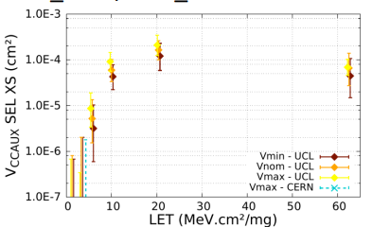
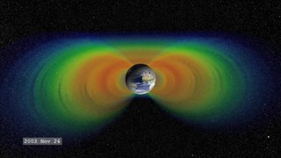
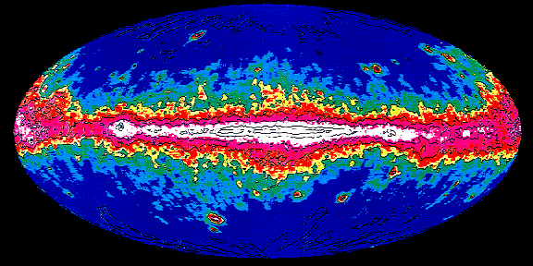
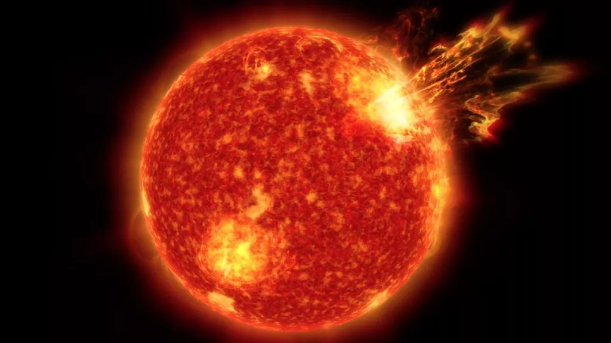
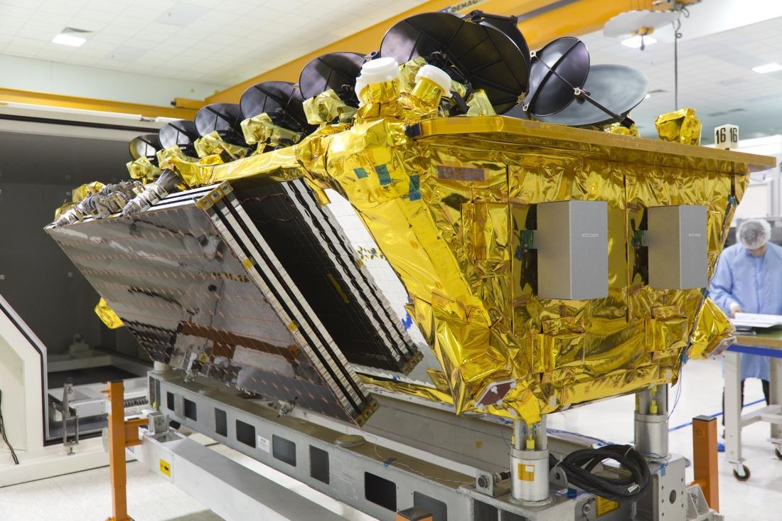
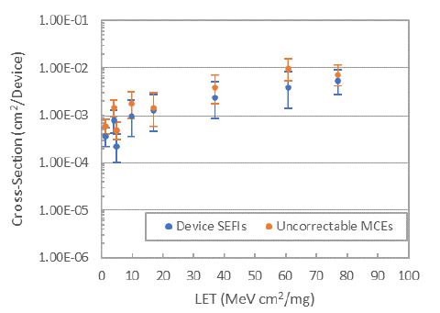
Error rate determination (simple view)
Xilinx UltraScale+ MP-SoC (16 nm FinFET)
As technology nodes (critical dimensions) decrease we see LETth <<1.0 MeV-cm2/mg, increased uncertainty and more
Trapped protons
GCRs
Transported flux (e.g., through spacecraft shielding); credit O3B
SPEs (flares)
Ambient particle flux
Error rate
AMD Steppe Eagle GPU (28 nm SHP GF)
T. Lange (2018); I. Troxel (2021)

Slide 6
Environment requirements definition
Mission Details
Parameter | Value
Varied | Use reference mission¹
Total Ionizing Dose (TID) / Displacement Damage Dose (DDD)
Environment | Model
Trapped Electrons | AE9 Ver. 1.57.004²
Trapped Protons | AE9 Ver. 1.57.004²
Plasma Electrons | AE9 Ver. 1.57.004²
Plasma Protons | AE9 Ver. 1.57.004²
Solar Protons | ESP / PSYCHIC or SAPPHIRE³
Radiation Transport (Dose Depth)
Environment | Model
Code | Novice
Geometries | Solid Sphere kernel Spherical Shell kernel
Equivalent Fluences | SCREAM
Radiation Transport (Dose Predictions)
Environment | Model
Ray Trace | Fastrad (Min & Slant)⁴
Monte Carlo | Not performed
Single Event Phenomena (SEP)
Environment | Model
Trapped Protons | AP9 Ver. 1.57.004²
SPE Protons | CREME96 → SIRE2
SPE heavy ions | CREME96 → SIRE2
GCR heavy ions | CREME96 → SIRE2
GCR protons | CREME96 → SIRE2
SEE / SEP Hazards
Environment | Model
Code | CREME96 → SIRE2
Geometries | CREME96 → SIRE2
Shielding (sphere) | CREME96 → SIRE2
Spacecraft Charging
Environment | Model
Plasma (surface) | ISO 19923:2017
Trapped electrons (internal charging) | NASA-HDBK-4002B⁵
Verification tool(s) | NASA-HDBK-4002B⁵ Fastrad (critical only)
Particles
Environment | Model
MMOD | MEM Ver. 3.0
Matrix considers a Class D (Class V) mission at LEO
Characteristics of a Class D (Class V) mission include
High risk acceptability
Not critical to national significance
Experimental or demonstration payload
Low acquisition costs
Less than 1 yr mission lifetime w/ no launch constraints
Class D (Class V) does not imply hazards are ignored but rather “appropriately tailored”
Reliance on infrequently-updated standards & handbooks for charging
Key
Climatological model
Engineering tool
Design standard
Notes
¹“Typical” mission of orbit type (e.g. LEO, PEO, MEO, GEO, HEO, … ). ²Confidence level of 75%? 95% Other? ³Whichever is worse; typically via SPENVIS. ⁴Dose at box level unless critical need. ⁵Or other standard.
J. Likar (2023)

Slide 7
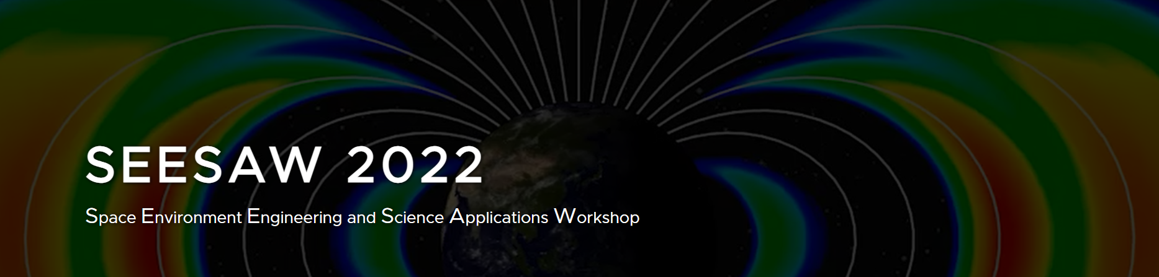
Hopes and dreams (including SEESAW recommendations)
A number of threads (see following chart) were extracted from the Space Environment Engineering and Science Applications Workshops (SEESAW)
5-8 September 2018 (Boulder, CO)
12-16 September 2022 (Laurel, MD)
SEESAW proceedings were organized by topics:
Surface charging
Internal charging
Single Event Effects (SEE)
Total Ionizing Dose and Displacement Damage
Forecast / Nowcast
Of note, there is (was) no explicit “LEO radiation” topic wherefore highlights / hot takes have been extracted from the topical areas listed above
Feedback / corrections / clarifications are most appreciated
Consolidated pLEO-specific notes / items (2022)
Data latency poor (~100 minutes old)
Sensor orientation at low L (avoid SEM-2)
Need tailorable RHA; legacy style RLAT not feasible
Cannot just use drift kinetic plasma models; need MIT coupling physics

Slide 8
Hopes and dreams (including SEESAW recommendations)
Anomaly attribution, triage, forensics, … , can we attribute root cause to SEE or ESD?
Spacecraft charging (not just surface charging and not just in the Aurora)
SEE is not just an SAA item
Attribution and RRC determination may be in the absence of detailed design / anomaly information
Global coverage electron model (300 keV to 10 MeV) coupled w/ time integrated charging code
Surface charging data gaps Jason2 AMBER / AMBRE, ISS FPMU & POES / MetOp
Localized (nowcast / forecast) plot(s) for auroral activity & Field Aligned Currents (FAC)
Worst-case plasma parameters for V&V in addition to more generalized hazard indicators
Surface charging (especially) is so very target vehicle dependent
Localized (nowcast / forecast) insights into geomagnetic collapse (impacts on proton / GCR driven SEE)
Quick look geomagnetic cutoff tools
Nowcasting / forecasting not enough but coupled with meaningful comparisons
Compare to regional history (e.g. confidence levels)
Compare to asset history since launch
Continued data assimilation into climatological models
Better data coverage at LEO (and elsewhere); low SWaP instrumentation
LEO specific data & models to include atmospheric density, AO & MMOD

