Slide 1
NAIRAS Atmospheric and Space Radiation Environment Model
Christopher J. Mertens
NASA Langley Research Center, Hampton, VA, USA

Slide 2
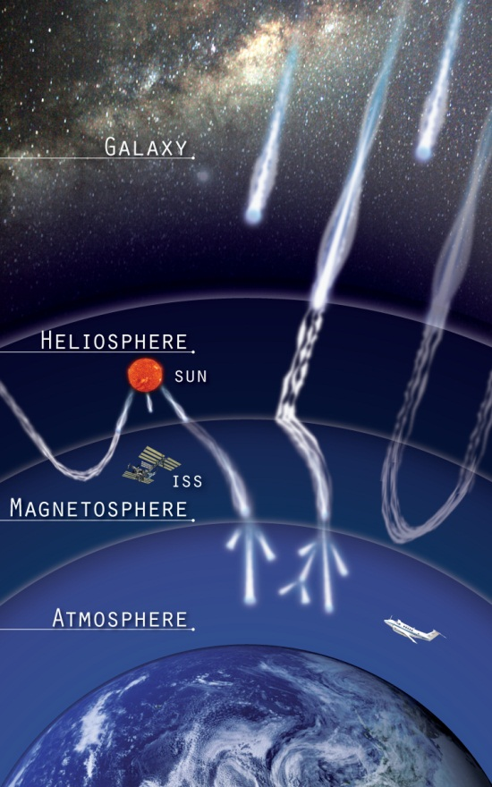
NAIRAS Model
Nowcast of Aerospace Ionizing RAdiation System (NAIRAS) Model
Running in real-time on NASA computer cluster since 2011, aviation radiation results hosted publicly on Space Environment Technologies server/website
Running in real-time at Community Coordinated Modeling Center (CCMC) since 2020
Key (Vintage) Model Features
Physics-based HZETRN (High Charge (Z) and Energy TRaNsport) code
Real-time inclusion of solar energetic particle (SEP) radiation
Real-time solar-magnetospheric effects on radiation (cutoff model by Kress et al. [2004, 2010])
New/Current Model Developments
Extend from atmosphere to space environment, now including trapped protons (TRP)
SEP heavy-ions (Z=2-92, A=4-238) added
Single-Event Effects (SEE) radiation risk assessment quantities added
Run-on-Request (RoR) @ CCMC

Slide 3
Real-Time NAIRAS @ CCMC
CCMC Integrated Space Weather Analysis (iSWA) System

Slide 4
NAIRAS Run-on-Request (RoR) User Input
Table: RoR Capability Summary and Description
Run Option | Output Quantities |  | User Input
Global Dosimetric | Absorbed dose in silicon, absorbed dose in tissue, dose equivalent, ambient dose equivalent, effective dose |  | Start/End Date-Time
Flight Trajectory | Dosimetric & Flux/Fluence |  | Trajectory file
 | Dosimetric | Same as global run | Shielding depths for dosimetric calculations
 | Flux/Fluence |  | Shielding depths for flux/fluence calculations
 |  | Integral GCR/SEP LET (linear energy transfer) SEP proton TRP proton | Lower LET/energy bounds of integral quantity
 |  | Differential GCR/SEP LET (linear energy transfer) SEP proton TRP proton | N/A (full model differential spectra written to output)

Slide 5
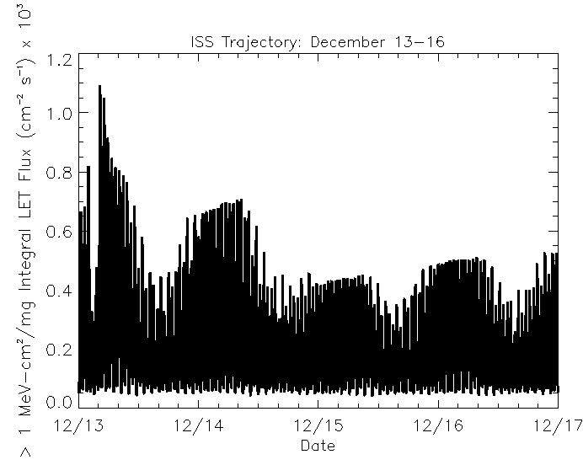
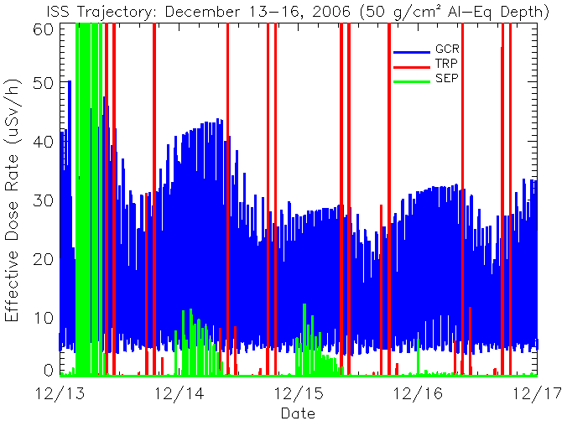
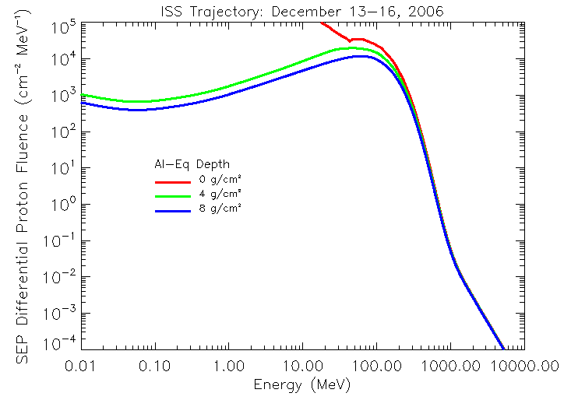
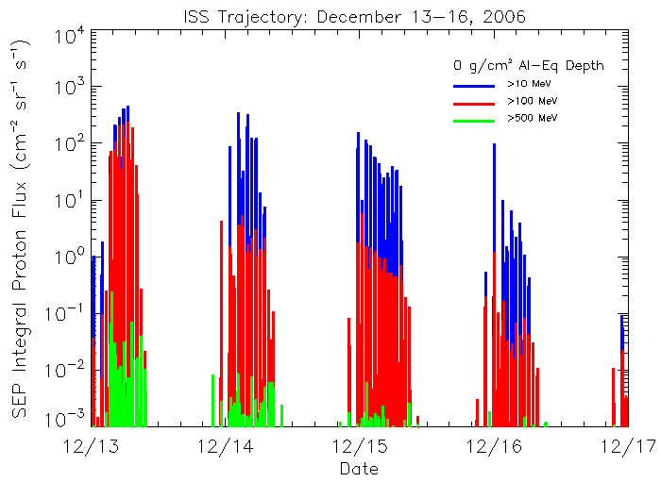
Dec 2006 SEP Events: ISS Radiation
Al Shielding: 50 g/cm²
Al Shielding: 4 g/cm²

Slide 6
NAIRAS/ARMAS ISS Comparison (Oct 6, 2022)
NAIRAS underestimates ARMAS within 30% for GCR, except sometimes at high-latitude …
… NAIRAS underestimation of ARMAS at high-latitude likely due to outer-belt electrons
NAIRAS overestimate ARMAS in SAA by factor 2
NAIRAS overestimate ARMAS accumulated daily dose by 60%, which is consistent with the other 208 days of ARMAS data on ISS

Slide 7
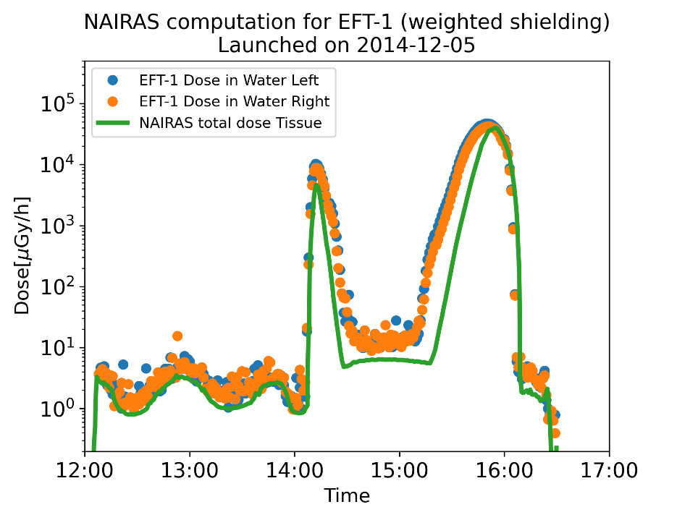
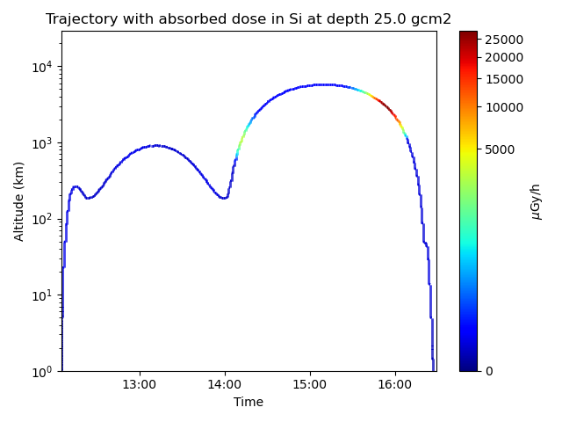
NAIRAS/BIRD Comparison on NASA EFT-1 Flight
NASA Orion Exploration Flight Test-1 (EFT-1)
Unmanned flight of NASA Orion Multi-Purpose Crew Vehicle (MPCV)
Orbital inclination: 28.6 degree
Battery-operated Independent Radiation Detector (BIRD)
Two BIRD active semiconductor detectors (called Left/Right): Timepix technology
Data analysis algorithm converts dose in silicon to dose in water (proxy for tissue)
NAIRAS/BIRD Comparison
NAIRAS underestimates BIRD by 60% in GCR region (before 14 UT) and TRP region (later than 14 UT)
BIRD overestimates total flight dose of other onboard dosimeter systems by 20%.
Considering BIRD biased by 20%, NAIRAS underestimates BIRD by 40%
NAIRAS uncertainty for GCR known to be within 30%

Slide 8
NAIRAS/Liulin ISS Comparison (June 2015 SEP)
Liulin dosimeter outside ISS on ESA EXPOSE-R2 Platform
Al Shielding: 0.8 g/cm²

