Slide 1
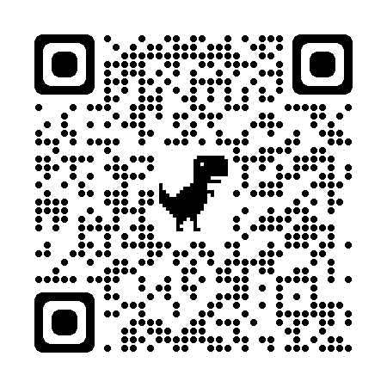
LEO Radiation Data Products From NOAA NCEI
Juan V. Rodriguez
University of Colorado Boulder, Cooperative Institute for Research in Environmental Sciences (CIRES)
NOAA National Centers for Environmental Information (NCEI)
SWPC Space Weather Prediction Testbed Satellite Exercise
October 26, 2023
https://www.ncei.noaa.gov/products/poes-space-environment-monitor
ncei.info@noaa.gov

Slide 2
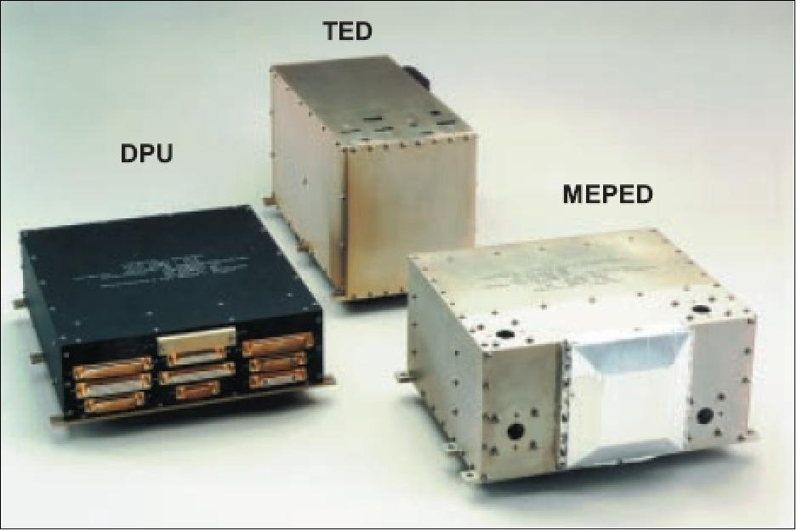
NOAA Space Environment Monitor (SEM-2)
Total Energy Detector (TED)
Eight electrostatic analyzers divided into two sets.
One set looks at at 0º and one at 30º from zenith
0.05-20 keV/q electrons and ions
Medium Energy Proton and Electron Detector (MEPED)
Two electron telescopes: >30 keV
Two proton telescopes: >30 keV
Four omnidirectional detectors (>16 MeV p+)

Slide 3
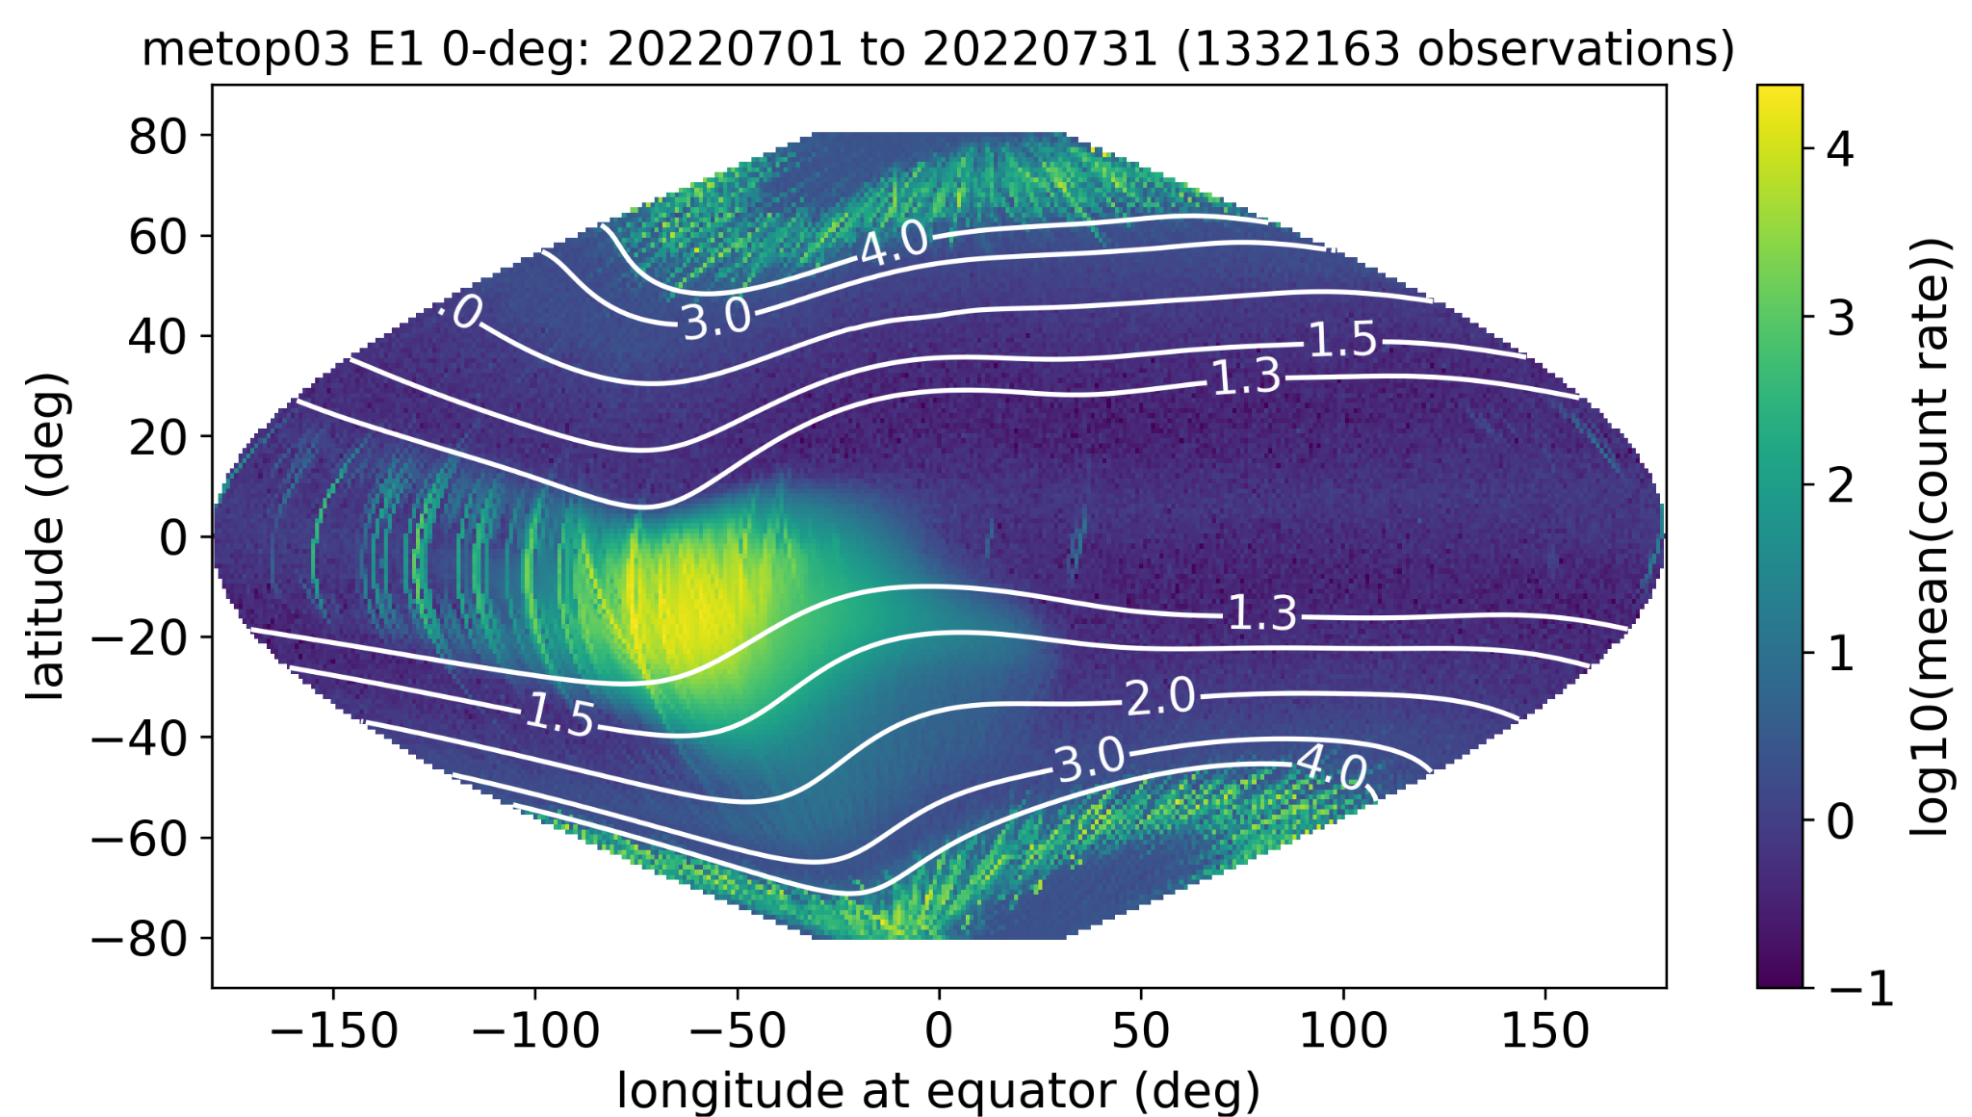
POES/Metop Space Environment Monitor (SEM) Data
Electron and Ion Fluxes:
Electrons and ions: 0.05-20 keV/q (ESAs)
Electrons: >30 - >300 keV (2 telescopes)
Protons: 0.03-6.9 MeV & >6.9 MeV (2 telescopes) and >16 - >140 MeV (omnidirectional)
Belt indices: used for anomaly resolution
Orbit: ~98.8 deg incl., 810-870 km altitude
Time coverage: 1978 to date (instrument redesign between NOAA-14 and -15)
Cadence: 2 or 4 seconds full-resolution
Current satellites: NOAA-15, 18, 19, Metop-B, C
Past satellites: TIROS-N, NOAA 6-8, 10, 12, 14, 16, 17, Metop-A
July 2022, Metop-C, >30 keV electron fluxes, zenith-looking telescope: transient fluxes in the drift loss cone

Slide 4
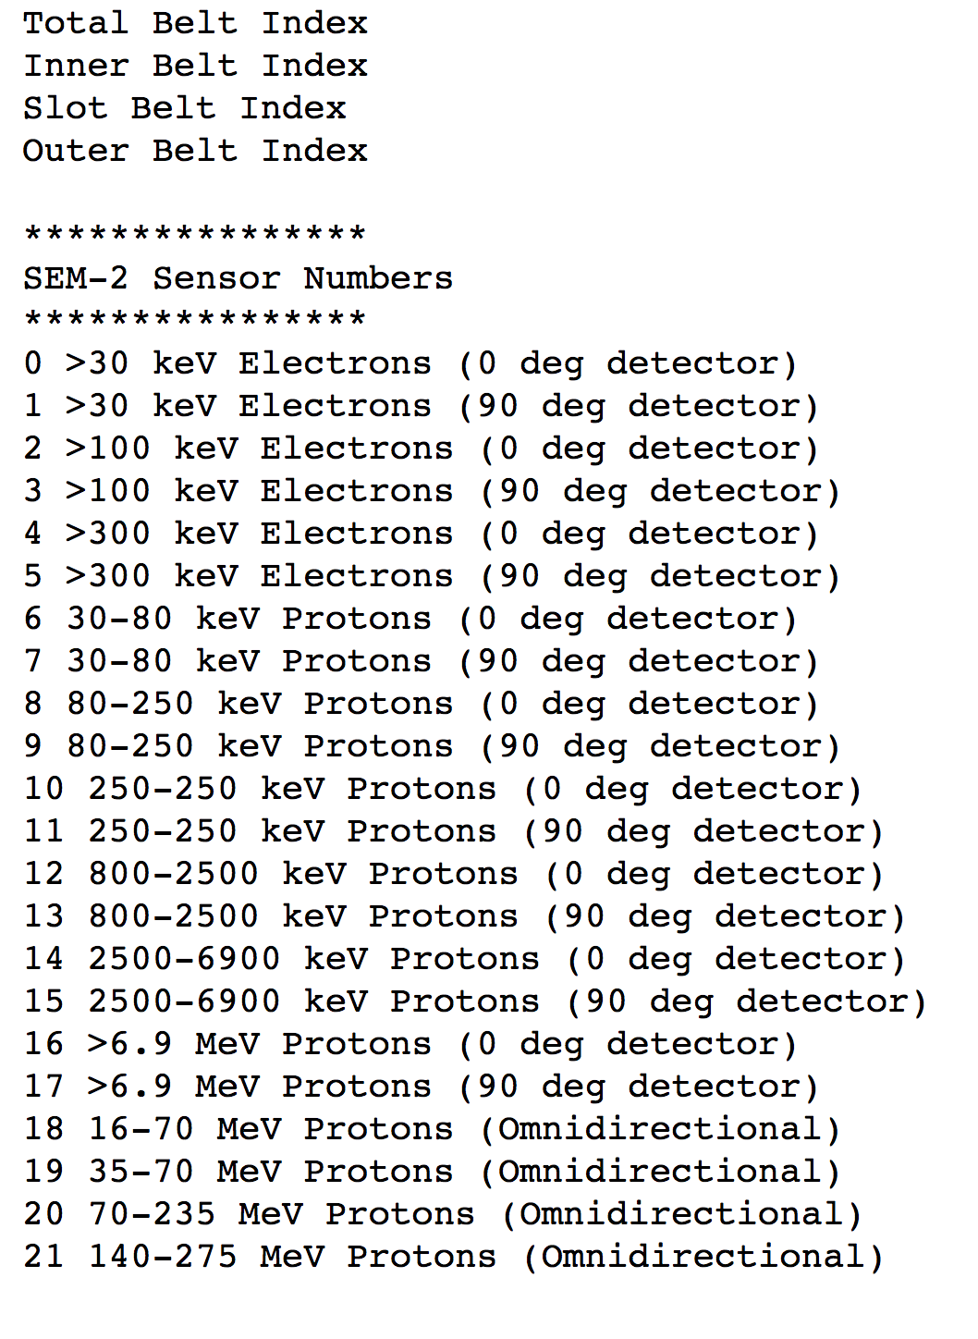
SEM-2 Radiation Belt Indices
Daily median vs satellite lifetime
22 indices / day / satellite
Currently NOAA-15, 18, 19, Metop-B, C
Total, Inner, Slot, Outer
L-shell boundaries
Used for satellite anomaly basic situational awareness
See O’Brien et al., 2020, ‘A Human-in-the-Loop Decision Tool for Preliminary Assessment of the Relevance of the Space Environment to a Satellite Anomaly—Update with REACH and MEO’, Aerospace Report TOR-2020-00349

Slide 5
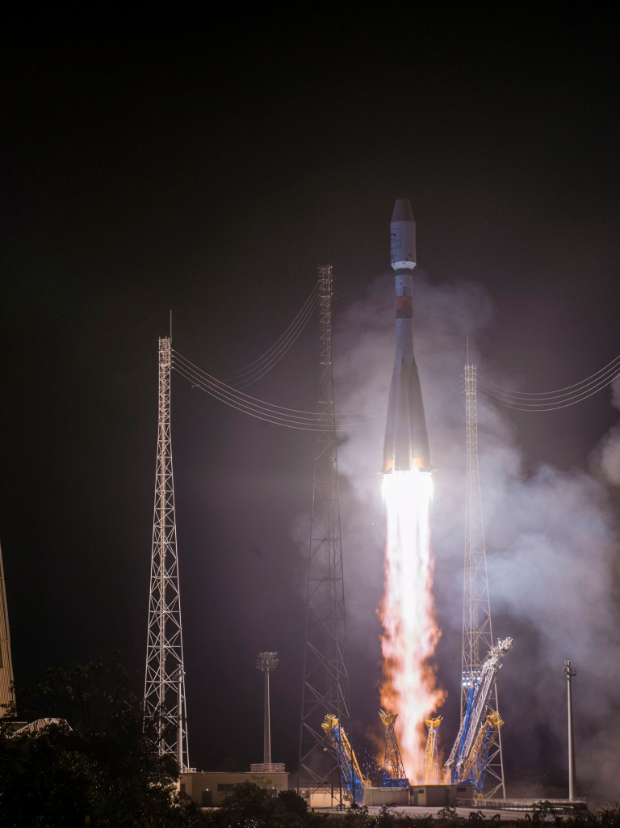
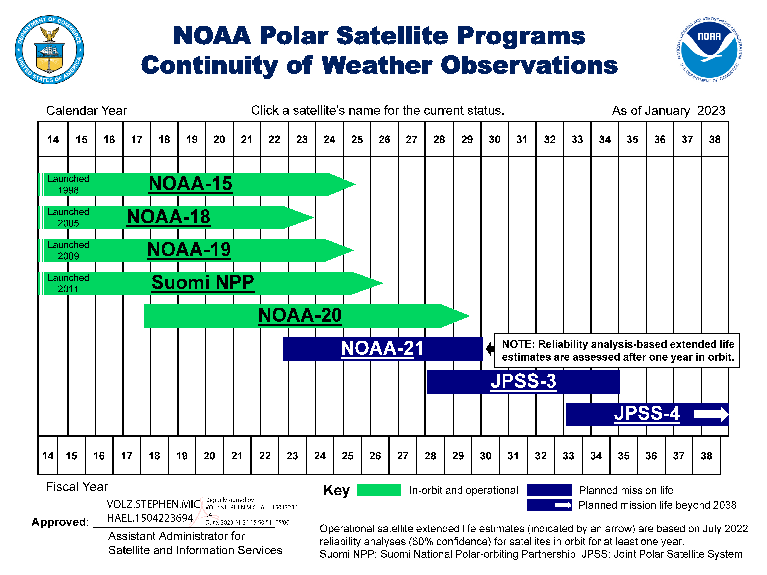
Recent Changes to SEM-2 Data Availability
Metop-C launch: November 7, 2018
Metop-A end-of-life (EOL) tests: November 16-27, 2021 (15 years after launch)
N18 and N15 processing being transitioned to Parsons C2 commercial ground services for Extended Life (8x5, ‘best-effort’ approach, no longer operationally supported)
Metop-C Launch
November 7, 2018
Satellite w/ SEM-2 | EOL
NOAA-15 | 2025
NOAA-18 | 2023
NOAA-19 | 2025
Metop-B | 2027?
Metop-C | 2033?

Slide 6
NCEI LEO Radiation Data Access
https://www.ncei.noaa.gov/products/poes-space-environment-monitor
Questions: ncei.info@noaa.gov

Slide 7
Backup Material

Slide 8
Metop-A End-of-Life (EOL) Deorbiting Tests (16-27 November 2021)
Purpose: to identify ways to improve Metop operations and products
First deorbit maneuver on November 16 - orbit progressively more elliptical
Final Metop-A SEM-2 file received at NCEI on November 27
Minimum altitude 588 km
This is the first time SEM-2 has been operated below 800 km.

Slide 9
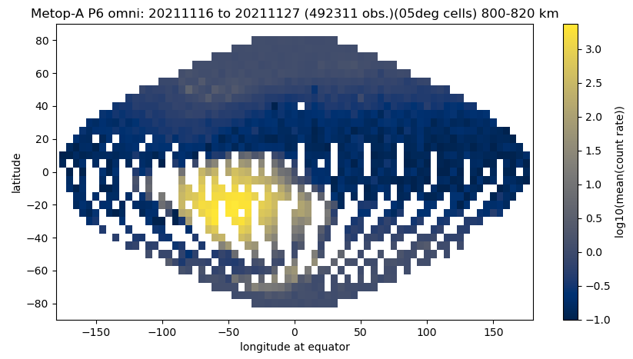
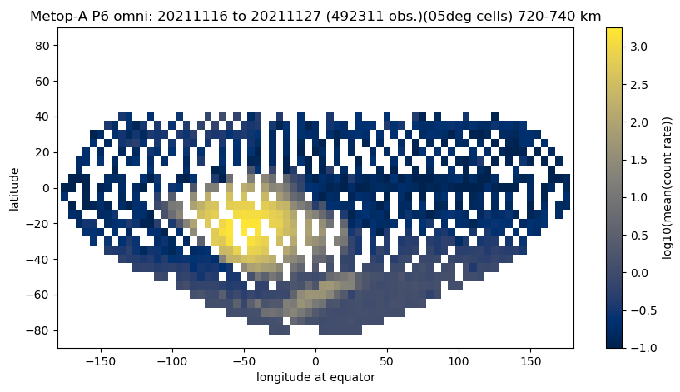
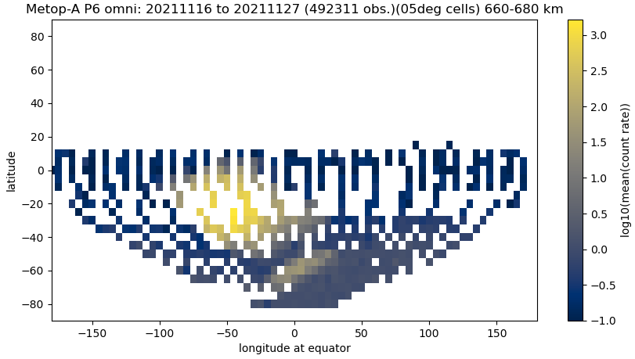
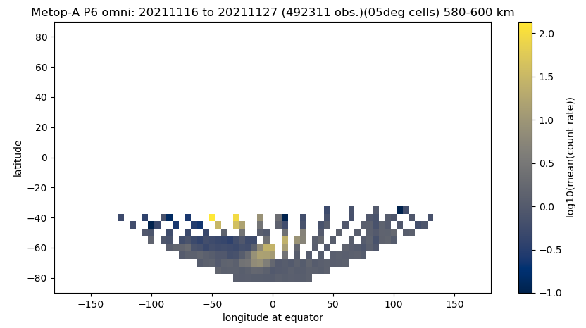
Metop-A EOL Observations Were Sparse
800-820 km
720-740 km
inner belt (protons)
outer belt (electrons)
660-680 km
580-600 km

