Slide 1
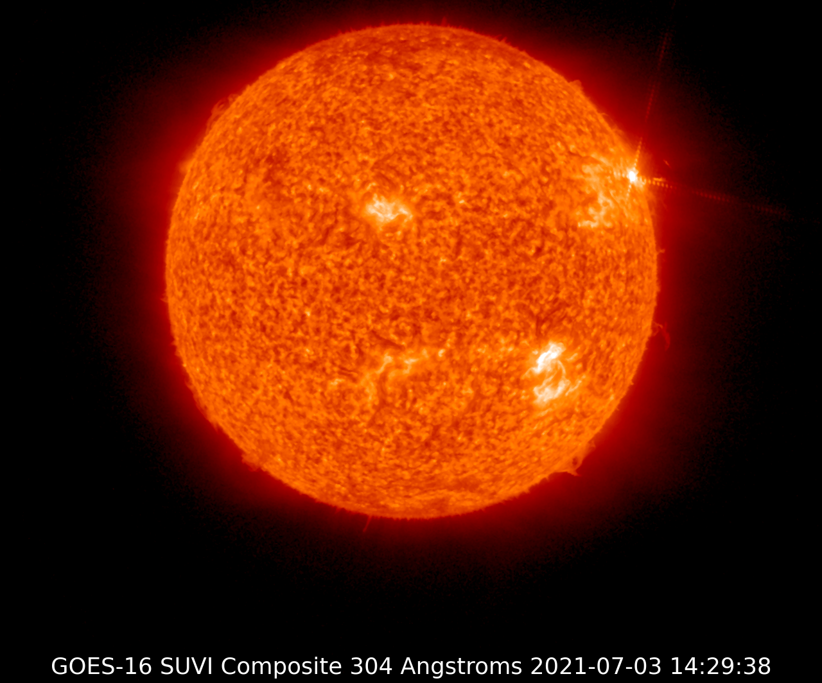
Update on the
Space Weather Advisory Group (SWAG)
Space Weather Prediction Testbed 2023
Satelite Exercise and Experiment
October 25, 2023
Dr. Tamara Dickinson
SWAG Chair
President, Science Matters Consulting, LLC.
*All opinions are my own and not those of SWAG*
Notes:
Thanks to the organizers for inviting me to speak to you today and for allowing us to conduct one focus group in our user needs survey in conjunction with this meeting.
Thanks for Jinni Meehan who is not able to be with us in person today but is joining us virtually.

Slide 2
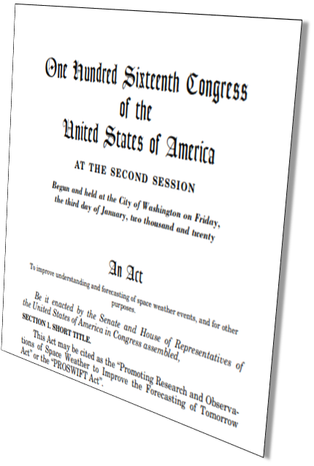
PROSWIFT Act - Overview
Basic Elements
60601 Space weather
Role of Federal Agencies
Interagency Working Group (SWORM)
Interagency Agreements
Space Weather Advisory Group (SWAG)
60602 Integrated strategy
60603 Sustaining and advancing critical observations
60604 Research activities
60605 Space weather data
60606 Knowledge transfer and information exchange (NASEM Roundtable)
60607 Pilot program commercial sector
60608 Benchmarks
Notes:
Hopefully by now everyone has at least heard of the PROSWIFT Act.
Approved Oct 2020.
PROSWIFT: PROMOTING RESEARCH AND OBSERVATIONS OF SPACE WEATHER TO IMPROVE THE FORECASTING OF TOMORROW ACT
While I’m not going to go through all the elements in the PROSWIFT Act, there are a few items I would like to highlight:
Section 60601 codifies roles and responsibilities for the Federal Departments and Agencies, clearly defining roles in support of observations, research, and operations.
Note that this includes the DOD, and know that DOD is an important player in SWORM, so the SWAG will keep that in mind as issues of national security come up.
And Codifies the SWORM (Space weather Operations, Research and Mitigation) committee. Originally set up during Obama administration. This law codifies it so it lives on longer than any one president.
And of course it directs the formation of the Space Weather Advisory Group.
Section 60606 calls for the NASEM space weather roundtable.

Slide 3
Committee Members
SWAG Nongovernmental End- User Representatives
Tamara Dickinson, SWAG Chair
Science Matters Consulting
Mark Olson
North American Electric Reliability Corporation
Michael Stills
United Airlines (retired)
Craig Fugate
One Concern (former FEMA Adm)
Rebecca Bishop
Aerospace Corp.
SWAG Commercial Sector
Representatives
Jennifer Gannon
Computational Physics, Inc.
Conrad Lautenbacher
GeoOptics, Inc. (former NOAA Adm)
Seth Jonas
Lockheed Martin
Kent Tobiska
Space Environment Technologies
Nicole Duncan
Ball Aerospace
SWAG Academic Community
Representatives
Tomas Gombosi
University of Michigan, Ann Arbor
Delores Knipp
University of Colorado, Boulder
Scott McIntosh
National Centers for Atmospheric Research
Heather Elliott
Southwest Research Institute
George Ho
Johns Hopkins University Applied Physics Laboratory
Notes:
Bios are on the website (weather.gov/swag)
The members were appointed by the SWORM. And the chair was selected from the group by NOAA Administrator Rick Spinrad. 3 year terms. No more than 2 consecutive terms.
The members were chosen to provide a range of views that represent the span of the space weather community and end-user sectors.
AND they are representatives not special fed employes

Slide 4
PROSWIFT Act - SWAG Duties
Advise White House SWORM Subcommittee on:
Facilitating advances in the space weather enterprise of the US
Improving the ability of the US to prepare for, mitigate, respond to, and recover from space weather phenomena
Enabling the coordination and facilitation of R2O2R
Developing and implementing the integrated strategy for coordinated observation
Conduct a comprehensive user needs survey of space weather products
Notes:
As I mentioned we advise the SWORM.
Advise on:
Overarching goal of advancing the space weather enterprise.
Improving ability to prepare for, mitigate the impacts of, respond to, and recover from space weather events.
Enable coordination/facilitation of R2O2R
Develop and implement an integrated strategy for space weather. This strategy is called for in PROSWIFT and is the responsibility of OSTP in collaboration with SWORM with advice from SWAG. I believe the SWORM has recently been tasked by OSTP to draft the strategy. (strategy and action plan)
User needs survey

Slide 5
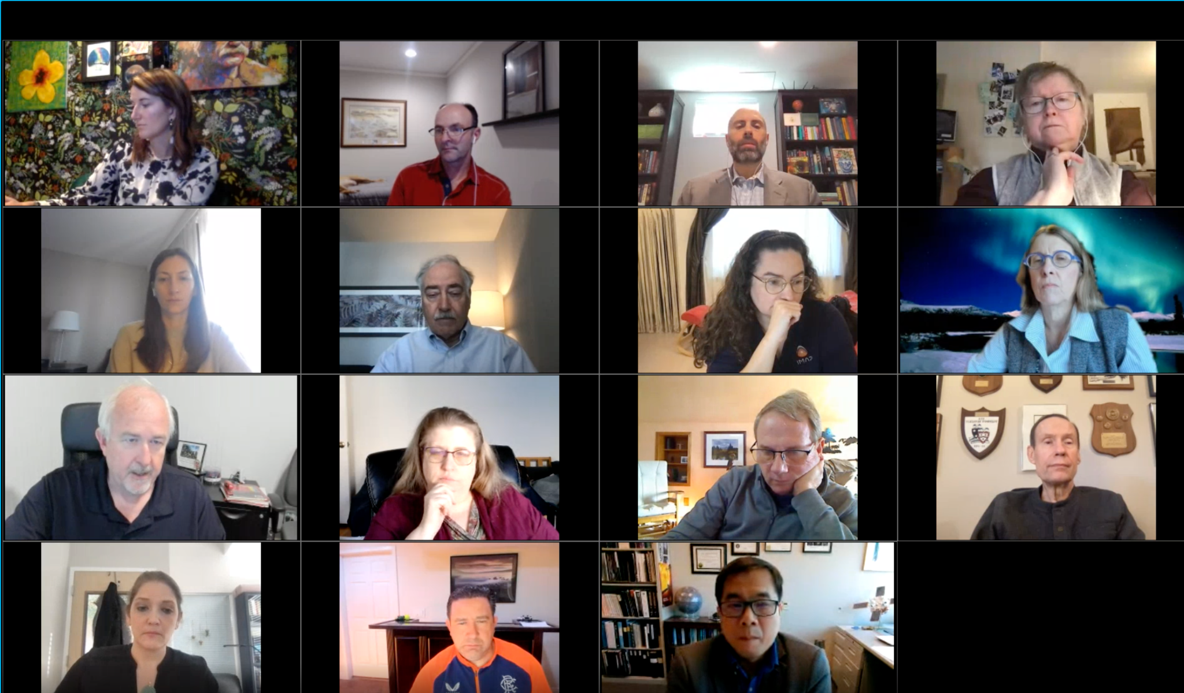
SWAG Meetings
2021
Kickoff meeting December (virtual)
2022
Two meetings (virtual)
Develop the user needs survey and process
2023
In-person meeting January
Gathered input for our report
Conduct the user needs survey
Contemplating a Winter meeting (virtual) focused on community building
For meeting information please visit: www.weather.gov/swag
Notes:
DELETE THIS SLIDE

Slide 6
Information Gathering
Asked by the SWORM to provide input as they update National Space Weather Strategy/Action Plan/Implementation Plan
Input for the report
2015 and 2019 Strategies/Action Plans
White Paper on the Implementation Status of the National Space Weather Strategy and Action Plan
National space weather policies and statutes
Decadal Survey on Solar and Space Physics 2024-2033 White Papers
Broader community thru a series of speakers, panels, and inputs from the public at January 2023 hybrid, open meeting
Audience – SWORM, Congress, Space Weather Enterprise
Notes:
DELETE THIS SLIDE BUT STATE SOME OF IT.
In June 2022, SWORM advised SWAG that they were initiating an update to the National
Space Weather Strategy and Action Plan and tasked SWAG to provide input.
In response, SWAG members developed the attached report, which was informed by the 2015 and 2019 National Space Weather Strategies and Action Plans, the White Paper on the Implementation Status of the National Space Weather Strategy and Action Plan, and the Decadal Survey on Solar and Space Physics 2024-2033 white papers in developing input to SWORM. The report was additionally informed by broader community input through SWAG–a statutory role of SWAG–which was collected through the January 2023 hybrid, open meeting that featured a series of speakers, panels, and inputs from the public.
DEFINE SPACE WX ENTERPRISE = Govt, commercial and academic
Thanks to everyone who participated in this process – SWAG members, SWORM members, panelists, public speakers…
Your input was valuable as we developed our findings and recommendations.

Slide 7
SWAG Report: Finding and Recommendations
Findings and Recommendations to
Successfully Implement PROSWIFT and
Transform the National Space Weather
Enterprise
www.weather.gov/swag
Notes:
The report is posted on weather.gov/swag.
The report consists of policy recommendations. And it is best taken as a package rather than focusing on individual recommendations. The recommendations are tied together. And one of the themes throughout the report is coordination and collaboration.

Slide 8
Broad Set of Space Weather Topics Covered
Overarching Recommendations
Ground-Based and Airborne Sensors and Networks
In-Space Architectures and Space-Based Observations
Data and Computing Infrastructure for Space Weather Operations
Improving Benchmarks, Metrics, and Scales for Space Weather End-Users
Space Weather Risk to Evolving Infrastructure Systems and Services
Economic Assessments on The Costs of Space Weather and the Value Of Forecasting and Mitigation
Promote Focused and Continued Engagement Across Industry and Government Space Weather Stakeholders
Additional Findings and Recommendations
Next Steps
Notes:
Had panels on topics 2-9 at January meeting
SWAG identified 25 findings with 56 recommendations which, if implemented, will provide the funding, processes, support, and structure to foster transformative change across the national space weather enterprise
When I gave the SWORM a progress update in March, they asked us to prioritize our recommendations. They didn’t say how to do that. So after a bit of discussion we decided to have a top 10 list. Rather than rank the priorities 1-56 or low medium and high…
We quickly came to 11 top priorities. So we ended up with a top 10 list including 11 items, which we now just call the priority list.

Slide 9
SWORM Progress
SWORM has made significant progress over the last nine years to build awareness and move the Nation towards resilience to space weather
Technology, infrastructure systems, and national priorities continue to evolve–with the space domain becoming increasingly important to national and economic security
Notes:
SWORM has made significant progress over the last nine years to build awareness and move the Nation towards resilience to space weather through coordinating operations, research, and mitigation activities across the Federal executive branch.
At the same time Technology, infrastructure systems, and national priorities continue to evolve–with the space domain becoming increasingly important to national and economic security.

Slide 10
Priority Recommendations
Fund the Federal Space Weather Enterprise. (R.1.1.)
Create and fund an applied research program office for space weather within NOAA to coordinate, facilitate, promote, and transition applied research across the national space weather enterprise. (R.2.1.)
Ensure OSTP staffing and White House led prioritization and coordination across the national space weather enterprise. (R.3.1. and more)
Protect space weather sensors from spectrum interference. (R.5.1.)
Provide long-term support for operational ground-based and airborne sensors and networks. (R.6.2.)
Provide and fund critical operational space weather services beyond near-Earth. (R9.2)
Notes:
And they aren’t in rank order. They are in the order they appear in the report
Explain what the numbers at the end of the recommendation means.
Fund the Federal Space Weather Enterprise. The Federal space weather enterprise is insufficiently funded to implement PROSWIFT actions, perform the codified roles and responsibilities, or appropriately address the risk space weather poses to the Nation. These risks have grown and continue to grow as new technology is adopted that can be affected by space weather. The executive branch should work with Congress to identify new and sustained funding to address these shortfalls. (R.1.1.)
We as a community need to be the one advocating for this. The federal agencies cant do that. So in my opinion this is a big role that the space weather enterprise can play.
Create and fund an applied research program office for space weather within NOAA to coordinate, facilitate, promote, and transition applied research across the national space weather enterprise. NOAA is not properly structured to meet their goal of addressing the critical societal challenge that space weather poses. NOAA should establish and fund an office within the NOAA Division of Oceanic and Atmospheric Research focused on space weather research necessary to complement and support the space weather roles and missions of NOAA NWS and NESDIS, and to achieve the roles and responsibilities outlined in PROSWIFT, the Weather, Water, and Climate Strategy for FY 2023-2027, and other relevant policies. This new office should coordinate, facilitate, fund, and promote academic and private sector applied research across the national space weather enterprise. (R.2.1.)
Ensure OSTP staffing and White House led prioritization and coordination across the national space weather enterprise. The Director of the White House Office of Science and Technology Policy (OSTP) has not sufficiently staffed or prioritized space weather, missing budget opportunities and slowing the progress towards resilience. OSTP should redouble efforts to further improve coordination and align budget priorities among SWORM agencies and space weather activities and roles across the federal interagency. This will require sustained staffing of a full-time equivalent by someone with space weather expertise. (R.3.1. and myriad other coordination-focused recommendations throughout)
Protect space weather sensors from spectrum interference. Space weather sensors are vulnerable to and potentially at risk of spectrum interference from electromagnetic emissions (e.g., radio frequency) originating from technology systems (e.g., 5G applications). SWORM should coordinate the establishment of domestic and global protections for space weather sensors akin to terrestrial weather sensors. (R.5.1.)
Provide long-term support for operational ground-based and airborne sensors and networks. NOAA should fundamentally change the way ground-based and airborne sensors and networks are prioritized, supported, and maintained, including those operated by academic and commercial sectors, to enable operational products and services and meet NOAA’s statutory role. (R.6.2.)
Provide and fund critical operational space weather services beyond near-Earth. NOAA should seek increased funding and partnerships (e.g., Depart of Defense, NASA, and commercial or international partners) to support an expanded in-space architecture to meet growing national needs in these regions. This includes meeting near-Earth operational needs and expanding support and funding for space weather services in medium-Earth orbit, geostationary Earth orbit, geostationary transfer orbit, cis-Lunar, and eventually Martian environments. NOAA will need to determine the in-space infrastructure needed to support space weather services in these regions. (R.9.2.)

Slide 11
Priority Recommendations
Fund NASA missions that advance fundamental science to support space weather research. (R.10.1.)
Coordinate benchmark development or improvement with industry. (R.14.1.)
Quantify the societal benefits for addressing risk from space weather by performing national-level and industry-wide economic assessments and consider space weather in the context of broader national risk. (R.18.1. and R.4.1.)
Support coordinated applied research within the thermosphere (above 100 km altitude) which is critical for space traffic coordination. (R.24.1-3.)
Foster and lead a global space weather enterprise. (R. 25.1-4)
Notes:
Fund NASA missions that advance fundamental science to support space weather research. NASA should seek increased funding to support coordinated and integrated space weather fundamental research missions that address well-rounded space weather fundamental science. Funding in support of space weather research missions should be commensurate with the risk space weather events pose. (R.10.1.)
Coordinate benchmark development or improvement with industry. For industries with mature space weather benchmarks, SWORM should reconcile government and industry benchmarks to ensure the latest research and knowledge from industry and the space weather enterprise is applied and can be expressed in terms and parameters that are applicable to end users. Where there are no mature industry benchmarks, SWORM should involve industry in the development of new benchmarks. (R.14.1.)
Quantify the societal benefits for addressing risk from space weather by performing national-level and industry-wide economic assessments and consider space weather in the context of broader national risk. Economic assessments and national-level risk assessments should be conducted to quantify risk and ensure the national space weather enterprise is funded at a level commensurate with the risk it poses to the Nation and society. (R.18.1.) and (R.4.1.) (Particularly as you will hear in a later session as we electrify our society – think electric vehicles.)
Support coordinated applied research within the thermosphere (above 100 km altitude) which is critical for space traffic coordination. There is an immediate and growing need for baseline models and data streams from across the national space weather enterprise for improving space traffic coordination and avoiding the negative consequences of space weather on the growing number and importance of space assets in low-Earth orbit (LEO). (R.24.1-3.)
Foster and lead a global space weather enterprise. The U.S. Federal Government (through the State Department) should develop and implement an international process (through the United Nations or similar entity) that seeks more opportunities to globally unify priorities, collaborate, coordinate, and co-fund observations and capabilities with partner and allied nations around the world, broadening international engagement, collaboration, and coordination to meet the growing global need for space weather products. This is needed to effectively address the growing global importance of space weather and the cost to address it. (R.25.1-4.)

Slide 12
PROSWIFT Act - User Survey
User Survey Requirements:
Assess the adequacy of Federal Government goals for lead time, accuracy, coverage, timeliness, data rate, and data quality for space weather observations and forecasting;
Identify options and methods to advance the above goals;
Identify opportunities for collection of data to address the needs of space weather users;
Identify methods to increase coordination of space weather R2O2R;
Identify opportunities for new technologies, research, and instrumentation to aid in understanding, monitoring, modeling, prediction, and warning of space weather; and
Identify methods and technologies to improve preparedness for space weather.
Notes:
We are conducting a comprehensive survey of the needs of users of space weather products to identify the space weather research, observations, forecasting, and modeling advances required to improve space weather products.
User Survey Requirements:
Assess the adequacy of Federal Government goals for lead time, accuracy, coverage, timeliness, data rate, and data quality for space weather observations and forecasting;
Identify options and methods to advance the above goals;
Identify opportunities for collection of data to address the needs of space weather users;
Identify methods to increase coordination of space weather R2O2R;
Identify opportunities for new technologies, research, and instrumentation to aid in understanding, monitoring, modeling, prediction, and warning of space weather; and
Identify methods and technologies to improve preparedness for space weather.

Slide 13
Sectors for User Needs Survey
Space Situational Awareness/ Space Traffic Coordination
Electric Power Grid
GNSS
Aviation
Emergency Management
Human space flight
Research
Satellite
National Security
Radio Frequency Application (comms and Radar)
Notes:
Divided into 10 groups.
Some of the focus groups are in person but most have been or will be virtual. In conjunction with this meeting we are holding an in person focus group with satellite owners and operators during Wed and Thurs lunch. However, we want to engage with all of you who are interested at a later virtual focus group. If you are interested in participating, please let Delores or George know.
For each sector the SWAG is defining what should be included in the sector or subsector. For those sectors survey in the Abt Associates report, the SWAG is determining if any additional survey work is needed. Or if a subsector needs to be surveyed.
Developing the common set of questions and sector specific questions.
Strategizing on how they will conduct the survey. Won’t be the same across all sectors
May prioritize sectors and not do all of them this year.
Report out on all of this at the next meeting. (Hopefully)

Slide 14
Space Traffic Management/Coordination
First ever survey of this potentially large and diverse sector
This hybrid meeting; focusing on LEO satellite owners/operators and entities involved in tracking and/or maneuvers
Self-identified at testbed-exercise registration
Two 1-hour lunch meetings (today and tomorrow) with same individuals
Additional virtual focus groups (same questions) in November
All attendees here invited
Contact Delores.knipp@colorado.edu to participate in these
Notes:
Preliminary results at AGU (Dec) and AMS (Jan). Final results by spring 2024.

Slide 15
User Survey
Chatham House Rules
Session will be recorded for note taking purposes only
High-level anonymized summary created by STPI for the SWAG
As required by the PROSWIFT Act, the results including recommendations will be compiled into a report that will be delivered to Congress and made public
Notes, transcripts and recordings with any identifiable information will be maintained by Science and Technology Policy Institute (STPI)
No identifiable information will reside on any federal systems and is therefore not subject to FOIA
Notes:
STPI is helping the SWAG - Science and Technology Policy Institute.
Dan Pechkis Is with us today and others from STPI are joining us virtually.
Chatham House Rule, where participants are free to use the information received, but neither the identity nor the affiliation of the speaker(s), nor that of any other participant, may be revealed.

Slide 16
User Survey Questions
1. Current use of space weather observations, information, and forecasts:
Which environmental conditions and parameters are important for your operations?
How do you consider space weather information in STM decisions?
How does your system monitor for relevant space weather conditions?
What are your sources for space weather information?
What other new or non-traditional sources of space weather data could be used for the STM sector?
Are you satisfied with the current quality and utility of space weather observations?
2. Future needs of space weather observations, information and forecasts:
What space weather forecasts, lead-times, and products are needed to implement future operations?
What type of information related to neutral density/drag issues and space/upper atmosphere conditions would be useful for operational mitigations, or technical mitigations?
What spatial and temporal resolution is needed?

Slide 17
User Survey Questions
3. Technological systems, components, or elements affected by space weather:
How does space weather affect common and specialized activities? [e.g. launch operations, tracking)
What are current or planned collaborations with the environmental research communities to improve resilience?
4. Current and future risk reduction and resilience activities:
What technological mitigation is used to reduce vulnerabilities or risk?
What kinds of tabletop exercises have you developed and implemented to explore space weather sensitivities to severe or extreme geomagnetic storms?
Which specific altitude or latitude regimes are more problematic for your operations?
How do any of your reduction/resilience activities rely on GNSS data availability?
How can operations be modified to compensate predicted or known space environment variations?
What are the limiting factors to the proposed operation modifications? (e.g., lead-time)
Are there known barriers or challenges to implementing the proposed mitigations?
What operating system improvements are required to compensate for neutral density or wind perturbations?

Slide 18
THANKS!
dickinson.tamara@yahoo.com
Delores.knipp@colorado.edu
www.weather.gov/SWAG

Slide 19
Broad Set of Space Weather Topics Covered
Overarching Recommendations
Ground-Based and Airborne Sensors and Networks
In-Space Architectures and Space-Based Observations
Data and Computing Infrastructure for Space Weather Operations
Improving Benchmarks, Metrics, and Scales for Space Weather End-Users
Space Weather Risk to Evolving Infrastructure Systems and Services
Economic Assessments on The Costs of Space Weather and the Value Of Forecasting and Mitigation
Promote Focused and Continued Engagement Across Industry and Government Space Weather Stakeholders
Additional Findings and Recommendations
Next Steps

Slide 20
BACKUP SLIDES

Slide 21
Input to Space Weather Enterprise
2015 and 2019 National Space Weather Strategies
Community input was via a Request for Information
Community didn’t feel it was an all of community activity
Congress heard you - Enter SWAG
Chartered to advise SWORM
Members from academia, end-users, and commercial space sectors
Representatives of our communities
Expected to reach into our communities to get input
Notes:
Pathways for community input were limited in 2015. RFI, comments on draft documents etc.
Heard from many here today when we were doing the 2015 strategy and action plan that you wanted a seat at the table. Congress heard you. The SWAG is your seat at the table.
Chartered to advise SWORM on a variety of space weather issues including the development and implementation of an integrated strategy for space weather (i.e., the National Space Weather Strategy and Action Plan)
Unlike other FACA’s we are representatives of our communities. Not special federal employees. So we are expected to go into our communities to get input

Slide 22
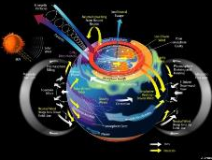
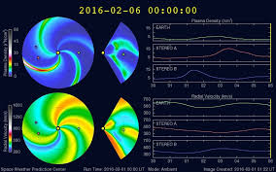
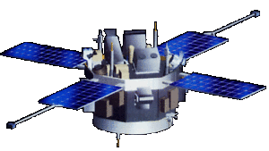
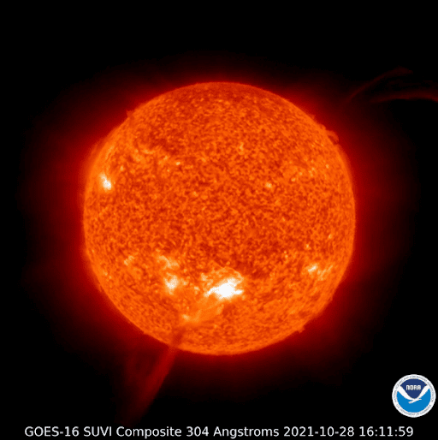
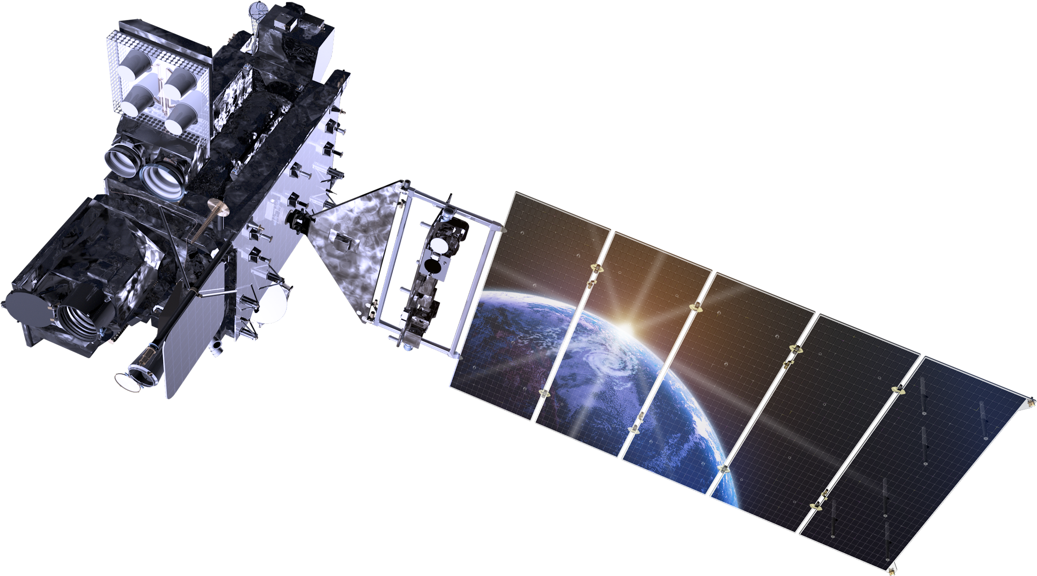
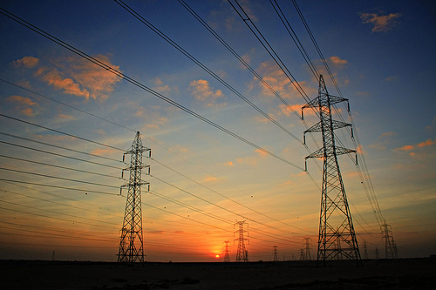
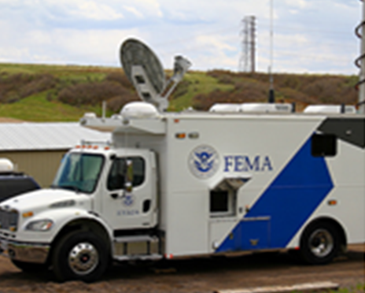
PROSWIFT Act - User Survey
The comprehensive user needs survey of space weather products will identify:
space weather research
observations
forecasting
prediction
modeling advances required to improve space weather products.
Notes:
First task is to conduct a user needs survey

Slide 23
Content
Chapter | Findings | Recs
Introduction
Overarching Recommendations | Finding 1-5 | 7
Ground-Based and Airborne Sensors and Networks | Finding 6-8 | 6
In-Space Architectures and Space-Based Observations | Finding 9-12 | 9
Data and Computing Infrastructure for Space Weather Operations | Finding 13 | 6
Improving Benchmarks, Metrics, and Scales for Space Weather End-Users | Finding 14-15 | 6
Space Weather Risk to Evolving Infrastructure Systems and Services | Finding 16-17 | 5
Economic Assessments on The Costs of Space Weather and the Value Of Forecasting and Mitigation | Finding 18 | 4
Promote Focused and Continued Engagement Across Industry and Government Space Weather Stakeholders | Finding 19-21 | 4
Additional Findings and Recommendations | Finding 22-25 | 9
Next Steps
Notes:
Put in back up.

Slide 24
Priority Recommendations
Fund the Federal Space Weather Enterprise. (R.1.1.)
Create and fund an applied research program office for space weather within NOAA to coordinate, facilitate, promote, and transition applied research across the national space weather enterprise. (R.2.1.)
Ensure OSTP staffing and White House led prioritization and coordination across the national space weather enterprise. (R.3.1. and more)
Protect space weather sensors from spectrum interference. (R.5.1.)
Provide long-term support for operational ground-based and airborne sensors and networks. (R.6.2.)
Provide and fund critical operational space weather services beyond near-Earth.
Notes:
ADD A FEW WORDS about each.

Slide 25
Priority Recommendations
Fund NASA missions that advance fundamental science to support space weather research. (R.10.1.)
Coordinate benchmark development or improvement with industry. (R.14.1.)
Quantify the societal benefits for addressing risk from space weather by performing national-level and industry-wide economic assessments and consider space weather in the context of broader national risk (R.18.1. and R.4.1.)
Support coordinated applied research within the thermosphere (above 1000 km altitude) which is critical for space traffic coordination. (R.24.1-3.)
Foster and lead a global space weather enterprise. (R. 25.1-4)

Slide 26
Overarching Recommendations
Funding the implementation of PROSWIFT
R.1.1. Fund the Federal Space Weather Enterprise.
Enabling NOAA to achieve their space weather priorities and accomplish their space weather mission
R.2.1. Create and fund an applied research program office for space weather within NOAA to coordinate, facilitate, promote, and transition applied research across the national space weather enterprise.
R.2.2. Develop internal NOAA strategies to ensure agency-wide coordinated implementation of PROSWIFT and their national space weather policy responsibilities – both overall and within each service office.
R.2.3. Expand NOAA R2O2R functionality to enable the transition to full operations.
Notes:
Finding 1. The Federal space weather enterprise is not sufficiently funded across all three legs (Federal Government and commercial and academic sectors) of the national space weather enterprise to implement PROSWIFT actions, perform and sustain the codified roles and responsibilities, or appropriately address the risk space weather poses to the Nation.
Finding 2. NOAA is not properly structured to meet their statutory responsibilities codified in PROSWIFT (51 USC 60601(2)(A)) or their goal of addressing the critical societal challenge that space weather poses.

Slide 27
Overarching Recommendations
Ensuring coordination of space weather across the Federal Government
R.3.1. Ensure OSTP staffing and White House led prioritization ansd coordination across the national space weather enterprise.
A national risk register
R.4.1. Consider space weather in the context of broader national risk.
Protecting space weather sensors from spectrum interference
R.5.1. Protect space weather sensors from spectrum interference.
Notes:
Finding 3. OSTP has not sufficiently staffed and prioritized space weather given PROSWIFT and their statutorily mandated role as coordinator for the “development and implementation of Federal Government activities conducted with respect to space weather to improve the ability of the United States to prepare for, avoid, mitigate, respond to, and recover from potentially devastating impacts of space weather” (51 USC 60601(b)). This has resulted in reduced coordination and collaboration across agencies leading to missed opportunities to take advantage of the exponential growth in space activities; a lack of prioritization of budgets, missions, and key activities; and to shortfalls in ensuring the timely implementation of PROSWIFT, infrastructure policies, and national space weather policy that would reduce the risk of space weather to the Nation.
Finding 4. The Federal Government does not have a sufficient, overall, unified process to identify and quantify risks from threats and hazards, such as space weather, to the Nation. This likely results in funding and prioritization of space weather activities that is not commensurate with the level of risk posed to the Nation and society.
Finding 5. Space weather sensors are vulnerable to and potentially at risk of spectrum interference from electromagnetic emissions (e.g., radio frequency) originating from technology systems (e.g., 5G applications). Emissions at frequencies similar to those used by space weather sensors could disrupt the sensors’ abilities to provide key data necessary to inform space weather products, forecasts, nowcasts, and situational awareness. Appropriate domestic and international protections should be given to space weather sensors parallel to those given to terrestrial weather sensors.

Slide 28
Ground-Based and Airborne Sensors and Networks
R.6.1. Assess and publish the prioritization of ground-based and airborne sensors needed for current and future space weather products.
R.6.2. Provide long-term support for operational ground-based and airborne sensors and networks.
R.6.3. Fund the transition of NSF research sensors and networks to operations.
R.6.4. Coordinate support for ground-based and airborne sensors and networks that are essential to space-based missions.
Notes:
Finding 6. A fundamental change is needed in the way ground-based and airborne sensors and networks are prioritized, supported, and maintained, including those operated by academic and commercial sectors, to enable operational products and services.

Slide 29
Ground-Based and Airborne Sensors and Networks
R.7.1. Expand the use of CRADAs to improve collaboration across the academic and commercial sectors.
R.8.1. Prioritize the addition of underutilized, existing real-time magnetometer data streams over new MT survey campaigns.
Notes:
Finding 7. NOAA has successfully used Cooperative Research and Development Agreements (CRADAs) to foster collaboration between government and non-government entities to evaluate and improve the use and availability of operational data from ground-based sensors.
Finding 8. While the completed magnetotelluric (MT) surveys of the United States have contributed a high value for science, the next most valuable investment and step is supporting real-time ground-based, operational magnetometers. Real-time specifications of the geo-electric field in the contiguous United States currently rely solely on data streams from six USGS magnetic observatories. This sparse distribution results in coverage gaps greater than 1,000 km, and includes high-hazard regions such as Minnesota and New England. With the expected near-term increase in geomagnetic activity and geoelectric field hazard to the power grid during solar maximum, it is a high priority to quickly augment Federal forecasting capabilities by leveraging existing non-government magnetic field sensors that can be put into operations in both of these high-hazard regions.

Slide 30
In-Space Architectures and Space-Based Observations
R.9.1. Revise the National Space Weather Strategy and Action Plan to broaden service coverage of additional space environments.
R.9.2. Provide and fund critical operational space weather services beyond near-Earth.
Notes:
Finding 9. Space weather services are necessary to support robotic and human activities in space. Space weather services include the data, data products, forecasts, nowcasts, warnings, benchmarks, catalogs, models and other information or tools that affected communities use to prepare for or respond to space weather events. These services need to expand from a near-Earth emphasis to include farther from Earth (e.g., medium-Earth orbit (MEO), geostationary Earth orbit (GEO), and geostationary transfer orbit (GTO)), and beyond Earth (i.e., cis-Lunar and eventually Martian space). Providing space weather services in these regions is of growing importance as U.S. defense, commercial, economic and human exploration activities have increased or are planned in these regions. The current National Space Weather Strategy and Action plan does not adequately reflect the national need in these regions. Expanding the Strategy and Action Plan to include environments relevant to human exploration is aligned with Space Policy Directive 1 and PROSWIFT (51 USC 60601(a)(1)(E)). This will eventually require expanded operational space weather programs at NOAA.

Slide 31
In-Space Architectures and Space-Based Observations
R.10.1. Fund NASA missions that advance fundamental science to support space weather research.
R.10.2. Use a coordinated approach to develop and deploy missions that advance fundamental science supporting space weather.
R.10.3. Establish O2R traceability in the NASA mission formulation process.
R.10.4. Develop a prioritization of space-based sensors to enhance space weather products.
Notes:
Finding 10. Space weather phenomena affect technological systems on a local and global scale. The NASA Heliophysics Division has greatly expanded the Heliophysics System Observatory (HSO). However, HSO could be further improved through a more coordinated and optimized approach to overall system-science development. Furthermore, additional basic research is still needed to understand the underlying physics to improve and expand predictions and forecasts The space weather research community has identified the need for in-space observations which connect systems; address mesoscale or global processes; access new (unexploited) vantage points; combine interdisciplinary approaches; integrate multi-point measurements; and fill observation gaps throughout the solar system.

Slide 32
In-Space Architectures and Space-Based Observations
R.11.1. Opportunistically deploy more space weather sensors.
R.11.2. Fly space weather particle sensors on every U.S. Government procured space vehicle.
R.12.1 Sustain resilient approaches to ensure continuity of in-space, operational space weather observations.
Notes:
Finding 11. Developers and operators of space systems require more consistent space weather data in high-interest regions (such as near-Earth, beyond near-Earth, cis-Lunar, Mars, and along the Sun-Earth line) and need improved coverage throughout the solar system.
Finding 12. Space weather forecasts depend on specific observational data. The measurements or other capabilities which enable these data must be sustained for the continuity of forecasts.

Slide 33
Data and Computing Infrastructure for Space Weather Operations
R.13.1. Fund, formalize, and expand the NOAA space weather prediction testbed.
R.13.2. Improve access to space weather data.
R.13.3. Improve interagency coordination of models and data.
R.13.4. Promote and prepare for the use of AI/ML algorithms as a complement to traditional empirical and physics-based models. R.13.5. Continue to identify and release novel and underutilized data sets that improve space weather products.
R.13.6. Promote career pathways for interdisciplinary technologists supporting the space weather enterprise.
Notes:
Finding 13. The infrastructure and workforce to support new data and models are not being developed at a pace that meets the needs of emerging technologies and new data streams.

Slide 34
Improving Benchmarks, Metrics, and Scales for Space Weather End-Users
R.14.1. Coordinate benchmark development or improvement with industry.
R.14.2. Promote industry participation in workshops and meetings to inform the mitigation of space weather hazards.
R.14.3. Use multiple approaches to validate benchmarks.
R.15.1. Identify and prioritize the development of key space weather metrics.
R.15.2. Update and expand NOAA space weather scales.
R.15.3. Maintain historical space weather indices.
Notes:
The NOAA Space Weather Scales have provided the worldwide reference, decades-long legacy of improved space weather understanding for end-users. NOAA scales have provided a basis for selecting the safest operating procedure for given space weather conditions but may now be too generalized given the increasingly complex operating environment.
However, to effectively operate in an ever-changing environment there is a need to evolve the accuracy and specificity of these scales for individual industries. In unison with needed enhancements of scales, there is also a need for education at a level which matches the complexity of space weather and how it affects technology systems.
Finding 14. The National Space Weather Action Plan (2015) established benchmarks, which provide points of reference, for induced geo-electric fields, ionizing radiation, ionospheric disturbances, solar radio bursts, and upper atmosphere expansion. Continued refinement of space weather benchmarks is necessary to bridge government, academic, and industry expertise, which was started by the next step space weather benchmarks process.
Finding 15. Metrics supporting long-term characterization of space weather conditions, and scales identifying levels of space weather activity, require improvements to support an increasingly diverse user landscape. Industry-specific indices should be prioritized for development to address individual needs of the user.

Slide 35
Space Weather Risk to Evolving Infrastructure Systems and Services
R.16.1. Develop an enduring process to understand evolving infrastructure needs.
R.16.2. Leverage industry assessments and applications of magnetotelluric data and geomagnetically-induced current data to improve Earth conductivity models and geomagnetically-induced current assessment tools.
R.17.1. Promote the development of vulnerability assessments by sector owners and operators.
R.17.2. Prioritize addressing space weather risks in sectors other than electric power and aviation.
R.17.3. Address interdependencies of and cascading risks to critical infrastructure.
Notes:
Finding 16. There is a need for regular collaboration with infrastructure owners, operators, and end-users to incorporate the needs of evolving infrastructure. Infrastructure sectors are rapidly evolving, integrating new capabilities and incorporating activities to identify and address risk from space weather events. For example, the electric power grid is transforming, while at the same time grid owners and operators are implementing reliability standards to improve resilience to space weather. This is changing the electric power industry’s need for space weather products, which may require increased granularity, lead-time, and specificity.
Finding 17. Activities to reduce space weather risks and enhance resilience are progressing in varying degrees across infrastructure sectors. An increased focus is needed on infrastructure sectors that may be lagging. The electric power subsector and aviation subsector have determined that space weather is a sufficient threat to the reliability of their infrastructure services and have taken action through regulatory and requirements processes to assess and address the effects of space weather on their systems. Other critical infrastructure sectors or subsectors do not yet have similarly mature and broad approaches for reducing risk and promoting resilience to the effects of space weather. This drives uncertainty in understanding the vulnerability space weather might have on that sector and to the Nation overall.

Slide 36
Economic Assessments on the Cost of Space Weather and the Value of Forecasting and Mitigation
R.18.1. Quantify the societal benefits for addressing risk from space weather by performing national-level and industry-wide economic assessments.
R.18.2. Develop and curate data necessary for effective economic assessments.
R.18.3. Broaden the scope of economic assessments.
R.18.4. Engage additional stakeholders for economic assessments.
Notes:
Finding 18. Economic assessments are important for informing how the risk of space weather should be addressed and for prioritizing funding for observations, models, mitigation measures, and insurance products. They are the basis for determining societal benefit.

Slide 37
Promote Focused and Continued Engagement Across Industry and Government Space Weather Stakeholders
R.19.1. Enhance distribution of space weather products.
R.19.2. SWORM should increase transparency by ensuring the publication of foundational documents, studies, and policies.
R.20.1. Develop standing MOUs or MOAs across and between all SWORM agencies.
R.21.1. Develop and implement broader participation in tabletop exercises.
Notes:
Finding 19. A key piece of national space weather policy is the need to establish and continue coordination of space weather research, awareness, information and products, and ways to address its effects among government, academic, and industry stakeholders.
Finding 20. The lack of extant MOUs or memoranda of agreement (MOAs) can be an impediment to cooperation and interaction between and among Federal departments and agencies.
Finding 21. There is a need for tabletop exercises to help organize and outline the steps that might need to be taken during a space weather event. By discussing the scenario and simulating responses in advance, space weather stakeholders and the communities affected can identify challenges and opportunities to improve space weather resilience, messaging, emergency management, and preparedness.

Slide 38
Other Key Recommendations
Assessing and addressing national security risks from space weather
R.22.1. Develop a national security annex or policy on space weather.
Promoting public awareness and education for space weather
R.23.1. Improve public awareness, education, and engagement regarding space weather application effects.
Notes:
Finding 22 The national security mission is broadly and uniquely exposed to space weather risks. Such risks warrant assessment(s) unique to mission circumstances.
Finding 23. SWORM must broaden and augment community and stakeholder engagement on space weather.

Slide 39
Other Key Recommendations
Critical need for thermospheric density specification to aid operational systems
R.24.1. Support coordinated applied research for the thermosphere (above 100 km altitude) which is critical for space traffic coordination.
R.24.2. Support coordinated R2O2R workshops and testbed activities for space traffic coordination.
R.24.3. Support and encourage new processes for the incorporation of data and observations to characterize the thermosphere (above 100 km altitude) environment.
Notes:
Finding 24. Support for coordinated applied research of the thermosphere is necessary to improve space traffic coordination and avoid the negative consequences of space weather on the growing number and importance of space assets in LEO.

Slide 40
Other Key Recommendations
Enhancing global engagement
R.25.1. Foster and lead a global space weather enterprise.
R.25.2. Promote Five-Eyes space weather collaborations.
R.25.3. Formalize bi-lateral or multilateral agreements to support coordinated messaging, mutual resilience, and to further the global space weather enterprise.
R.25.4. Participate in and leverage the international standards development relevant to space environment and space weather.
Notes:
Finding 25. The U.S. Federal Government should seek more opportunities to collaborate, coordinate, and co-fund observations, forecasts, and capabilities with partner and allied nations around the world, broadening international engagement, collaboration, and coordination to meet the growing need for space weather products.

