Slide 1
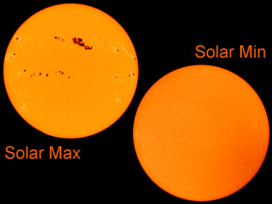
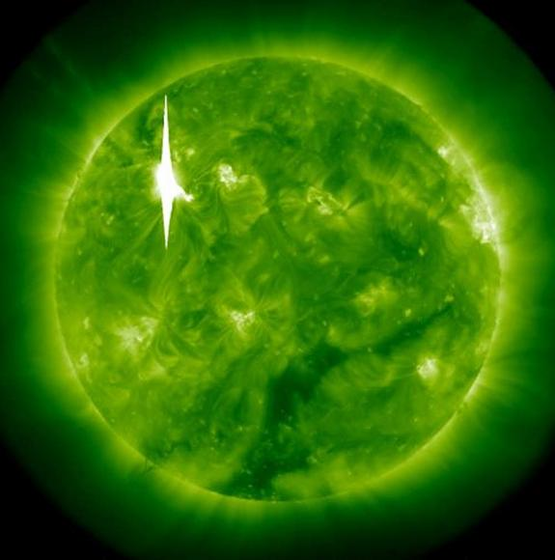
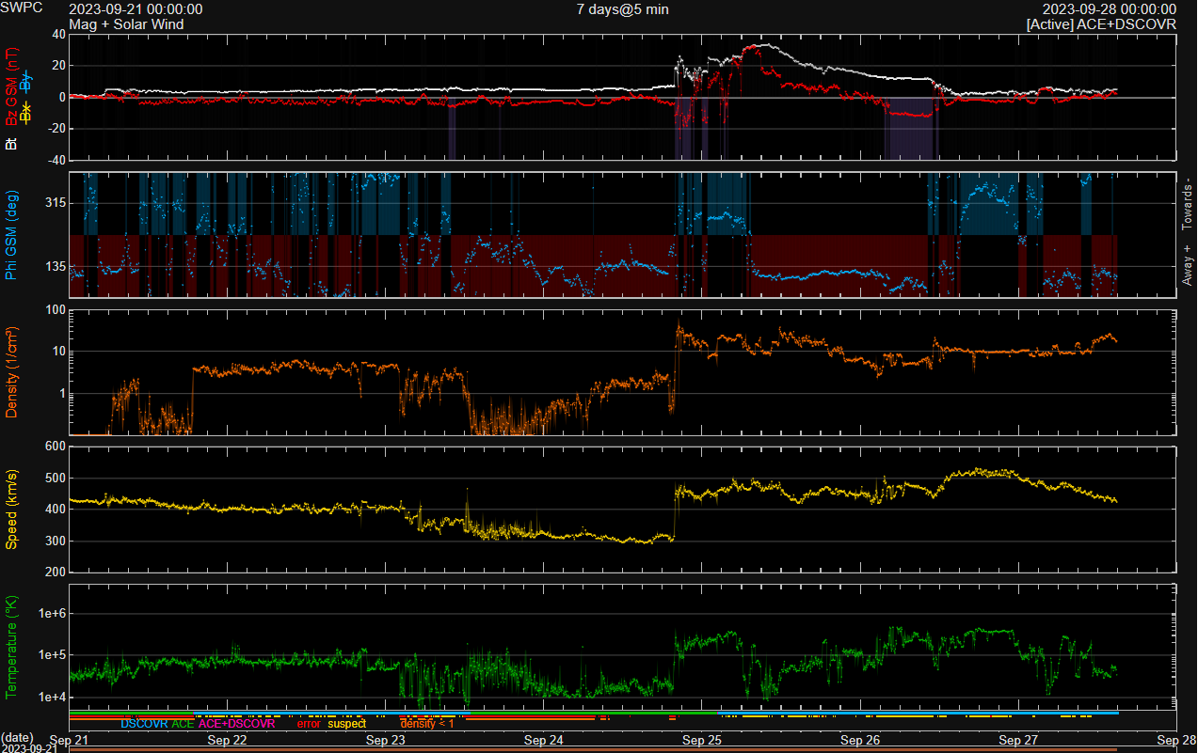
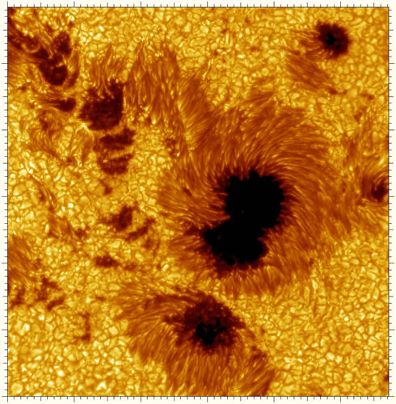
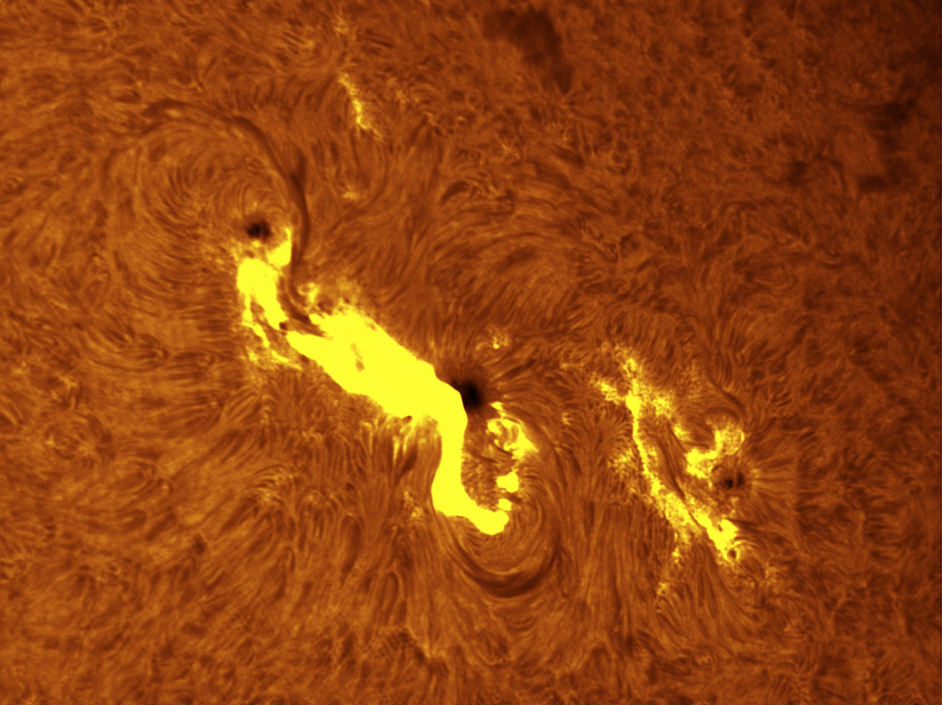
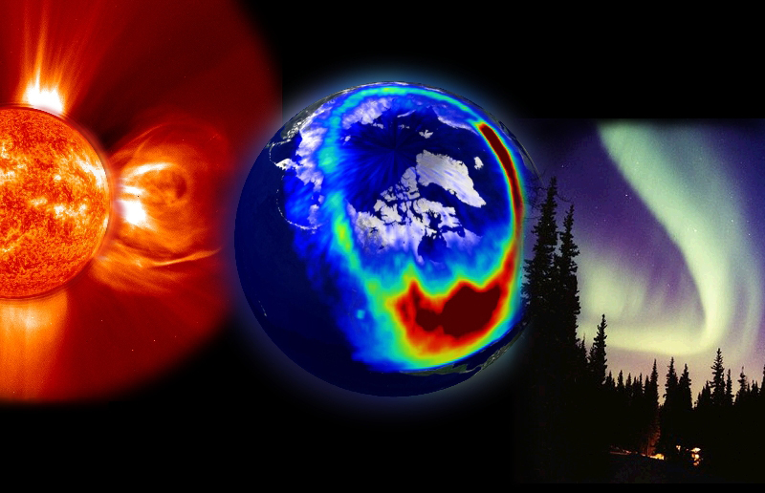
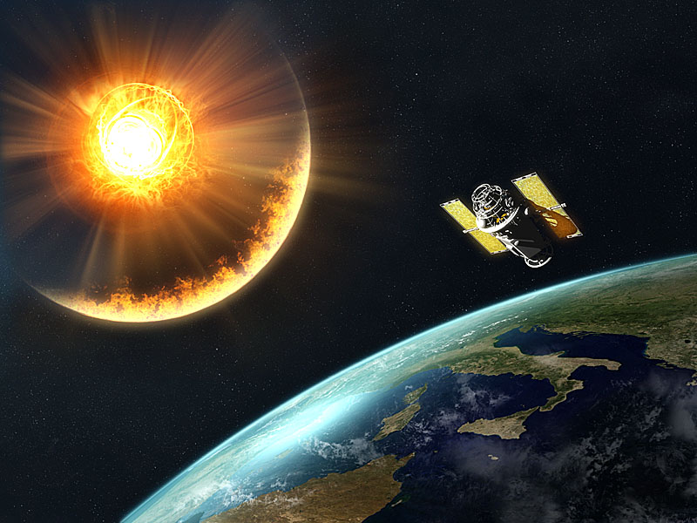
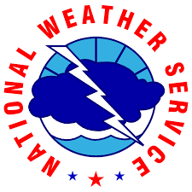
Space Weather and Forecasting for the Satellite Community
Shawn Dahl – Service Coordinator
Robert Steenburgh – Space Scientist
NOAA / NWS Space Weather Prediction Center (SWPC) Boulder, CO
Notes:
Space weather is little understood by the majority of the public and media; however, it gains much attention quickly when something notable occurred or higher thresholds of NOAA space weather scale activity is forecast or taking place. This presentation is designed to help better understand the importance of space weather; basic knowledge about some of the primary space weather events, drivers and impacts; space weather forecasting process, products, and areas of focus; and finally examples of how space weather can be part of IDSS and integrated into emergency planning.

Slide 2
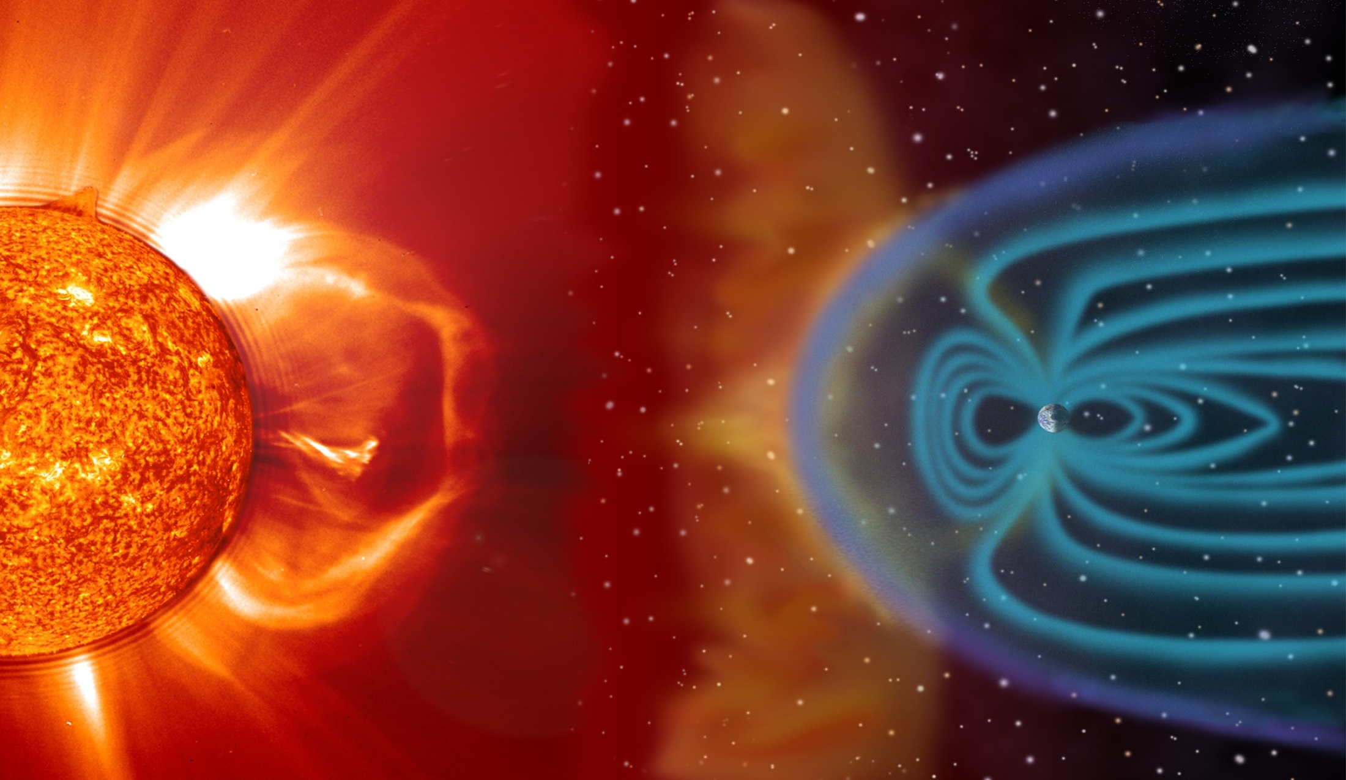
What is Space Weather?
Space weather refers to the variable conditions on the Sun and in space that can influence performance and reliability of space and ground­-based technological systems, and endanger life or health.
Ionosphere
Coronal
Mass
Ejection
Various emissions from the Sun affect Earth
Magnetosphere
93 Million Miles from Sun to Earth
Notes:
Magnet shot into space interacts with Earth’s magnet.

Slide 3
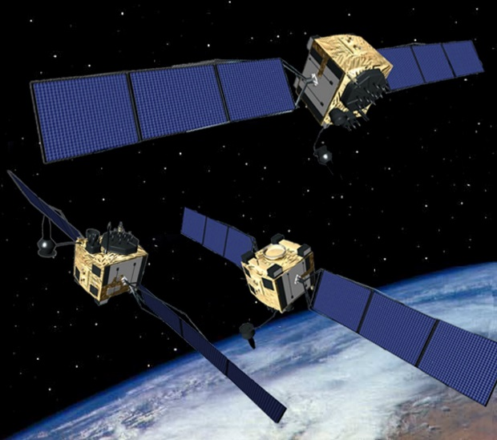
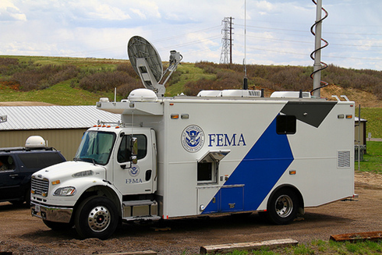
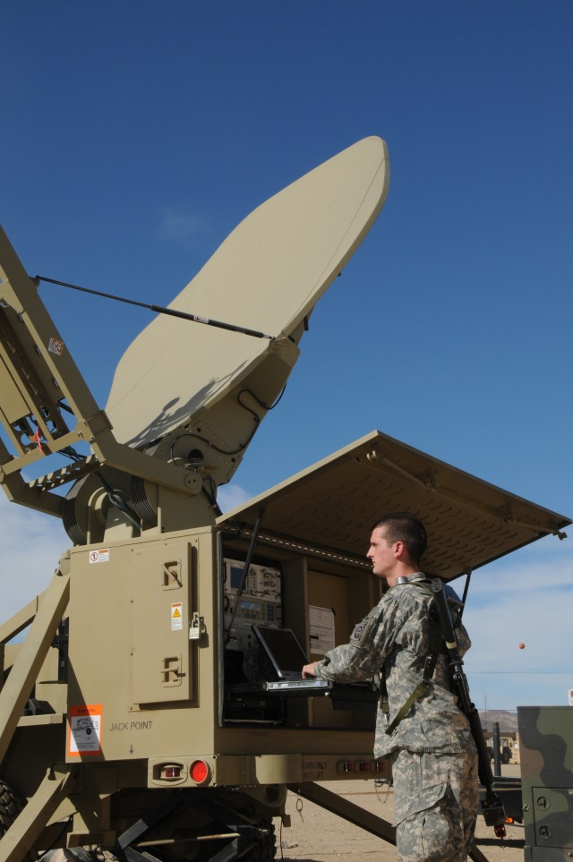
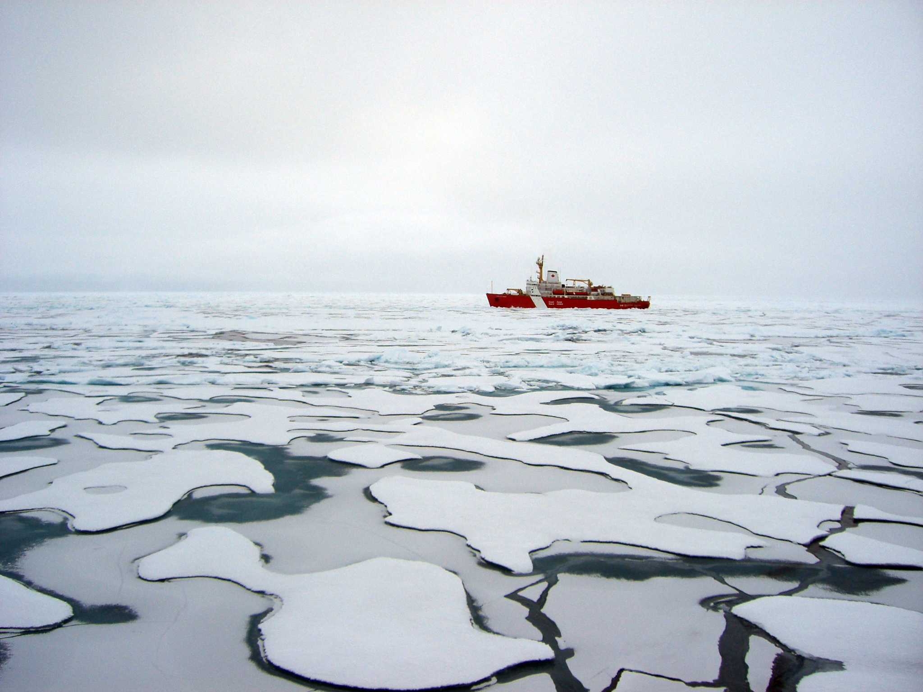
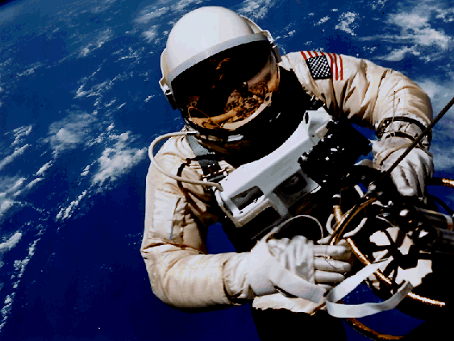
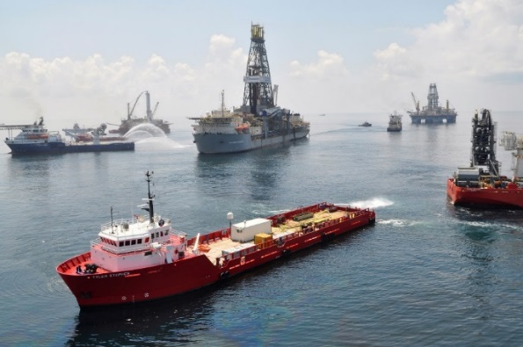
Space Weather Impacts are wide ranging Infrastructure and Activities Vital to National Security and the Economy
Satellite Malfunctions; Radiation Exposure; Power Outages; GPS Degradations
SATCOM Interference/Disruption; Satellite Drag; Communication Dropouts
Space weather-induced electricity blackout: Daily domestic economic loss in the U.S. = $41.5 billion plus an additional $7 billion loss through the international supply chain.
"Quantifying the daily economic impact of extreme space weather due to failure in electricity transmission infrastructure,” Centre for Risk Studies, University of Cambridge, Jan 2017

Slide 4
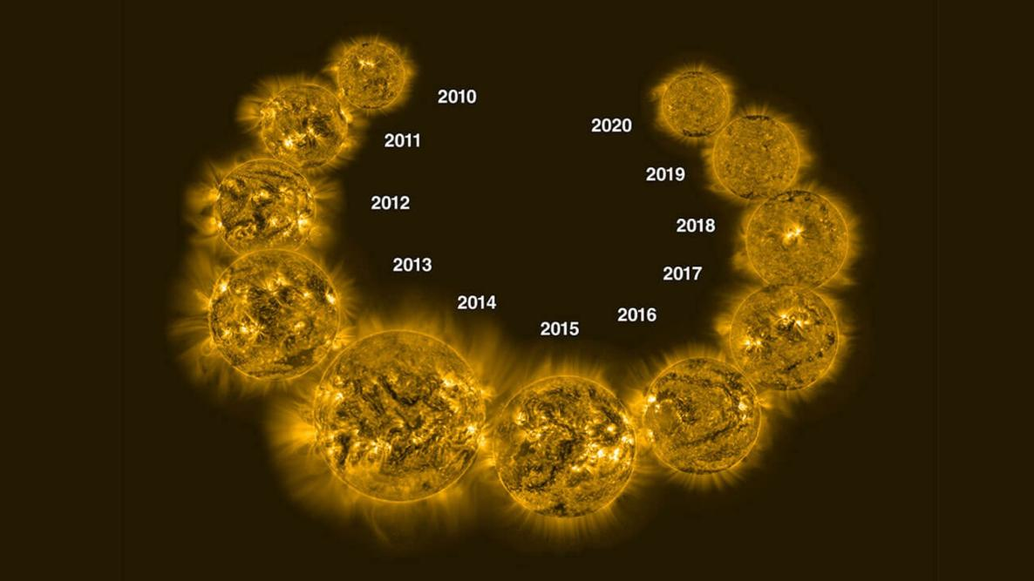
On average, every 11 years the Sun goes from quiet to active and back to more quiet. This is called the
“Solar Cycle”.

Slide 5
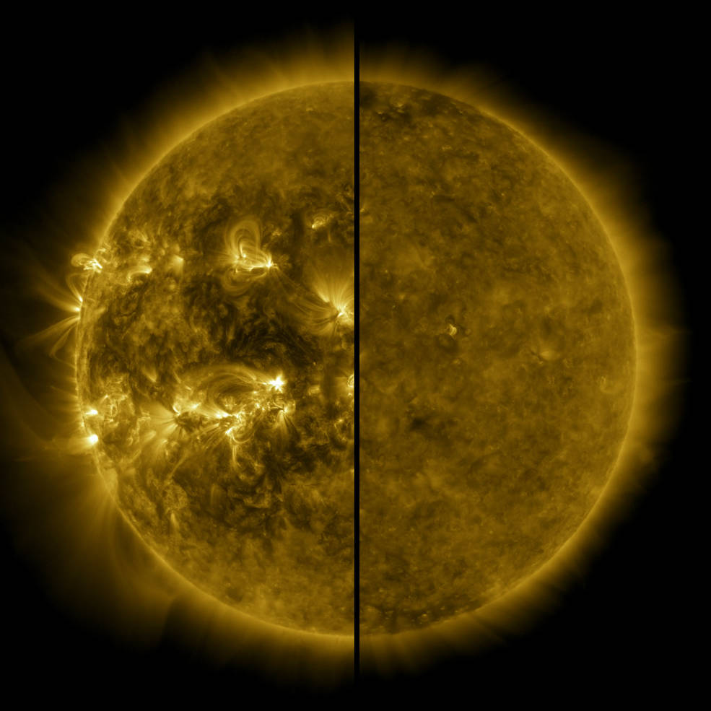
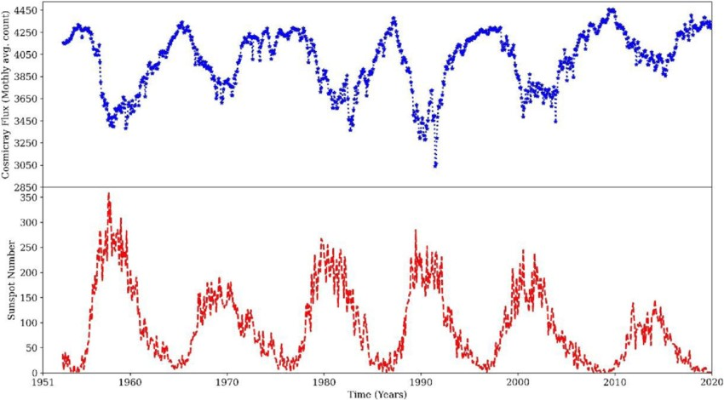
An increase in galactic cosmic rays occurs during solar minimum

Slide 6
Notes:
Mention about location importance for solar proton events.

Slide 7
NOAA Scale Forecast areas
Three main activities in SWPC forecasts (Flares, SPE, & Geomagnetic)
Satellite Community Relevant Impacts & Phenomena Based Forecasts
Solar Radiation Storms (S-scale) : related to Solar Proton Events
Geomagnetic Storms (G-scale): as related to origin source
Coronal Mass Ejection (CME), Coronal Hole (CH)
Radiation Storm Warnings and Alerts
Geomagnetic Storm Watches, Warnings, and Alerts
R 3
G 3
R 4
G 4
R 5
G 5
R 1
G 1
R 2
G 2
Notes:
There are other areas of focus, to include: electron flux, 10.7cm radio flux, solar wind changes – to name a few. But, the three primary areas put together in the 3-day forecast products include only these 3 areas. The forecast discussion product adds a forecast about electron flux and solar wind changes. Other products include 10.7cm flux forecast.

Slide 8
Other Forecast Focus Areas
Short and long range forecasts available
2 MeV Electron Flux @ 1000 pfu Alert
Forecast Discussion [twice a day]
- Electron Flux categorical forecast at GOES (normal, moderate, high, very high]
Joint USAF/NOAA Solar Geophysical Activity Report & Forecast [daily]
- Provides 3-day prediction of 10.7cm flux and daily Ap
27-Day Space Weather Outlook Table [weekly]
- Provides a day-by-day forecast out 27 days for 10.7cm flux and Ap
45-Day USAF Prediction [calculated and updated daily]
- Provides a day-by-day forecast for 10.7cm flux and Ap
Notes:
There are other areas of focus, to include: electron flux, 10.7cm radio flux, solar wind changes – to name a few. But, the three primary areas put together in the 3-day forecast products include only these 3 areas. The forecast discussion product adds a forecast about electron flux and solar wind changes. Other products include 10.7cm flux forecast.

Slide 9
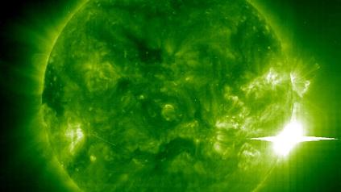
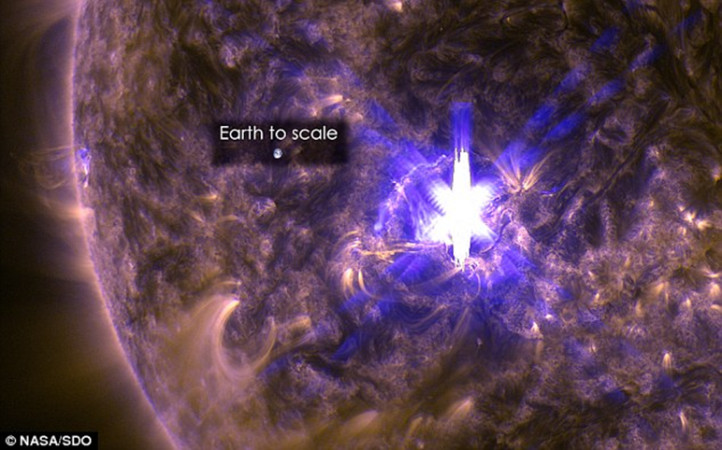
Solar Flares: great, sudden bursts of electromagnetic energy
that can immediately impact the sunlit side of Earth from minutes to hours. More intense flares can ionize the lower ionosphere (D-layer) and cause HF Radio Blackouts
X28
4 Nov 2003

Slide 10
Solar Flares:
Their X-ray energy strength correlates to the likelihood of radio interference on the sunlit side of Earth
Strong radio bursts on specific, discreet frequencies
of use may be temporarily impactful to
GNSS and satellite communications

Slide 11
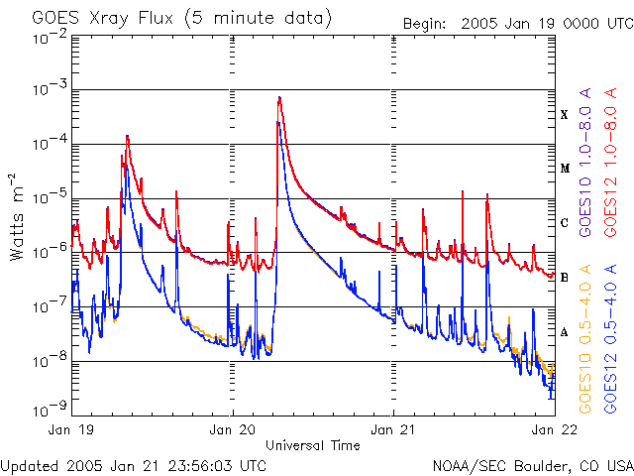
Solar Flares: intensity measured by X-ray flux as observed by
the NOAA GOES satellites. Probabilities forecasted for:
“C”: first notable flare level
“M”: minor to mod flares; (R1 - R2 on NOAA scale)
“X”: strong to extreme flares; (R3 to R5 on NOAA scale)
X20 and higher (R5)
X1 to X9X(R3)
X10 to X19 (R4)
**Rule of Thumb**
The higher the probability of M-class and X-class flares, the better chance for associated impactful events
“B” Background Flux
“A” Quiet Sun
Notes:
We issue an alert whenever the M5 (R2-Moderate) level is reached for a flare and issue summary reports after the flare is over for any flares that reached M5, X1, X10 or X20 and above. Anything above X17 is estimated because of sensor limitations on the GOES-15 and below platforms. However, GOES-16 and future platforms have a better calibrated sensor and the values above X17 will no longer be estimated. We forecast flare probabilities for C-class, M-class, and X-class events. During active periods of strong sunspot activity, the background flux can often be well into the C-level range – this would make us forecast C-class flare chances of 99%. We also focus on the soft xrays (longer wavelength 1.0 to 8.0 A) when determining flare intensity and timing.

Slide 12
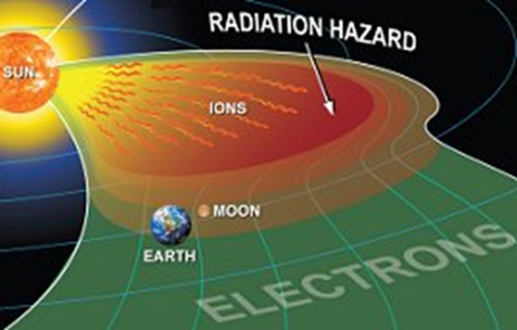
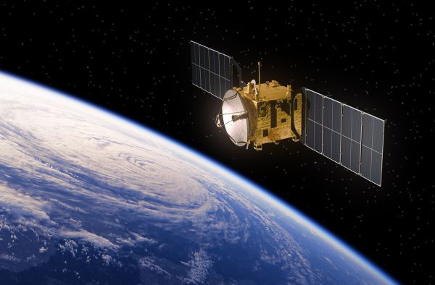
Solar Proton Events: enhancement in energetic proton flux (>10 MeV). Sources
are energetic solar eruptions; protons spiral out along magnetic field lines at near relativistic speeds. Can reach Earth in 10’s of minutes. SWPC forecasts probability of events at the 10 MeV levels and as it correlates to Solar Radiation Storms
May adversely affect satellites;
increased risk to single event upsets
X28
4 Nov 2003
Notes:
Energetic protons are more a result of CME dynamics as opposed to flare dynamics. We have no observable or immediate model means of determining whether a proton event was launched (and Earth-directed) when we detect the associated flare. We have a statistical-based model that we quickly input some observed values to help determine whether a proton event is possible and how soon. However, we really don’t know whether a radiation storm is taking place until the protons begin getting picked up by the GOES sensors. We do not issue Watches for these events – but we do have limited capability to issue a warning.

Slide 13
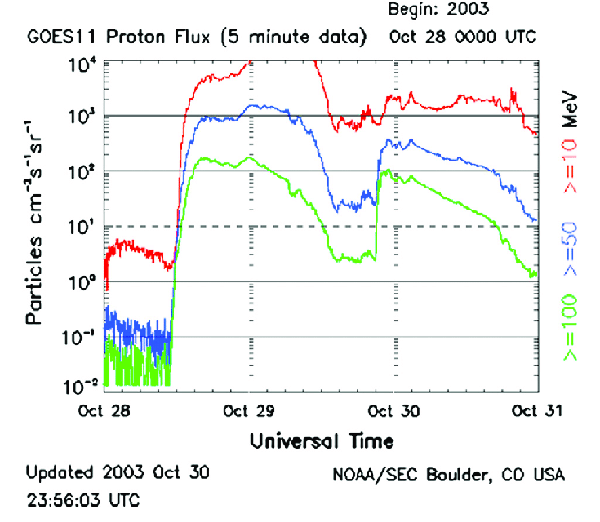
Solar Proton Events: intensity measured by the GOES satellites. SWPC does not issue Watches for these events. Warnings are issued, however, only for the 10 MeV at 10 particle flux units (pfu) and for 100 MeV at 1 pfu. Unfortunately, due to the potential speed of these events, warning time can be short.
10 MeV at 100,000 (S5)
10 MeV at 10,000 (S4)
10 MeV at 1000 (S3)
10 MeV at 100 (S2)
Alert issued at
each S1 – S5
level:
10 MeV at 10 (S1)
X28
4 Nov 2003
Notes:
Energetic protons are more a result of CME dynamics as opposed to flare dynamics. We have no observable or immediate model means of determining whether a proton event was launched (and Earth-directed) when we detect the associated flare. We have a statistical-based model that we quickly input some observed values to help determine whether a proton event is possible and how soon. However, we really don’t know whether a radiation storm is taking place until the protons begin getting picked up by the GOES sensors. We do not issue Watches for these events – but we do have limited capability to issue a warning.

Slide 14
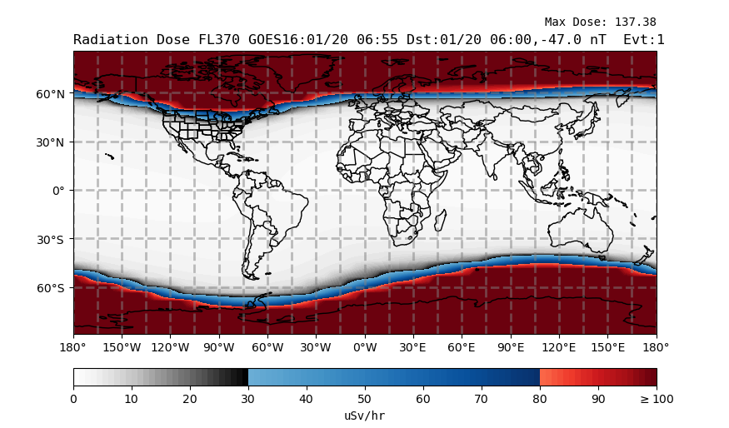
Solar Proton Events and relationship to Solar Radiation Storms as correlated to Earth’s magnetic field total intensity.
There is an offset of the geomagnetic and geographic pole. The impact of these events are restricted to the higher North/South latitudes.
Further South Progression
CARI-7 model
X28
4 Nov 2003
Notes:
Energetic protons are more a result of CME dynamics as opposed to flare dynamics. We have no observable or immediate model means of determining whether a proton event was launched (and Earth-directed) when we detect the associated flare. We have a statistical-based model that we quickly input some observed values to help determine whether a proton event is possible and how soon. However, we really don’t know whether a radiation storm is taking place until the protons begin getting picked up by the GOES sensors. We do not issue Watches for these events – but we do have limited capability to issue a warning.

Slide 15
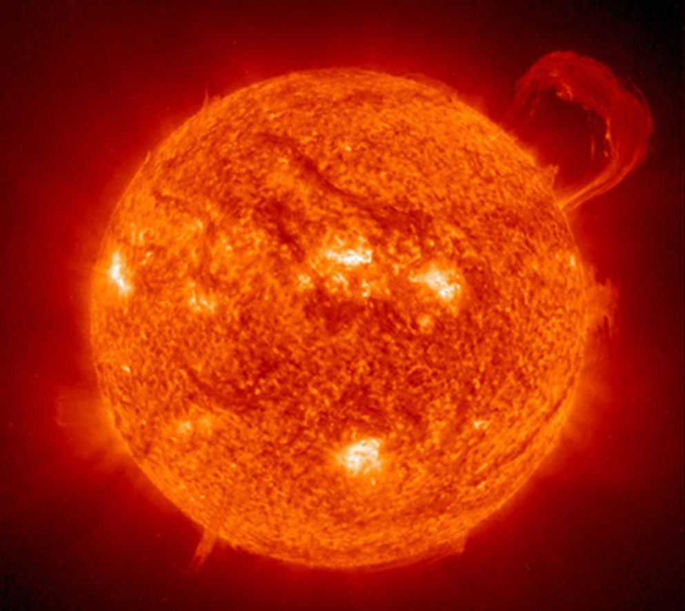
Solar plasma can be suspended
and held in place by magnetic field lines. Prominences are seen along the limb of Sun; Filaments are same thing but seen on the disk.
Filament
Prominence

Slide 16
Filament Prominence Eruptions:
carry solar plasma and a strong magnetic field along with it.
Not often correlated with solar radiation storms and usually not associated with most severe or extreme geomagnetic storms
NASA SDO

Slide 17
Coronal Mass Ejection (CME):
tremendous expulsions of solar material from or
through the solar corona, carrying embedded magnetic fields.
Their impact to our magnetosphere can cause major
changes resulting in Geomagnetic Storms
Located at the L1 orbital location
NASA SOHO

Slide 18
Full Halo CME
Fastest
Earth-directed CMEs can get here in 15 hours. Usually, they are slower and take 2 to 4 days.
Imagery: NASA/SOHO

Slide 19
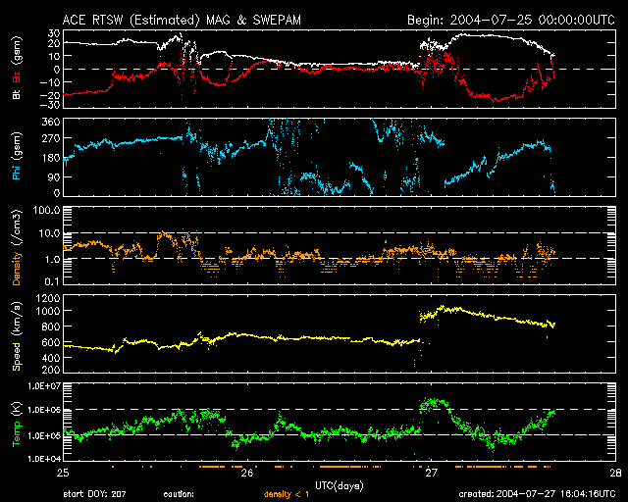
Satellites (DSCOVR & ACE) in orbits between
the Earth and Sun at L1, are monitored for
solar wind changes that indicate CME arrival
Interplanetary Shock Arrival
Magnetic
Cloud
Any appropriate Warnings are issued upon CME arrival – sometimes beginning with shock arrival and Sudden Impulse Warning.
Notes:
The DSCOVR platform was our primary, new NOAA-operational satellite for monitoring solar wind conditions; however, there has been a problem with the spacecraft and we are now back to using the NASA research satellite ACE. Additionally, the NASA research satellite SOHO has a coronagraph and is our primary (really only means) method of confirming a CME has taken place. We can than measure the optical parameters of the CME and inject it into the supercomputer out east in order to get a returned model output of any Earth-directed component, speed and arrival time. These spacecraft are at an orbital point called the Lagrange point (L1) about 1M miles from Earth and always in between the Earth and the Sun. ACE/DSCOVR are like are buoys and SOHO is our optical observatory for seeing if a CME took place.

Slide 20
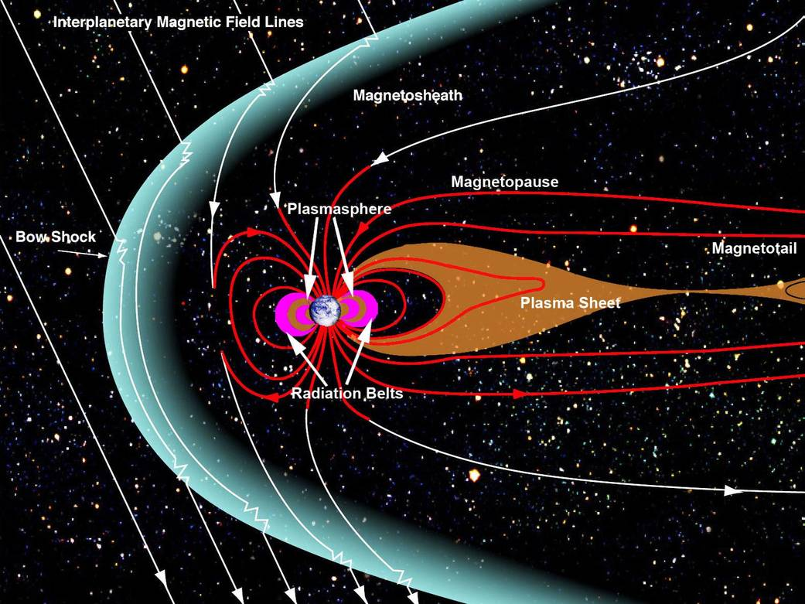
GEOMAGNETIC STORMS
When a CME strikes and envelopes Earth’s magnetic field, storms may begin. In particular, if the CME mag field connects with Earth’s.
Image Credit: NASA/Goddard/Aaron Kaasse https://www.nasa.gov/mission_pages/sunearth/science/magnetosphere2.html

Slide 21
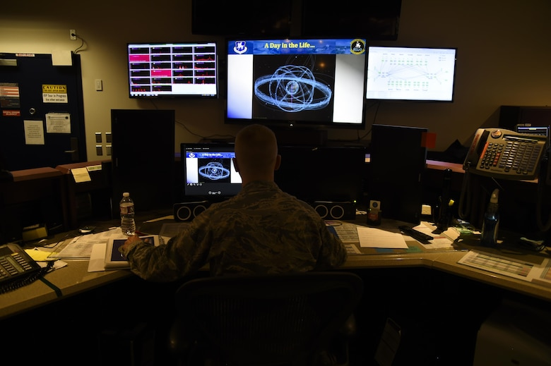
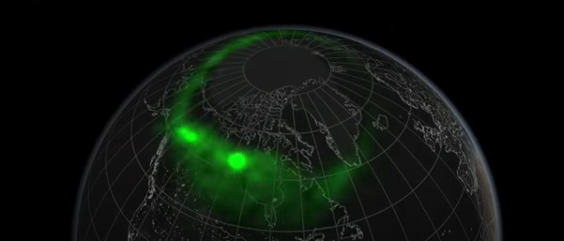
GEOMAGNETIC STORMS
… and can lead to ionosphere and thermospheric storms that may impact SATCOM, GNSS, satellite drag, and more

Slide 22
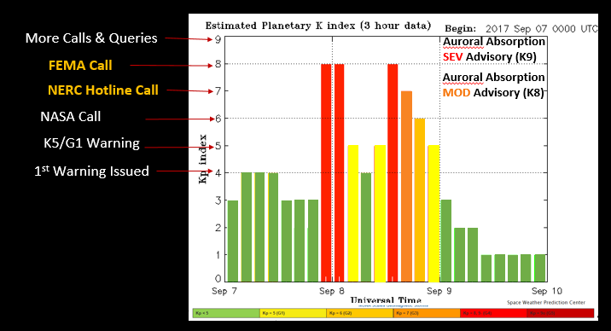
Geomagnetic Storms: Forecast probabilities and intensities out 3 days
One geomagnetic storm event – but with varying levels of intensity throughout. There could be periods of very intense reaction at any point during the storm; regardless of the final 3-hr value estimate
Warnings issued for
Kp 4 up to
Kp 7 and greater
Estimated in real-time; with a final value attributed at the end of each 3-hour period. This can cause confusion, because we may not reach expected levels every 3 hours. Think of it like a rain gauge being emptied every 3 hours – but the heavy rain event continues, with varying amounts of precipitation rates
Alerts issued at
each Kp level
Based on Estimated Planetary K-index (8 magnetometer stations).
Kp5 = G1; Kp6 = G2; Kp7 = G3; Kp8-K9m = G4; Kp9z = G5
*each Kp level divided into three levels: m (-); z (0); and p (+)

Slide 23
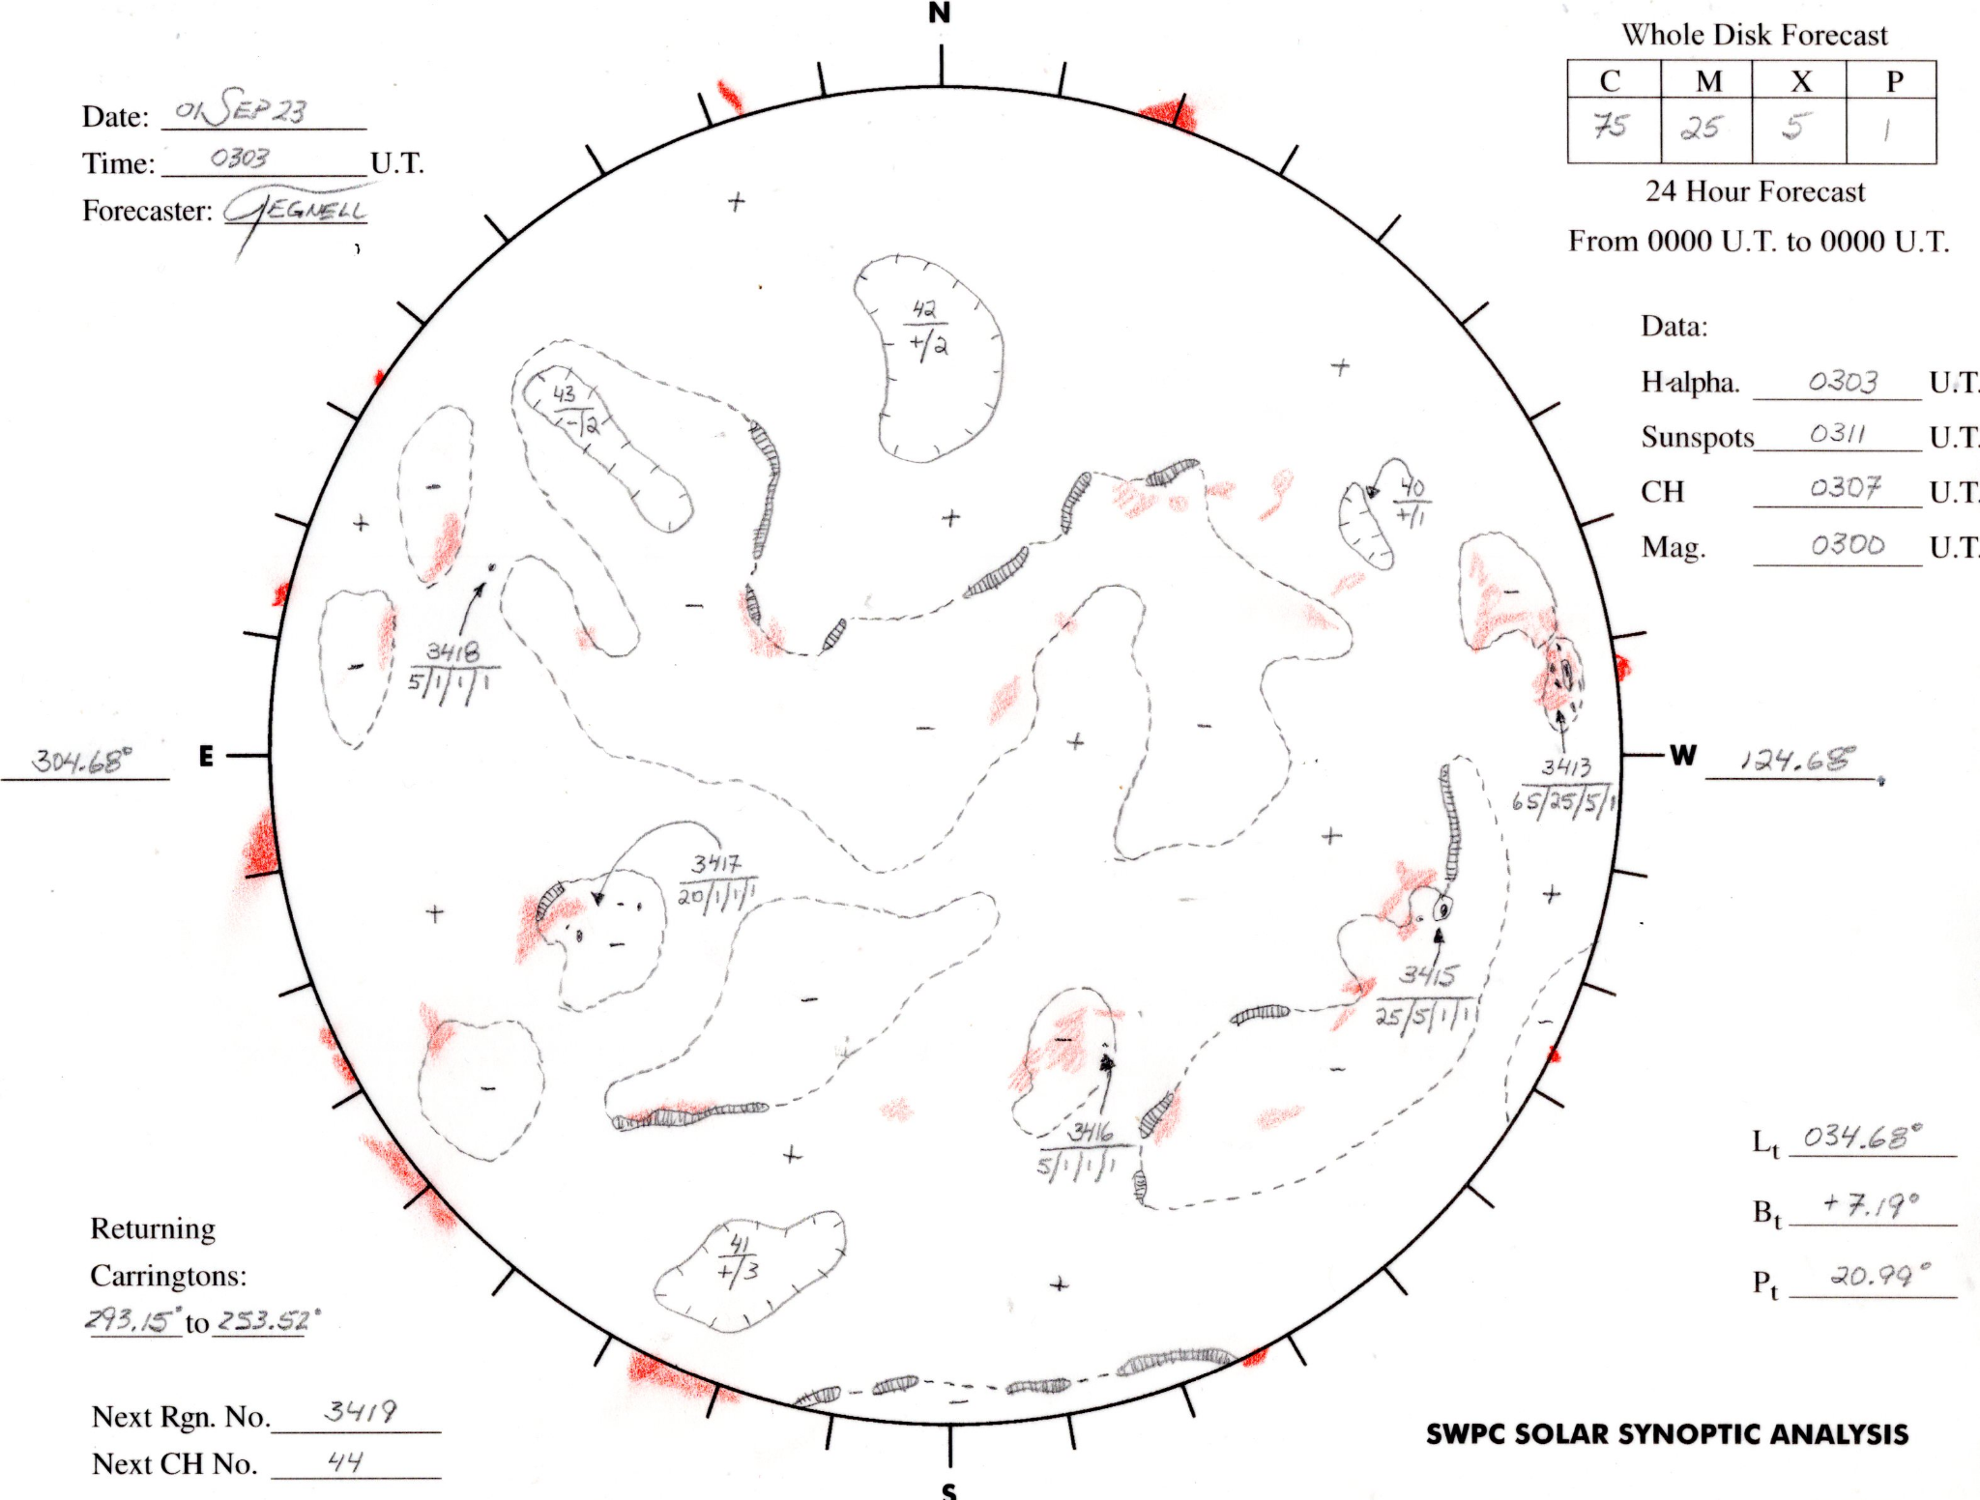
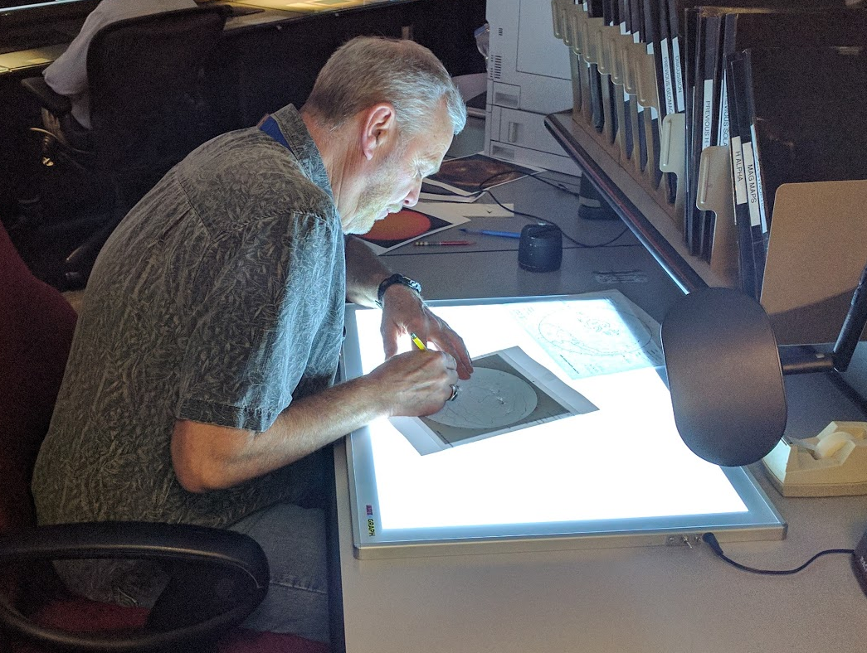
Probabilistic Forecasts - the 3-day & 3-day Geomagnetic

Slide 24
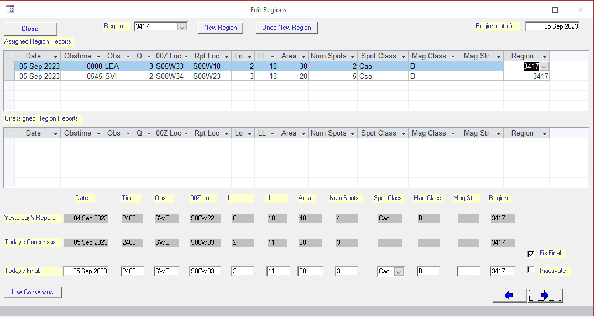
Probabilistic Forecasts - the SGARF (RSGA) and the 3-day
Building the Solar Region Summary:
Examine region reports from USAF observatories
Determine most representative classificaiton based on trends.
Number and classify new regions
Perform on-the-spot quality control for each region

Slide 25
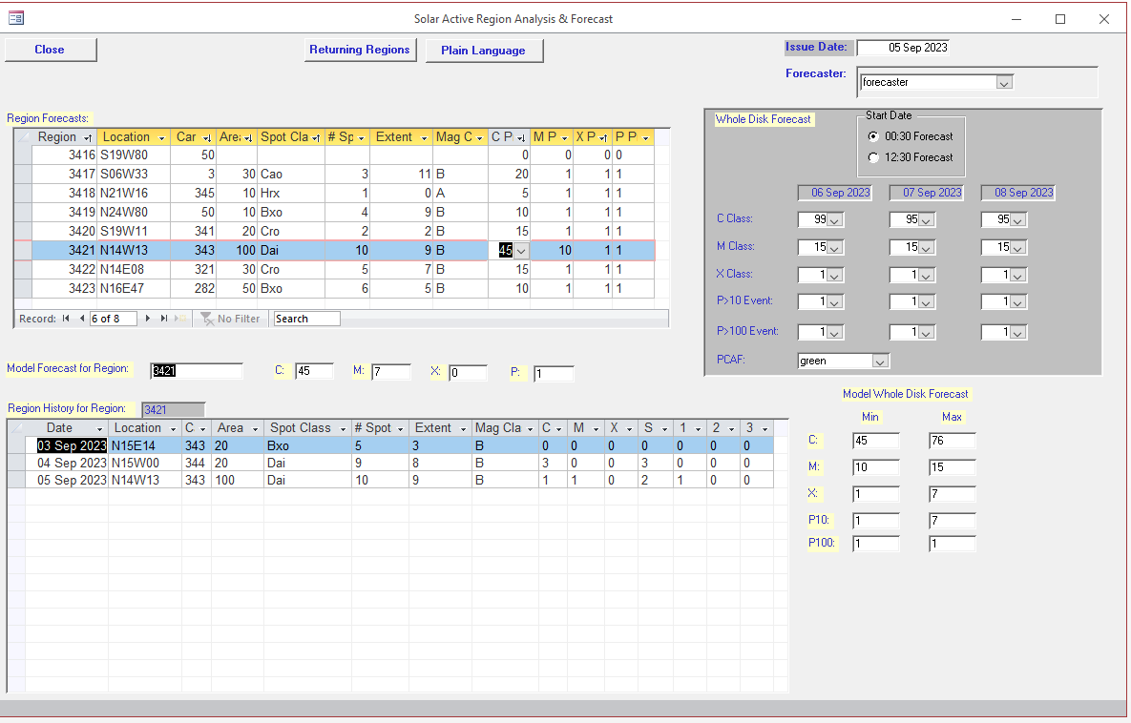
Probabilistic Forecasts - the SGARF (RSGA) and the 3-day
Create probabilistic forecast based on:
McIntosh classification
Magnetic Complexity
Trends
Location

Slide 26
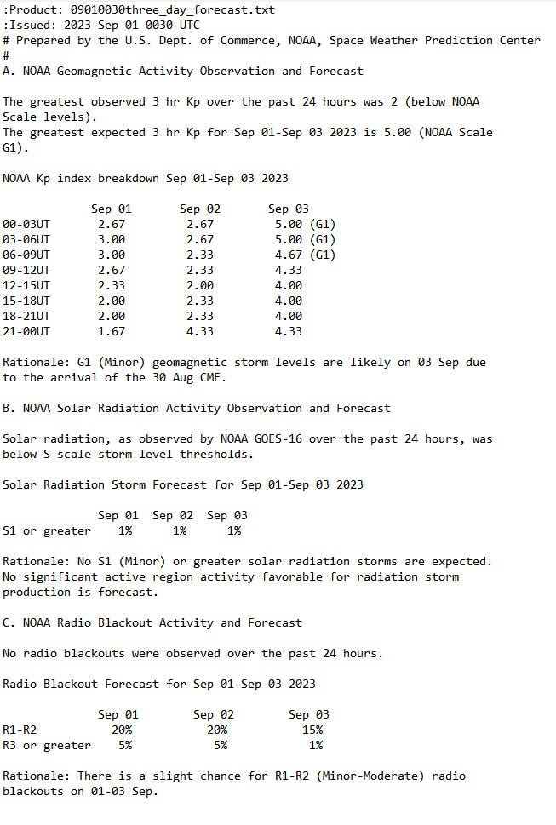
Probabilistic Forecasts - the 3-day
Geomag
Geomag
Radiation
Flares

Slide 27
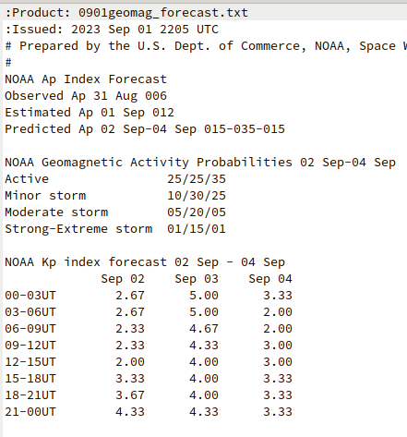
Probabilistic Forecasts - the 3-Day GEOMAGNETICnd the
Ap Deterministic
Probabilistic based on ISES Definitions
Kp Deter-ministic

Slide 28
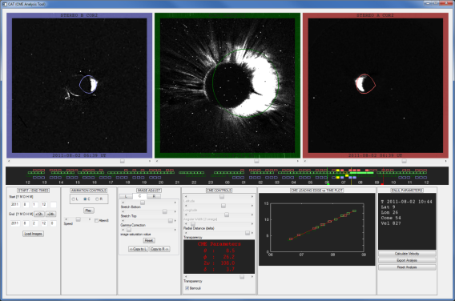
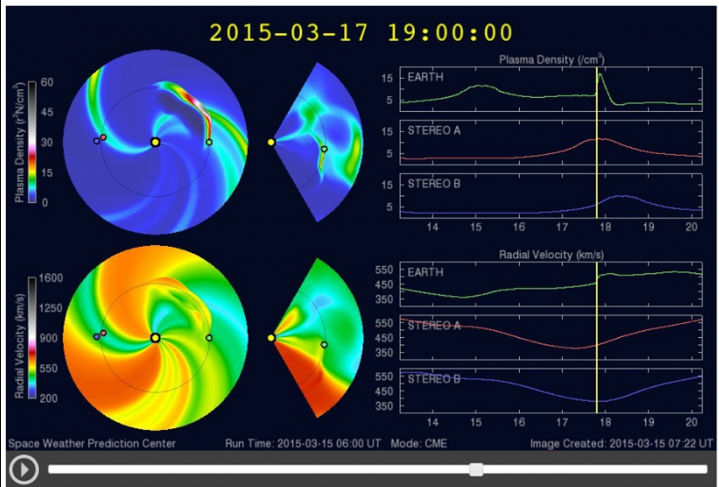
Forecasters “fit” CMEs to obtain parameters for WSA-Enlil model run
CME
arrival
Compact
Less Lengthy
Magnetic Field Mixed

Slide 29
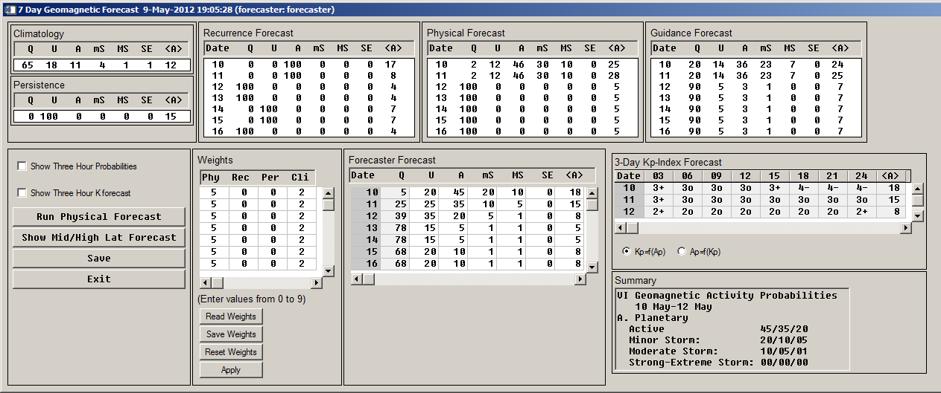
3-Day Geomagnetic Forecast Development
Geomagnetic forecast integrates:
Climatology
Persistence
27-Day Recurrence
Physical Forecast (Fast Streams & CMEs)
Timing influenced by WSA-Enlil model guidance
Compact
Less Lengthy
Magnetic Field Mixed

Slide 30
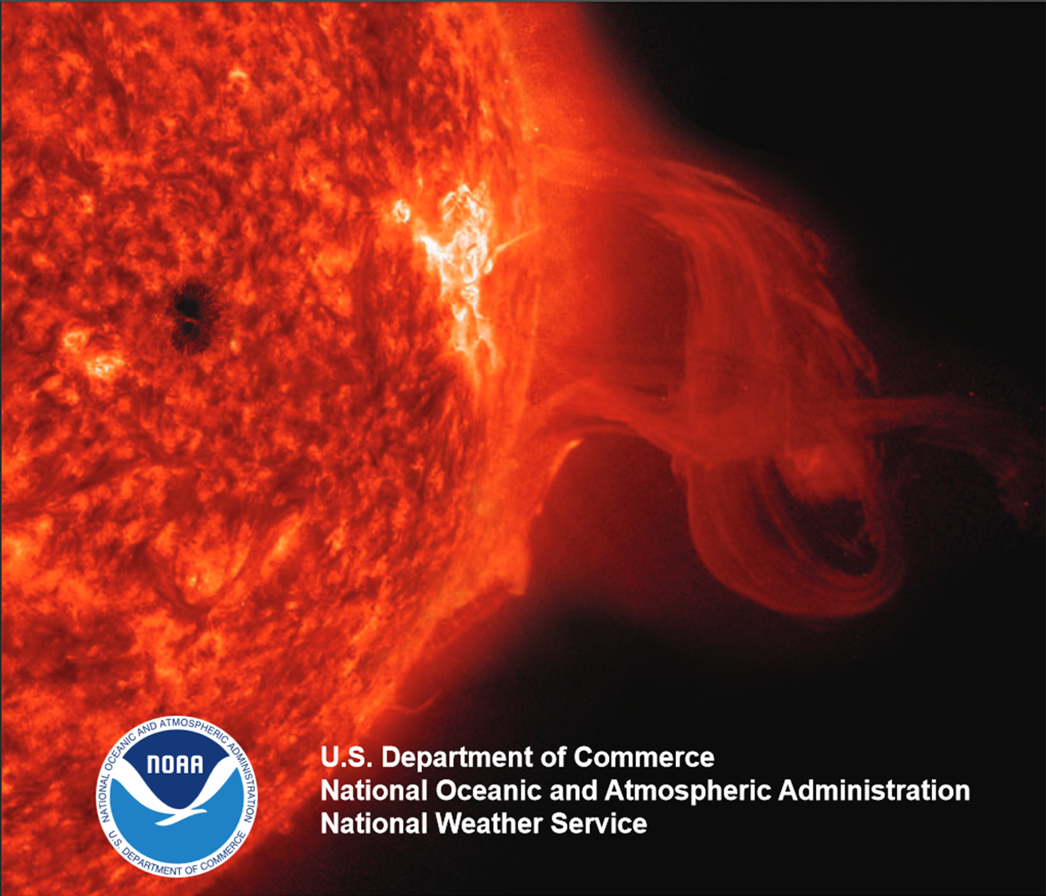
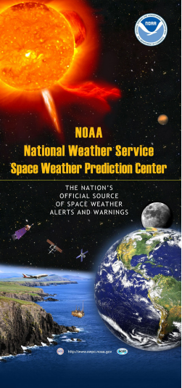
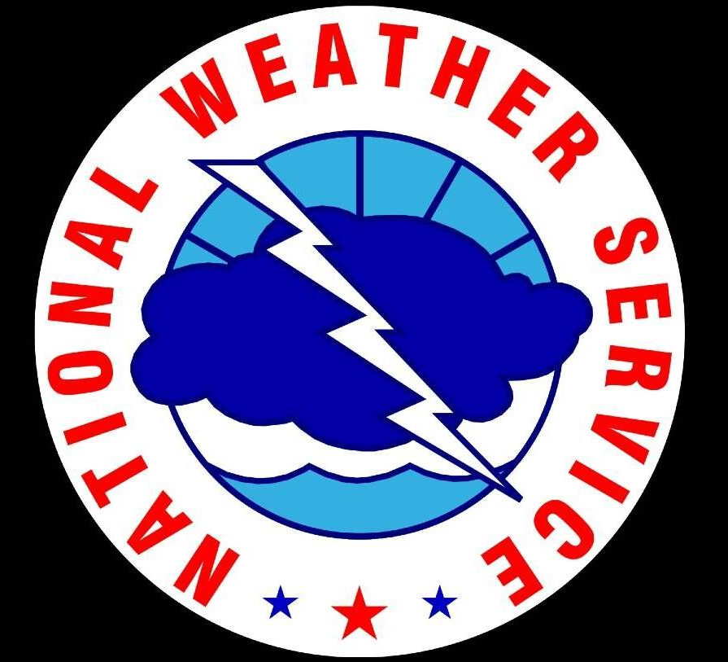
ALERT
WARNING
WATCH
event detected;
in progress
G1-G5; S1-S5; >M5 flare (R2)
event imminent; minutes to hours notice
(G1-G3+); and S1 Events
event potential;
1-3 days in advance
(G1-G4+)
G5
G4
G3
G2
G1

Slide 31
Sequence of Space Weather Events
Geo-
magnetic Storm
Alert
Warning
Watch
CME
Analysis and Modeling¹
NOTES:
Coronagraph Imagery Essential for Modeling can be delayed up to 17 hours
Forecasts Issued every 12 hours at:
1230 UTC - 0830 EDT
0030 UTC - 2030 EDT
Protons
Warning
Alert
Radio
Alert
X-ray Flare
Alert
1 Min
10 Mins
1 Hr
10 Hr²
1 Day
10 Days
Notes:
Type-II as first hack? Slop in estimates?
Plane of sky speed as first hack? (requires imagery - STEREO?)

Slide 32
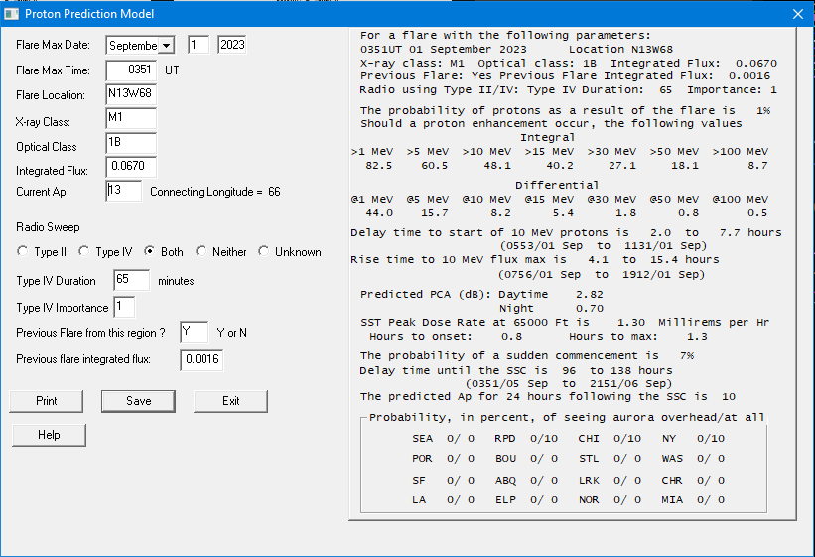
Warning - Alert - Summary
Proton Prediction Inputs:
Flare Maximum Time
Flare Location
X-ray Class
Optical Class
Integrated Flux
Current AP
Radio Sweeps
Type IV duration & importance
Previous Flare & Integrated Flux

Slide 33
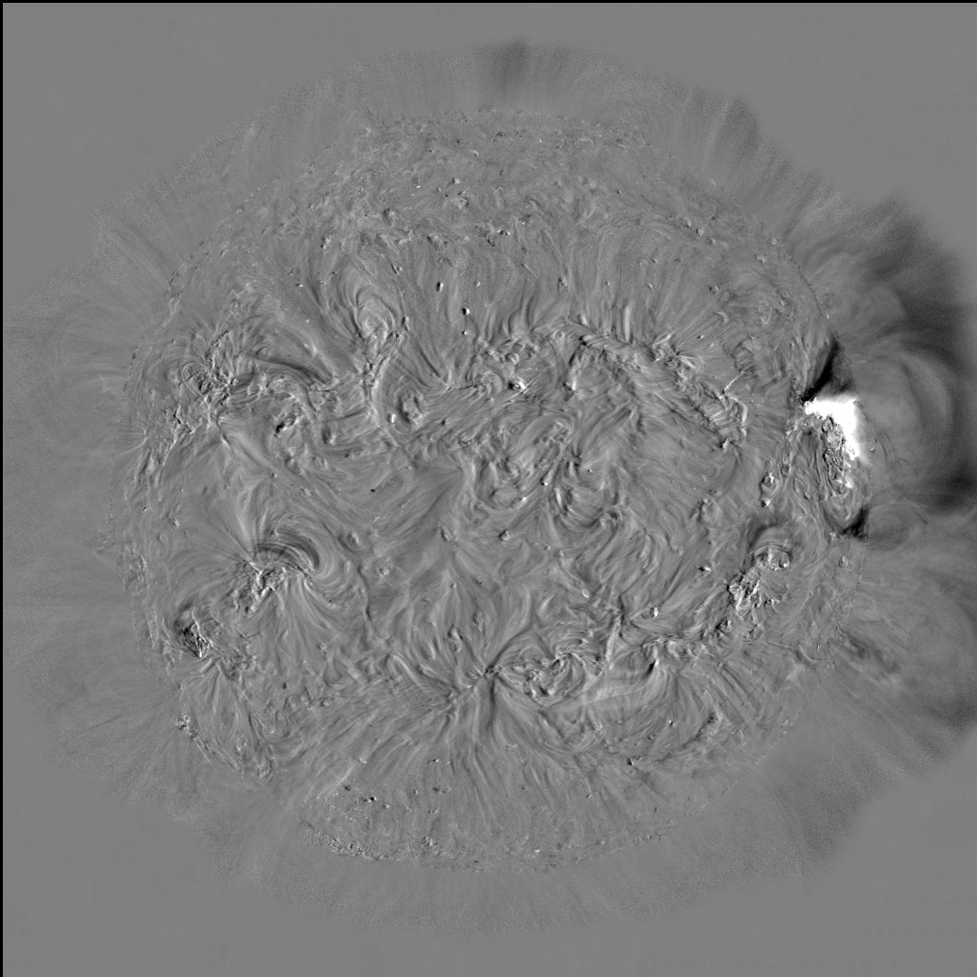
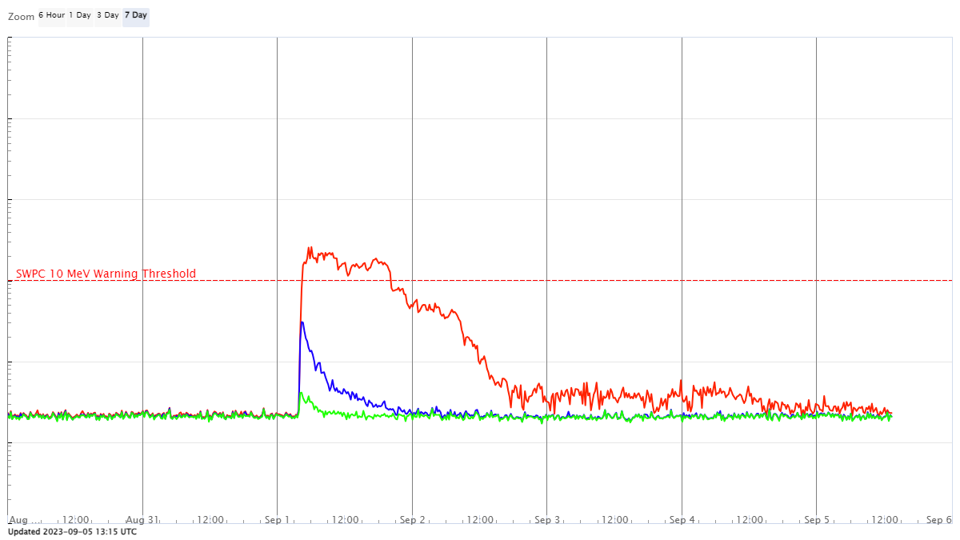
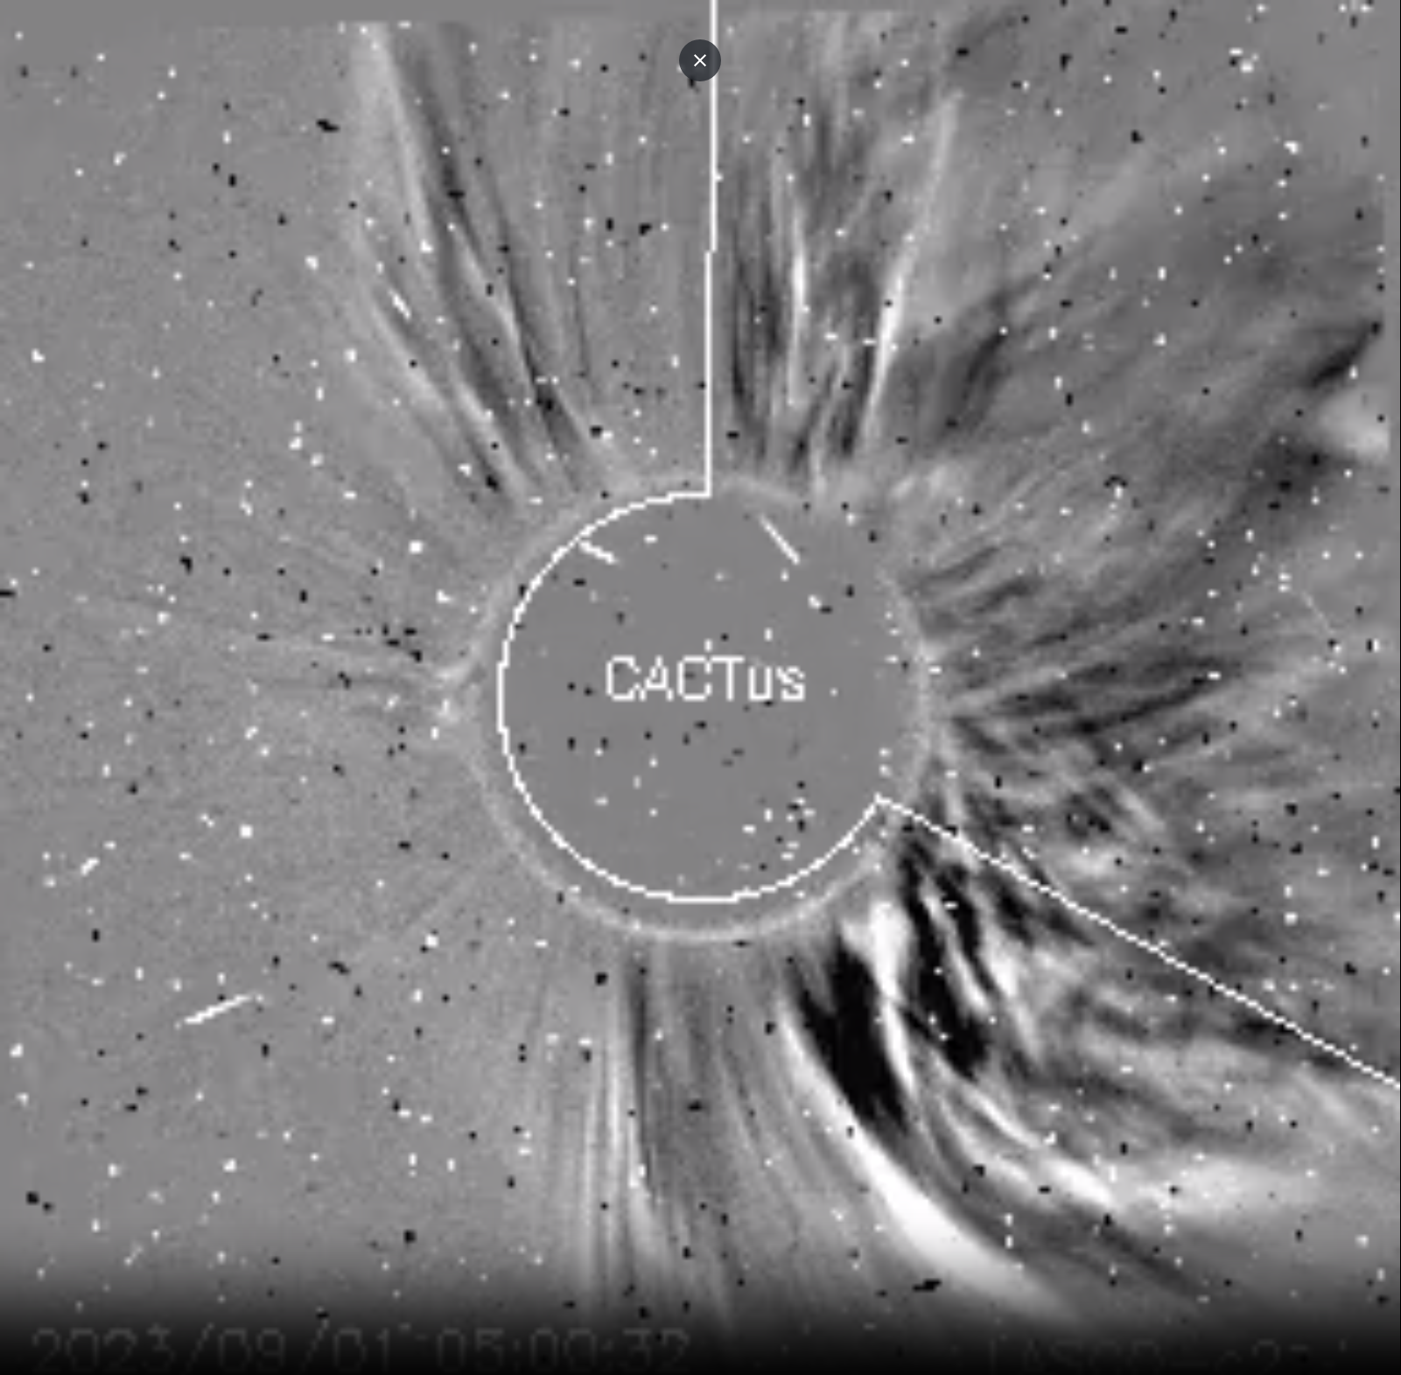
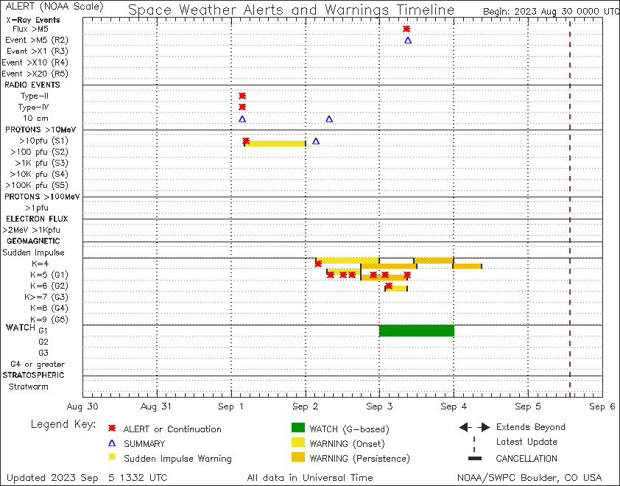
Warning - Alert - Summary
Space Weather Message Code: SUMPX1
Serial Number: 104
Issue Time: 2023 Sep 02 0326 UTC
SUMMARY: Proton Event 10MeV Integral Flux exceeded 10pfu
Begin Time: 2023 Sep 01 0430 UTC
Maximum Time: 2023 Sep 01 0610 UTC
End Time: 2023 Sep 01 2010 UTC
Maximum 10MeV Flux: 25 pfu
NOAA Scale: S1 - Minor
NOAA Space Weather Scale descriptions can be found at
www.swpc.noaa.gov/noaa-scales-explanation
--------------------------------------------------------------------------------
Space Weather Message Code: ALTPX1
Serial Number: 338
Issue Time: 2023 Sep 01 0446 UTC
ALERT: Proton Event 10MeV Integral Flux exceeded 10pfu
Begin Time: 2023 Sep 01 0430 UTC
NOAA Scale: S1 - Minor
NOAA Space Weather Scale descriptions can be found at
www.swpc.noaa.gov/noaa-scales-explanation
Potential Impacts: Radio - Minor impacts on polar HF (high frequency) radio propagation resulting in fades at lower frequencies.
--------------------------------------------------------------------------------
Space Weather Message Code: WARPX1
Serial Number: 527
Issue Time: 2023 Sep 01 0419 UTC
WARNING: Proton 10MeV Integral Flux above 10pfu expected
Valid From: 2023 Sep 01 0425 UTC
Valid To: 2023 Sep 01 2359 UTC
Warning Condition: Onset
Predicted NOAA Scale: S1 - Minor
NOAA Space Weather Scale descriptions can be found at
www.swpc.noaa.gov/noaa-scales-explanation
Potential Impacts: Radio - Minor impacts on polar HF (high frequency) radio propagation resulting in fades at lower frequencies.
--------------------------------------------------------------------------------
3
2
1

Slide 34
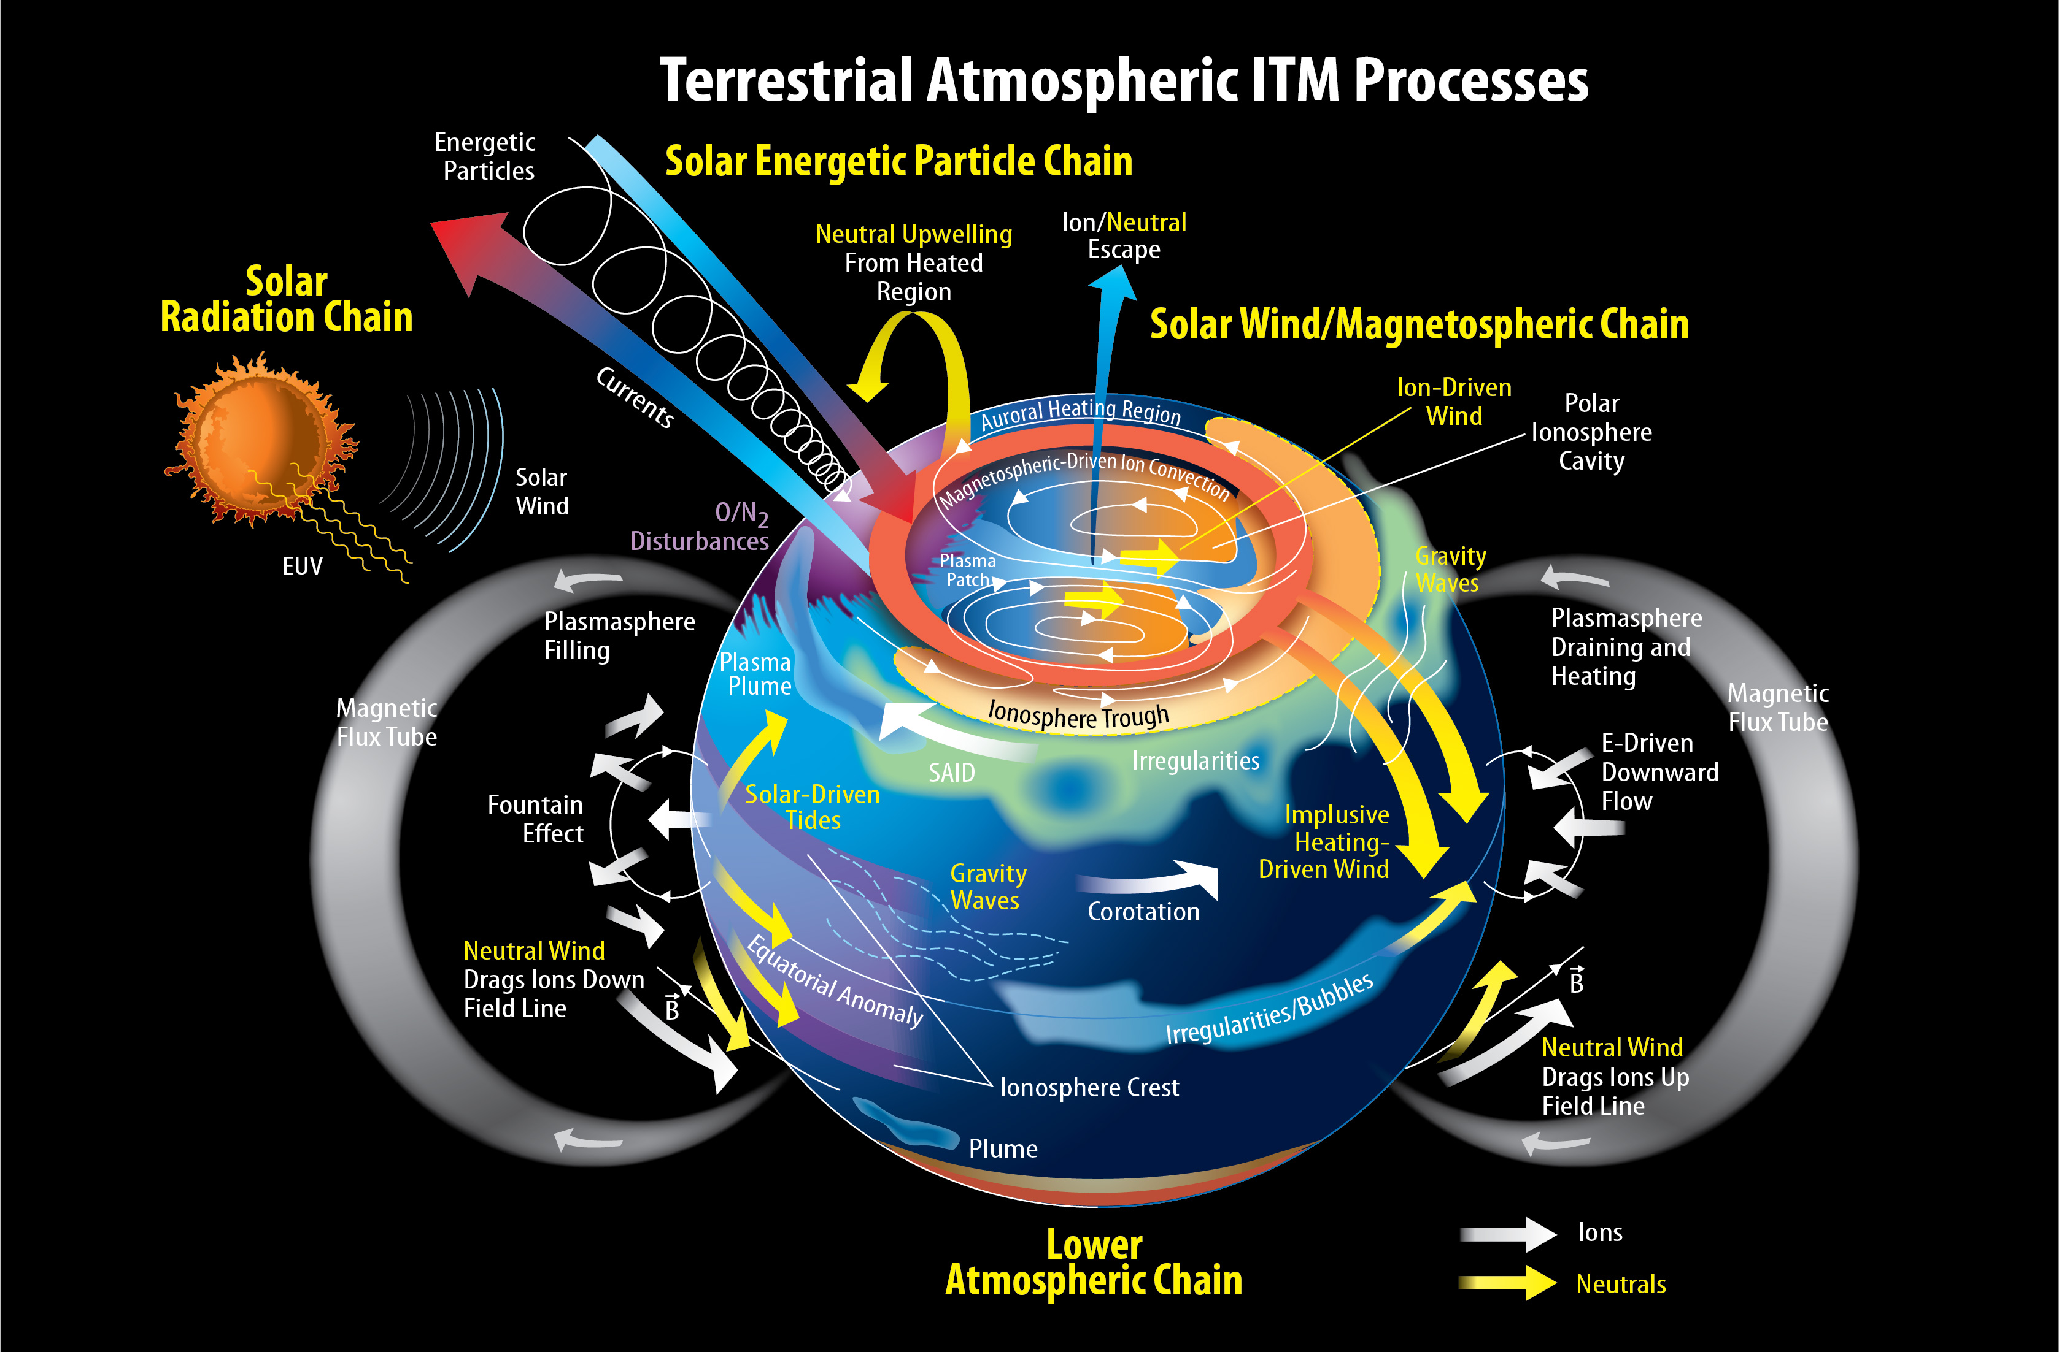
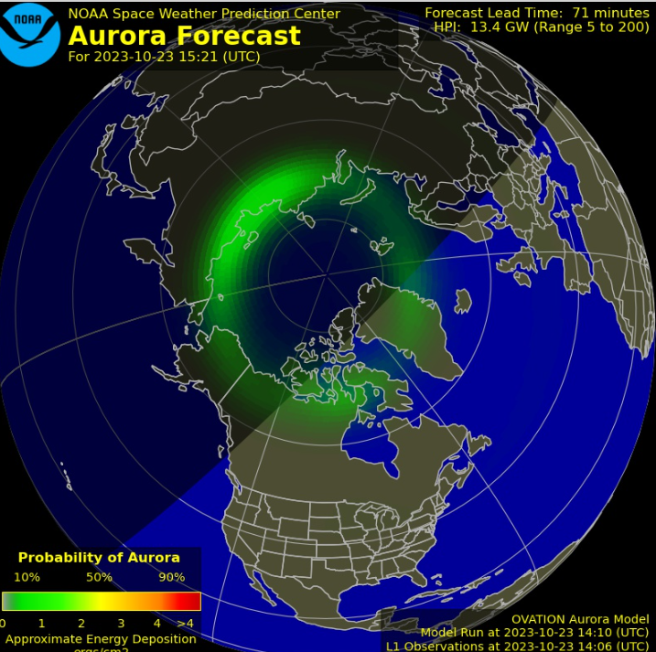
Ionosphere and Thermosphere Impacts
OVATION Model
Quiet Conditions
Kp 9 Condition (simulation)
Aurora, GNSS PNT, SATCOM, Aviation, Satellite Drag
Notes:
there are various complex physics that would start to impact the ionosphere and thermosphere, which impact GNSS PNT (position, navigation, timing), Satellite Communications, Aviation, and enhance the satellite drag. You can also say Tzu-Wei and Tim will cover most of the satellite drag impact in the following sessions.

Slide 35
SWPC Satellite Dashboard

Slide 36
Thank You!
POCs for your questions or needs
Bill Murtagh
william.murtagh@noaa.gov
Rob Steenburgh
robert.steenburgh@noaa.gov
Shawn Dahl
shawn.dahl@noaa.gov
“Safeguarding Society with Actionable Space Weather Information”
Notes:
As an emergency manager I am interested in: what do the warnings mean? How is this relevant to me?
which dashboard should we look at and how to understand?
how are we affected?
what actions should EMA take, the public take?

