Slide 1
Impact of Space Weather on Satellite Drag
Tim Fuller-Rowell
Tzu-Wei Fang
NOAA Space Weather Prediction Center, USA

Slide 2
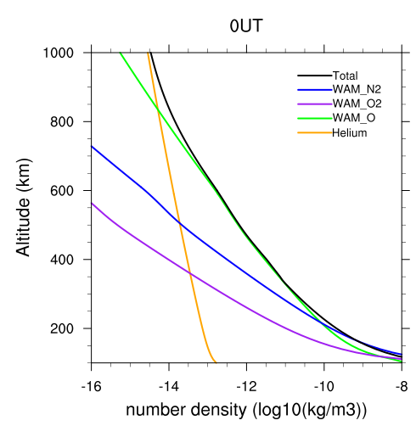
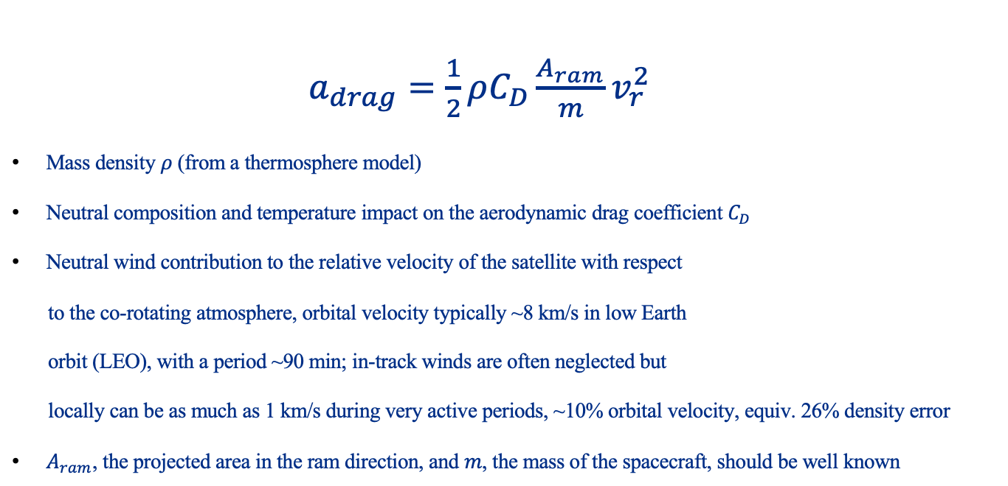
Impact of the Atmosphere on Satellite Drag
$a_{drag}=\frac{1}{2}ρ{C_{D}\frac{A_{ram}}{m}v}_{r}^{2}$
Mass density $ρ$ (from a thermosphere model)
Neutral composition and temperature impact on the aerodynamic drag coefficient $C_{D}$
Neutral wind contribution to the relative velocity of the satellite with respect
to the co-rotating atmosphere, orbital velocity typically ~8 km/s in low Earth
orbit (LEO), with a period ~90 min; in-track winds are often neglected but
locally can be as much as 1 km/s during very active periods, ~10% orbital velocity, equiv. 26% density error
$A_{ram}$, the projected area in the ram direction, and $m$, the mass of the spacecraft, should be well known
Species Mass Densities vs Height
He
O
N₂
2

Slide 3
Space Weather Impact on Neutral Density
Orbit averaged neutral density impacts satellite orbit prediction and collision avoidance
Localized structure and temporal changes in the neutral density experienced by satellite can be ~50% enhancements
Two main drivers of neutral density:
  Solar heating, which varies over a solar rotation and over the 11-year solar cycle (NOAA SWPC uses observations of F10.7cm from Penticton, and produces a routine 3-day the forecast)
  Impulse changes during geomagnetic storms (NOAA SWPC G-Scale and Kp forecast)
  Response to solar flares (R-Scale), solar radiation storm (S-Scale), are general small
Empirical models: good average neutral density conditions in response to changes in the solar cycle (solar radiative heating of the upper atmosphere). They tend to underestimate the response to geomagnetic activity and don’t capture the structure and temporal changes well – together these can represent an underestimate in localized density by 100% (factor 2)
3

Slide 4
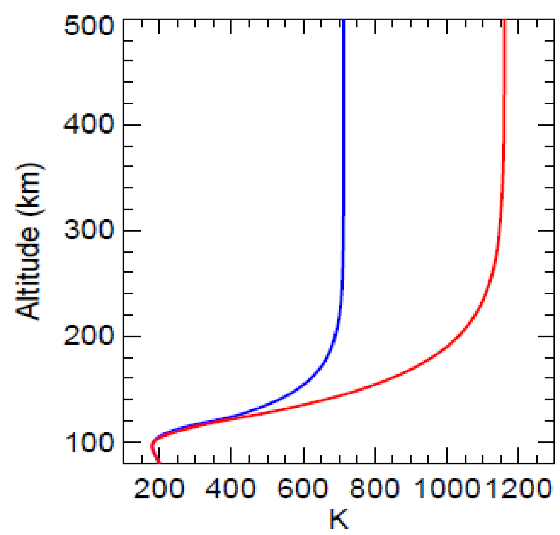
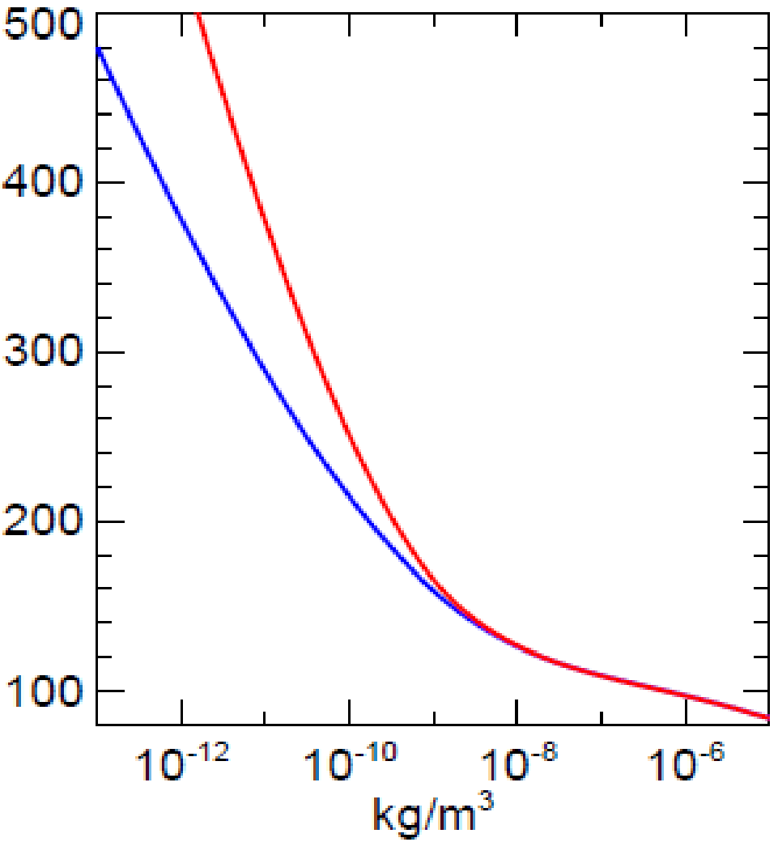
Solar Cycle: Thermal Heating and Atmospheric Expansion
Global average temperature profiles of the thermosphere
over the 11-year solar cycle
Changes in thermospheric mass density over the 11-year solar cycle
700 K
Mass density increase
>10 times over solar cycle
at 400 km altitude
1150 K
400 km
Neutral Density vs F10.7
Solar Min
F10.7 ~70
Solar Max
F10.7 ~200
Solar Max
F10.7 ~200
EUV radiation heat source correlated well with average of daily F10.7 and 81-day average of F10.7
Solar Min
F10.7 ~70
Log scale
4

Slide 5
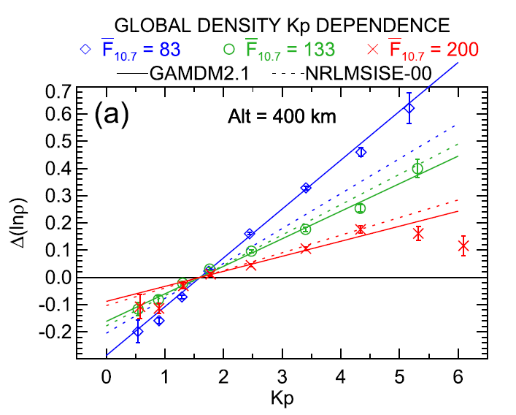
Geomagnetic Activity Impact on Neutral Density
A shorter-term response - figure shows the relative global response from an empirical model to a 3-4-day average of Kp, 60 to 100% increase – relative response is strongest at solar minimum
A major storm can increase neutral density at 400 km by 500% in one day (e.g., Nov 2003)
A physical model can follow the latitude and temporal response
Strength of a geomagnetic storm often described by D_{st} (ring current index) – which represents the time integrated energy input from the solar wind/magnetospheric driver
0.7 ≡ 100%
0.4 ≡ 50%
Emmert, ASR, 2015
(3-4-day average)
5

Slide 6
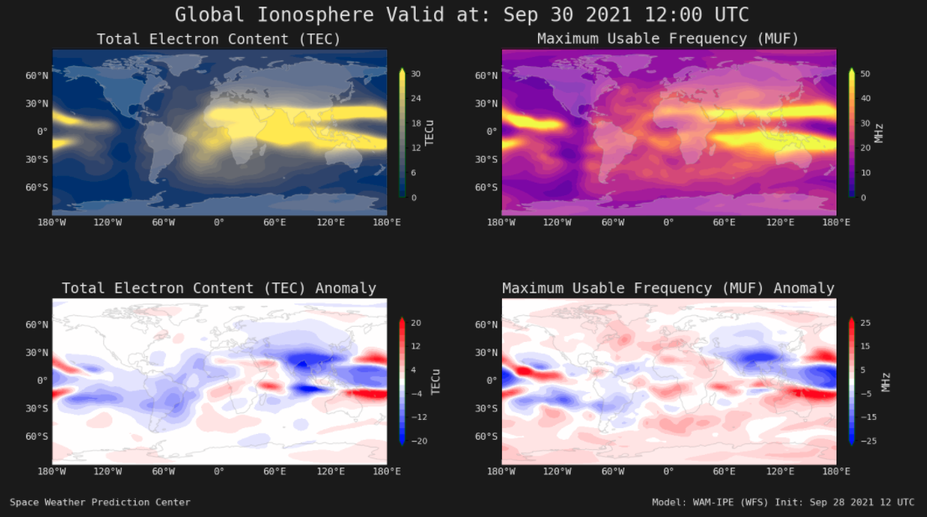
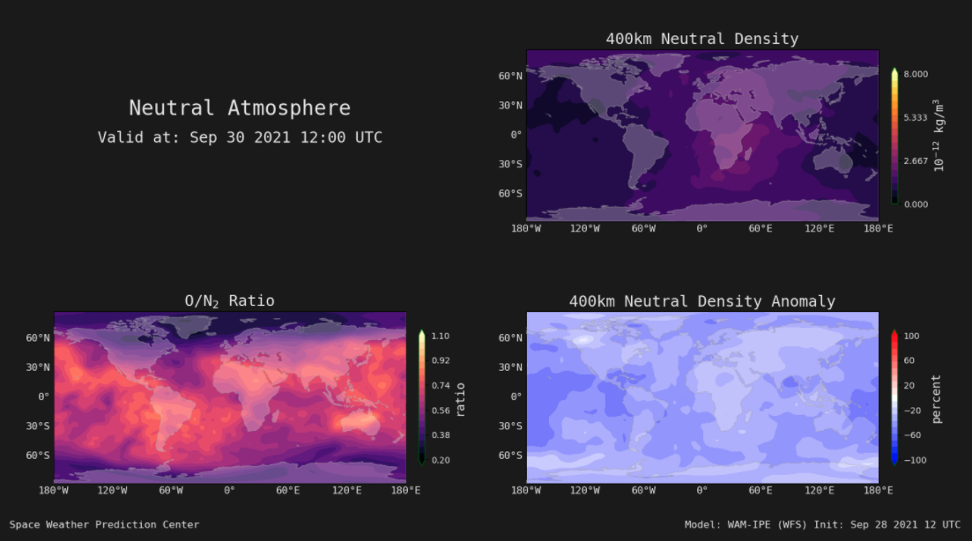
WAM-IPE Operational Model at SWPC
Whole Atmosphere and Ionosphere Plasmasphere Electrodynamics Model
An extension of the US weather model to 600 km altitude coupled with a plasma component of the atmosphere.
Includes all the lower atmosphere weather and dynamics processes, as well as all the additional T-I physics (including electrodynamics and plasma processes)
WAM provides the 3D fields for neutral winds, temperature, density, major species composition O, O₂, N₂. for drag. The plasma component, IPE, provides plasma densities and velocities, and temperatures in the ionosphere and plasmasphere for communications and navigation impacts
WAM-IPE has been in operation since July 2021 with the latest upgrade in Aug 2023. Two operational CONOPS provide T-I nowcast as well as forecast two days in advance
https://www.swpc.noaa.gov/products/wam-ipe
6

Slide 7
WAM-IPE Workflows in Operations
CONOPS I (WAM-IPE Forecast System, WFS)
― Include tropospheric weather into upper atmosphere forecast
Low-frequency (atmospheric data driven, hours)
Based on NWS global workflow (6-hour cycles) with WAM data assimilation, and 2-day forecast
WAM Data Assimilation Scheme (WDAS): modified Gridpoint Statistical Interpolation (GSI) 3D-VAR with Incremental Analysis Update (IAU)
Driven by observed F10.7 and solar wind for specification, and forecasted F10.7 and K_{P} for 2-day forecast
CONOPS II (WAM-IPE Realtime System, WRS)
― Capture the impact of near real-time solar wind conditions
High-frequency (solar data driven, 5 minutes)
Extension of global workflow (CONOPS I) with online solar data polling
Initialize at end of IAU “corrector” segment from CONOPS I with available solar wind drivers
Advance as soon as observed solar wind data are available
7
Notes:
The need for 2 CONOPS

Slide 8
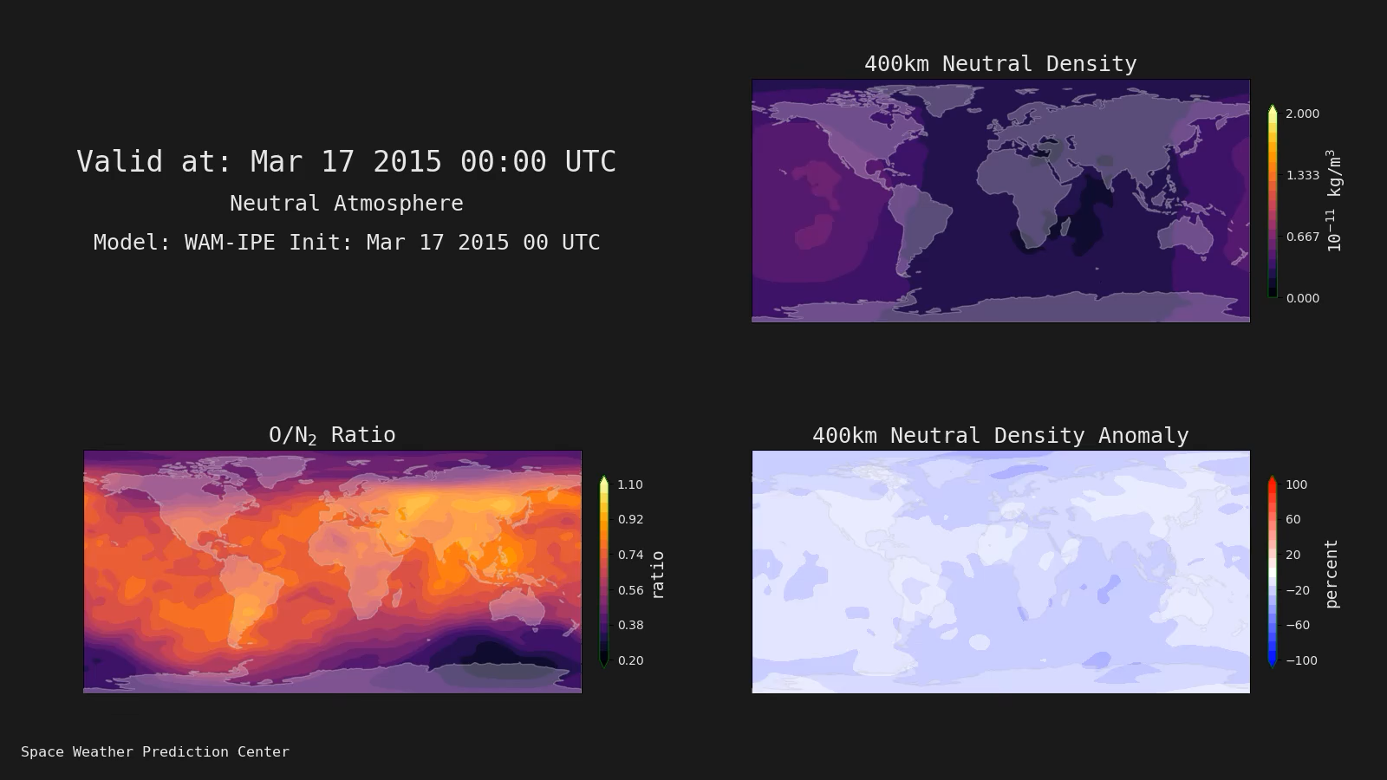
Physical model response to geomagnetic storm
9
8
7
6
5
4
3
2
1
May 16
May 17
May 18
May 19
May 20
8

Slide 9
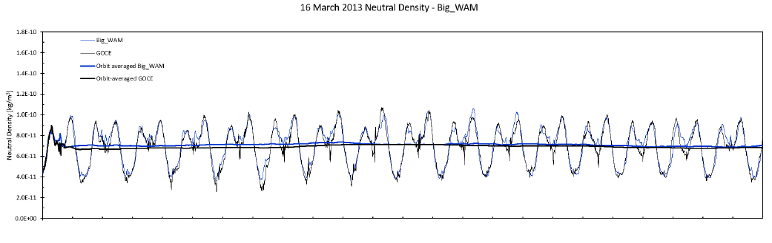
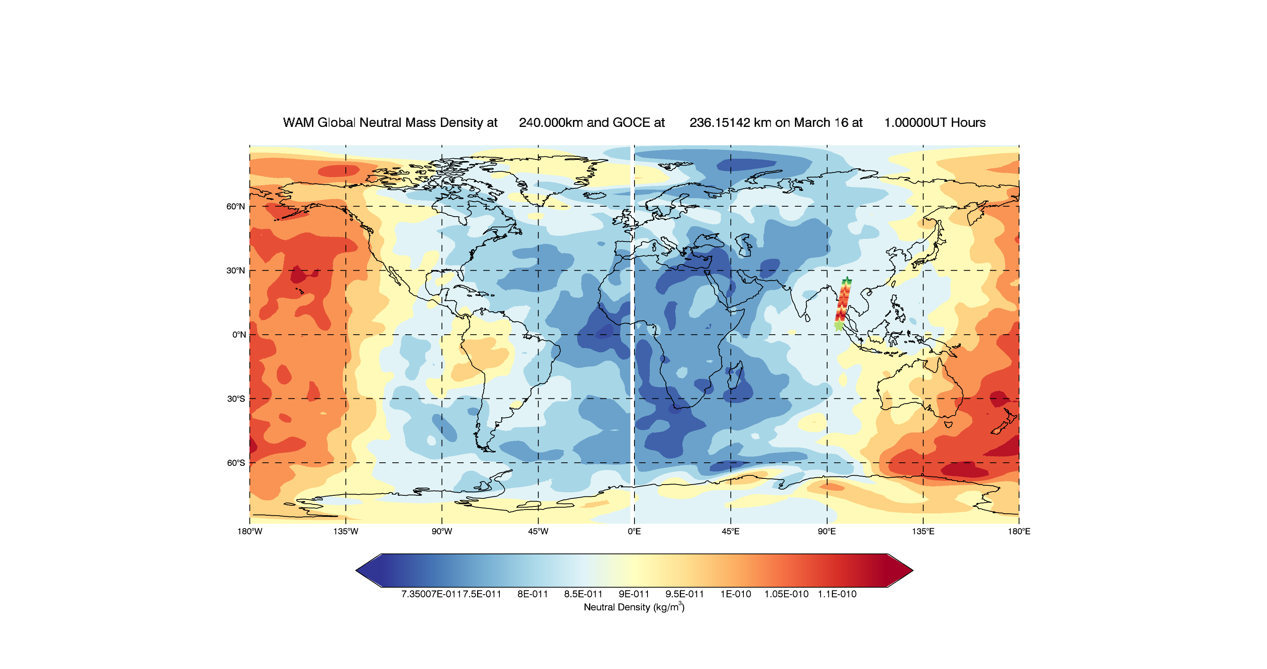
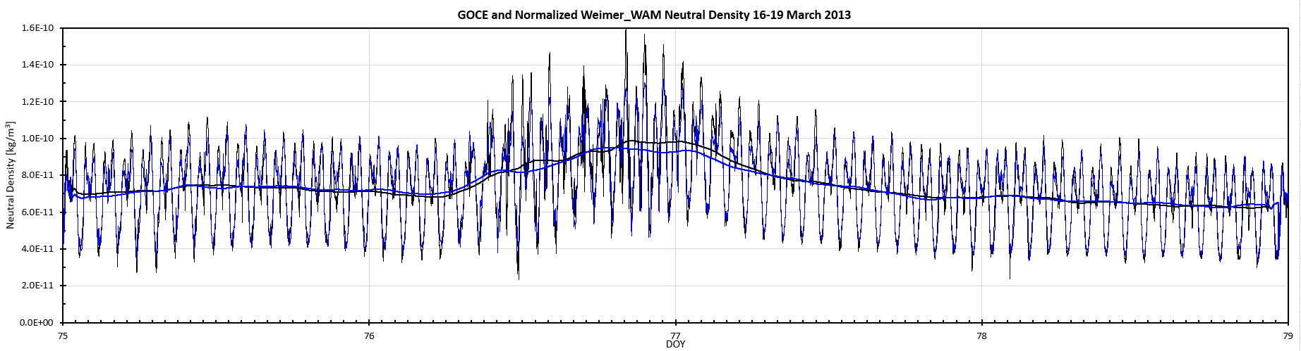
Neutral density response to minor storm ~50% at 400 km
16-19th March 2013, D_{st} = -132
SD: 1.8% orbit average, 8.2% along track
1st day - quiet
WAM vs GOCE accelerometer
at ~250 km
~30% increase during storm
at 250 km
Kp Index, March 16-19, 2013
4-days
9

Slide 10
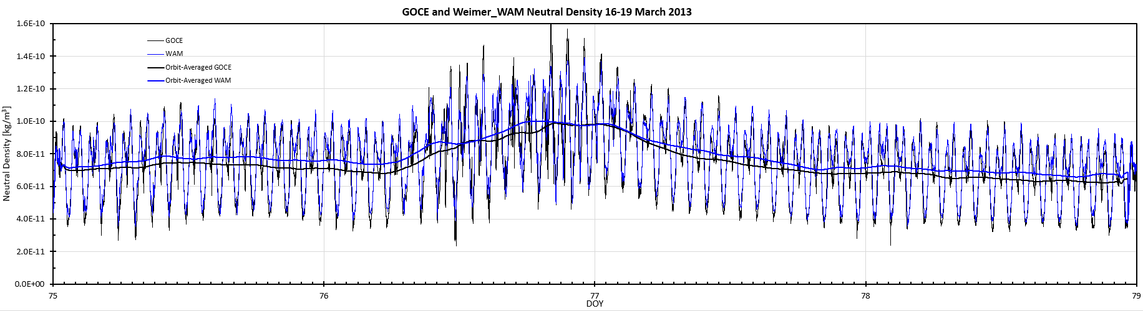
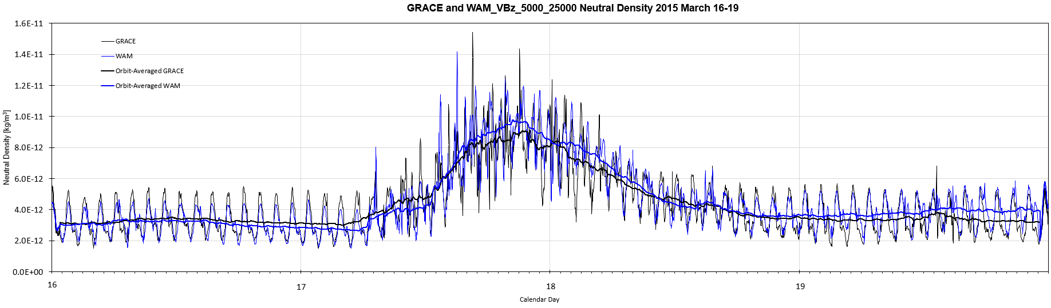
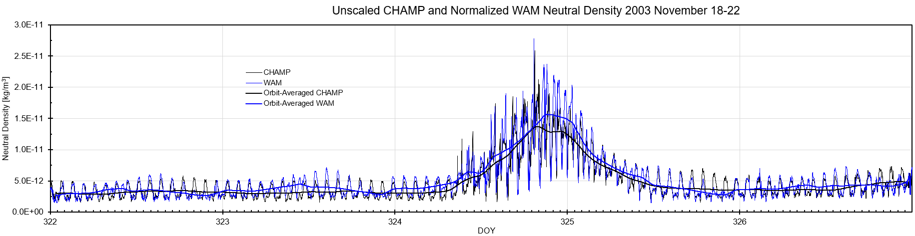
Validation: GOCE at 250 km
March 2013 D_{st} = - 132
Neutral Density
At 400 km the globally average neutral density response to a storm increases from ~50% in a minor storm to 500% for a major storm
The neutral density product has a good match to the data through the storm periods for these vastly different storm intensities
Moderate: 50% increase at 400 km
With saturation curve
for Joule heating
Validation: GRACE at 500 km
March 2015 D_{st} = - 243
Strong: 250% increase
at 400 km
Validation: CHAMP at 400 km
Nov 2003 D_{st} = - 472
Major: 500% increase at 400 km
10
Notes:
Comparison of neutral density to increasing storm intensity, with good agreement in the simulations as density increases from 50% to 500% at 400 km altitude.

Slide 11
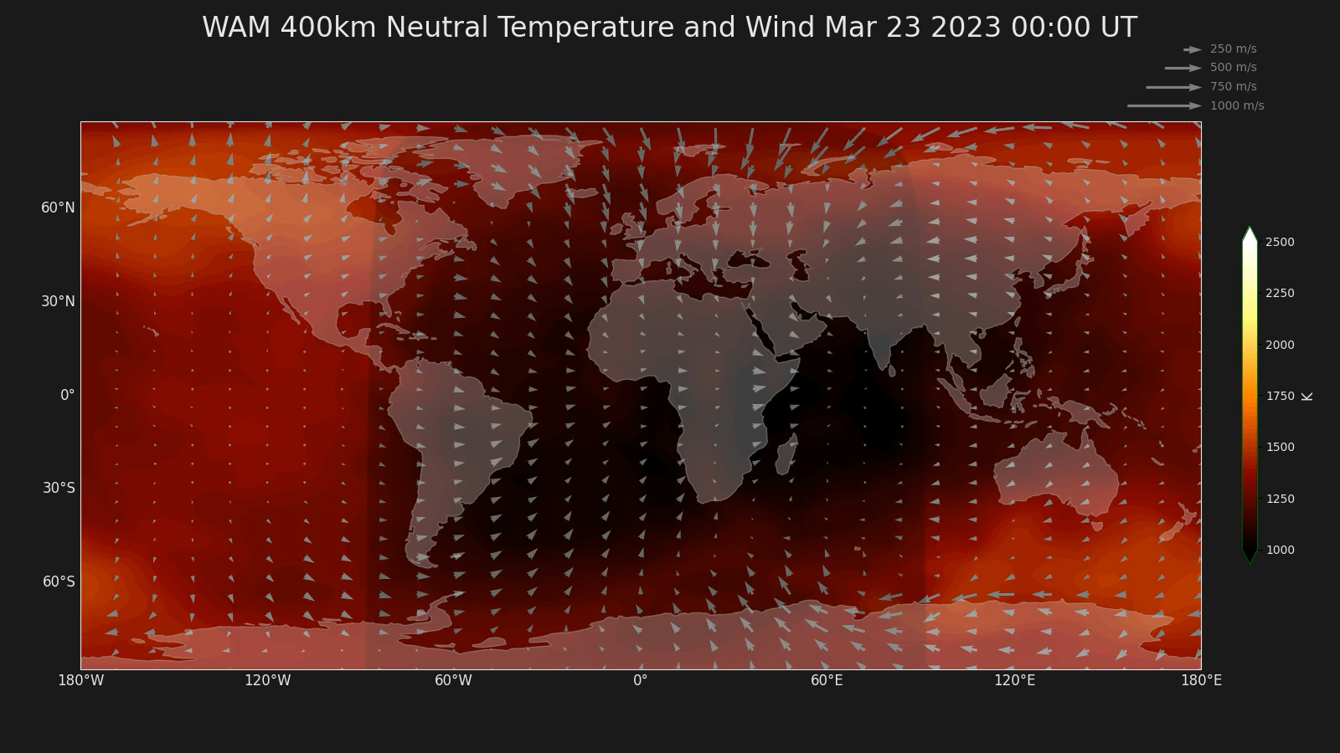
Neutral Wind Response to G3 Storm
Neutral winds exceed 500 m/s even for modest storm
In track wind of 500 m/s equiv. 13% drag acceleration increase
In-track wind of 1000 m/s equiv. 26% drag acceleration increase
Kp Index, March 22-25, 2023
9
8
7
6
5
4
3
2
1
Mar 22
Mar 23
Mar 24
Mar 25
Mar 26
11

Slide 12
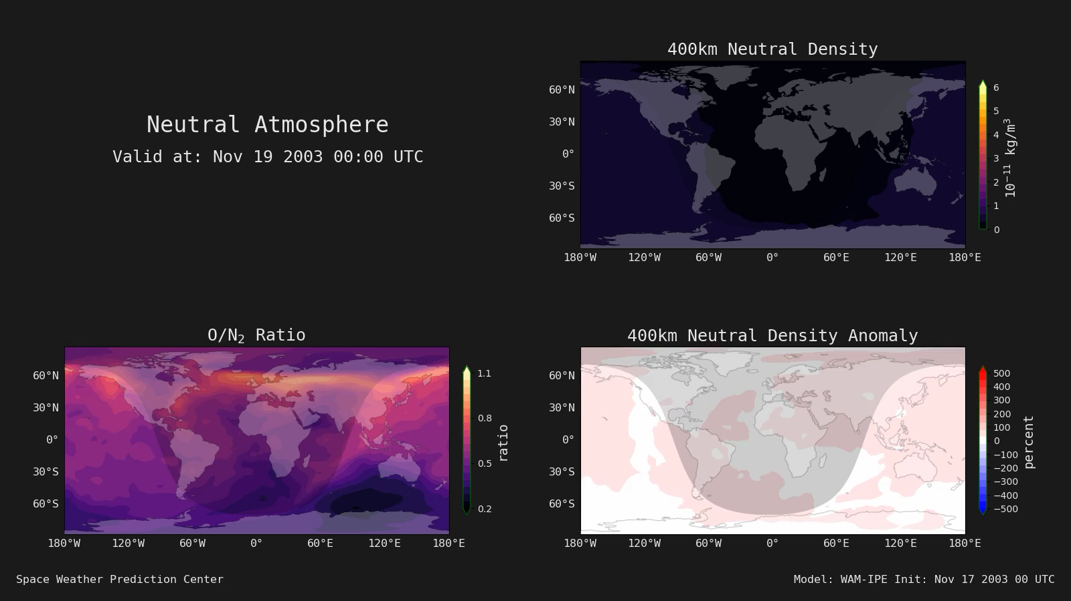
Neutral Density Response to a “Carrington” Event
A storm with twice the power of the biggest storm in 20 years
Need Adam’s animation here
Storm time evolution but with twice the power
9
8
7
6
5
4
3
2
1
Nov 19
Nov 20
Nov 21
Nov 22
Nov 23
12

Slide 13
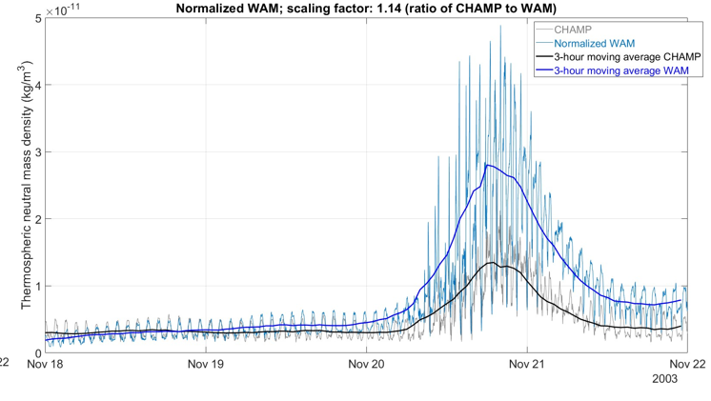
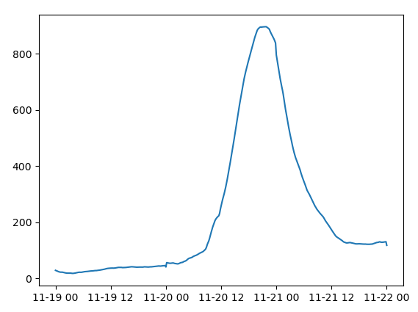
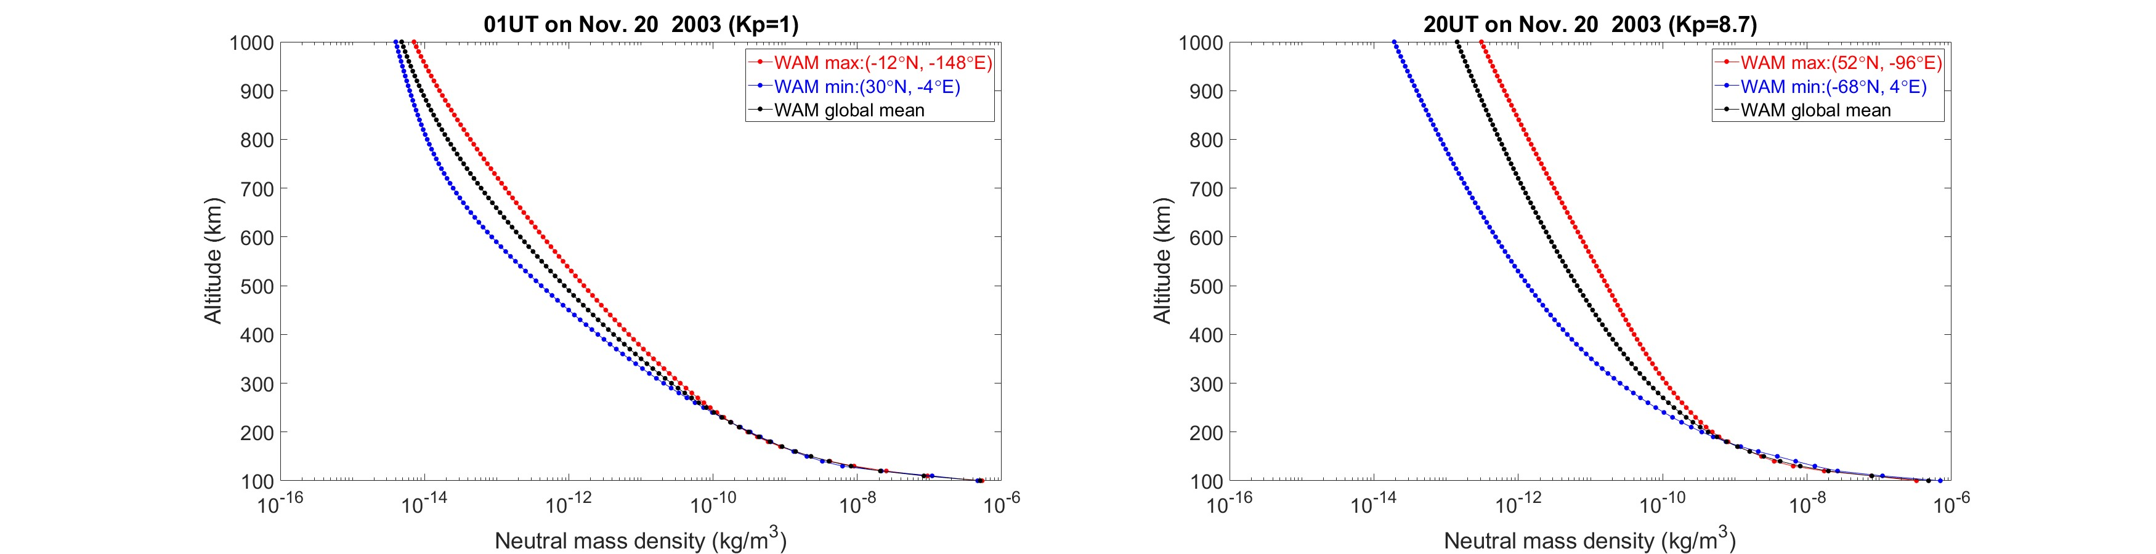
Neutral Density Response to a “Carrington” Event
A storm with twice the power of the biggest storm in 20 years
Neutral Density Response
Global mean
peak density
> 800%
400 km
Doubles the neutral density response at 400 km altitude compared to Nov 2003 storm
% increase
Carrington level
Nov 19th – 22nd
Max and Min Profiles at Peak
Nov 2003 level
13

Slide 14
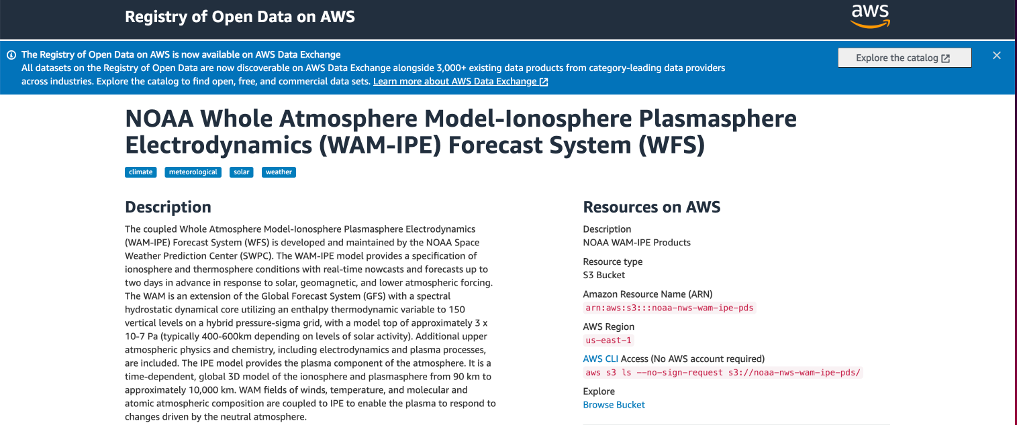
SWPC Neutral Density Product
Based on the operational WAM neutral atmosphere component
Provides specification and 2-day forecast of neutral mass density for drag estimation (includes structure and follows temporal response to storms for spacecraft stability analysis)
4D data cube:
  100 to 1000 km altitude at 10 km resolution,
  Global 2∘x4∘ geographic lat/long horizontal grid
  10-minute temporal cadence
Product can also include temperature, species densities (He, O, N2, O+), and winds in the future
The product is based on CONOPS-1 for 2-day forecast, and CONOPS-2 for nowcast, and is available through NOAA NODD system (https://registry.opendata.aws/noaa-nws-wam-ipe/)
A forecast product with data assimilation based on CONOPS-2 is planned, together with the operational use of ADAPT to improve the F10.7 forecast for up to 7 days
14

Slide 15
Summary
Neutral density is the dominant uncertainty in predicting satellite drag and orbit prediction in Low Earth Orbit (LEO)
  Density can change by a factor 10 over the 11-year solar cycle at 400 km altitude
  A large geomagnetic storm can increase density by a factor 5 at 400 km altitude in 1 day
Empirical model predictions tend to underestimate storm response and do not follow the temporal variations well
The neutral density product provides realistic neutral density for quiet and disturbed condition over a wide range of solar energy inputs
4D Data Cube specification and forecast of neutral density is available for distribution
15

Slide 17
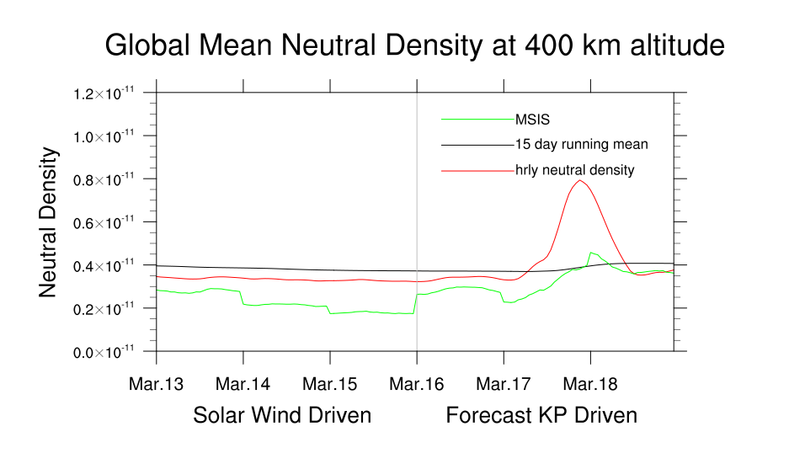
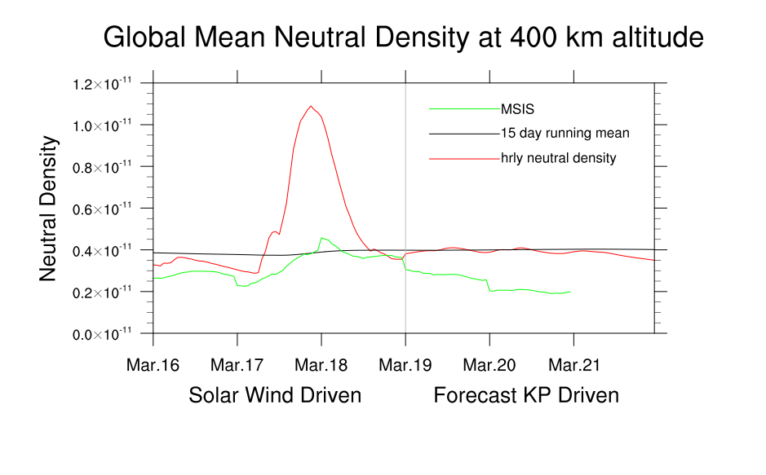
Insert new version??
Neutral Density Product - SWPC visualization
Currently have a 2-day forecast from the WAM-IPE operational model – do we need 3-days?
Main product is 4-D data cube – additional visualization of neutral density at 400 km altitude: 3-days before current time driven by solar wind observation, and 2- or 3-day forecast driven by SWPC Kp forecast
Examples show forecast response and subsequent actual response
Neutral density or percent change?
Could add estimation of standard deviation for those using an empirical model
17

Slide 18
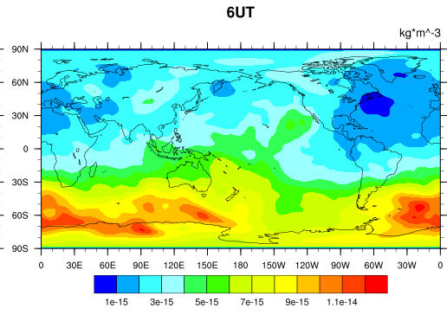
Helium correction for extrapolation to 1000 km
Helium
During quiet times (e.g., 0 UT and 06 UT, March 2015 storm) and low solar activity (top panels) Helium takes over as the dominant neutral species above 850 km
During a storm (18 UT, March 2015 storm) thermal expansion of the atmosphere and increase in atomic oxygen reduces the importance of Helium
Captures winter helium bulge 800 km altitude in July
18

Slide 19
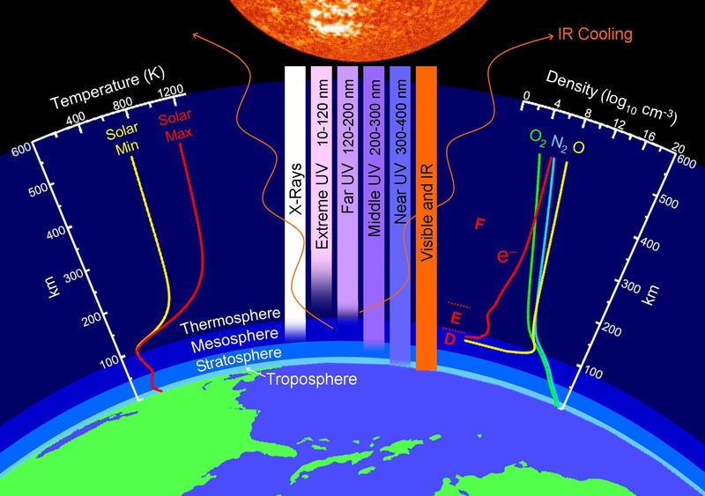
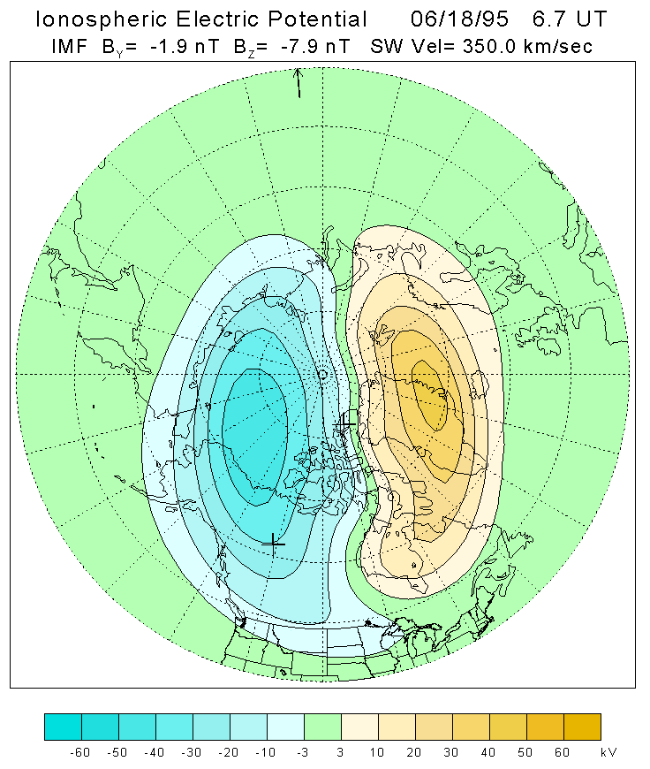
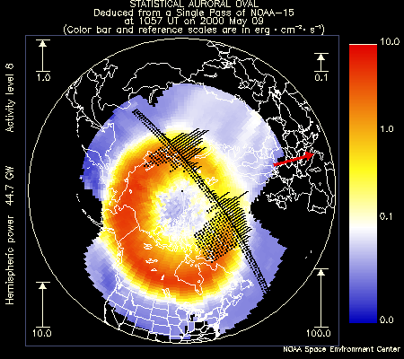
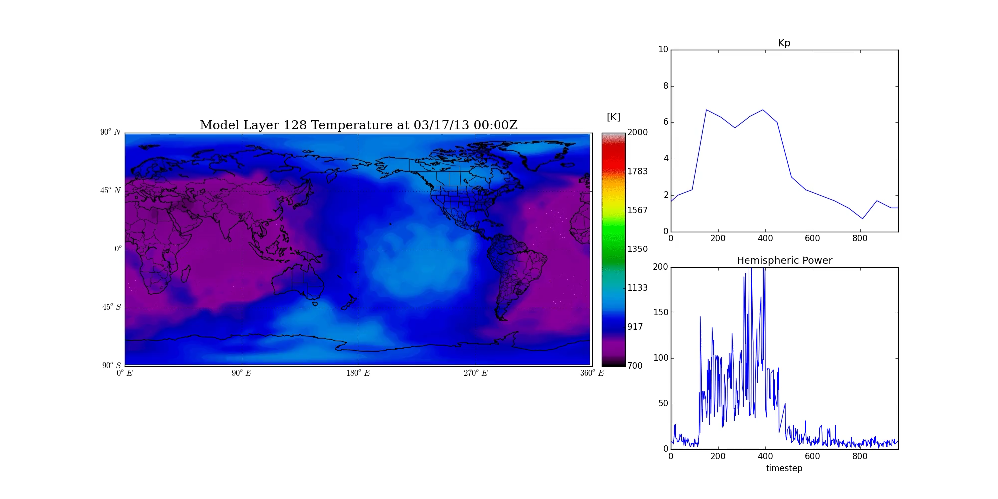
Two main drivers: solar and geomagnetic activity
Solar Radiation Influence
Source: EUV/UV, Index: F10.7
Geomagnetic Storm Influence
Source: solar wind plasma filtered by magnetosphere
Index: Kp/Ap, G-Scale
Credit: John Emmert/NRL
19

