Slide 1
Space Weather Overview, Part II: Radiation and Charging Hazards
SWPC Space Weather Prediction Testbed Satellite Exercise
October 25, 2023
Boulder, Colorado
Juan V. Rodriguez
University of Colorado Boulder, CIRES
NOAA National Centers for Environmental Information (NCEI)

Slide 2
Space Radiation and Charging Hazards to Spacecraft
Single event effects (SEEs): energetic protons and heavy ions (>30 MeV)
Internal charging: radiation belt electrons (>100 keV)
Surface charging: auroral and radiation belt plasmas (<50 keV)
Total dose: energetic protons (inner belt and solar) and radiation belt electrons (outer belt)
These hazards are encountered in all Earth orbits.
The severity depends on the orbit.
This presentation focuses on LEO.

Slide 3
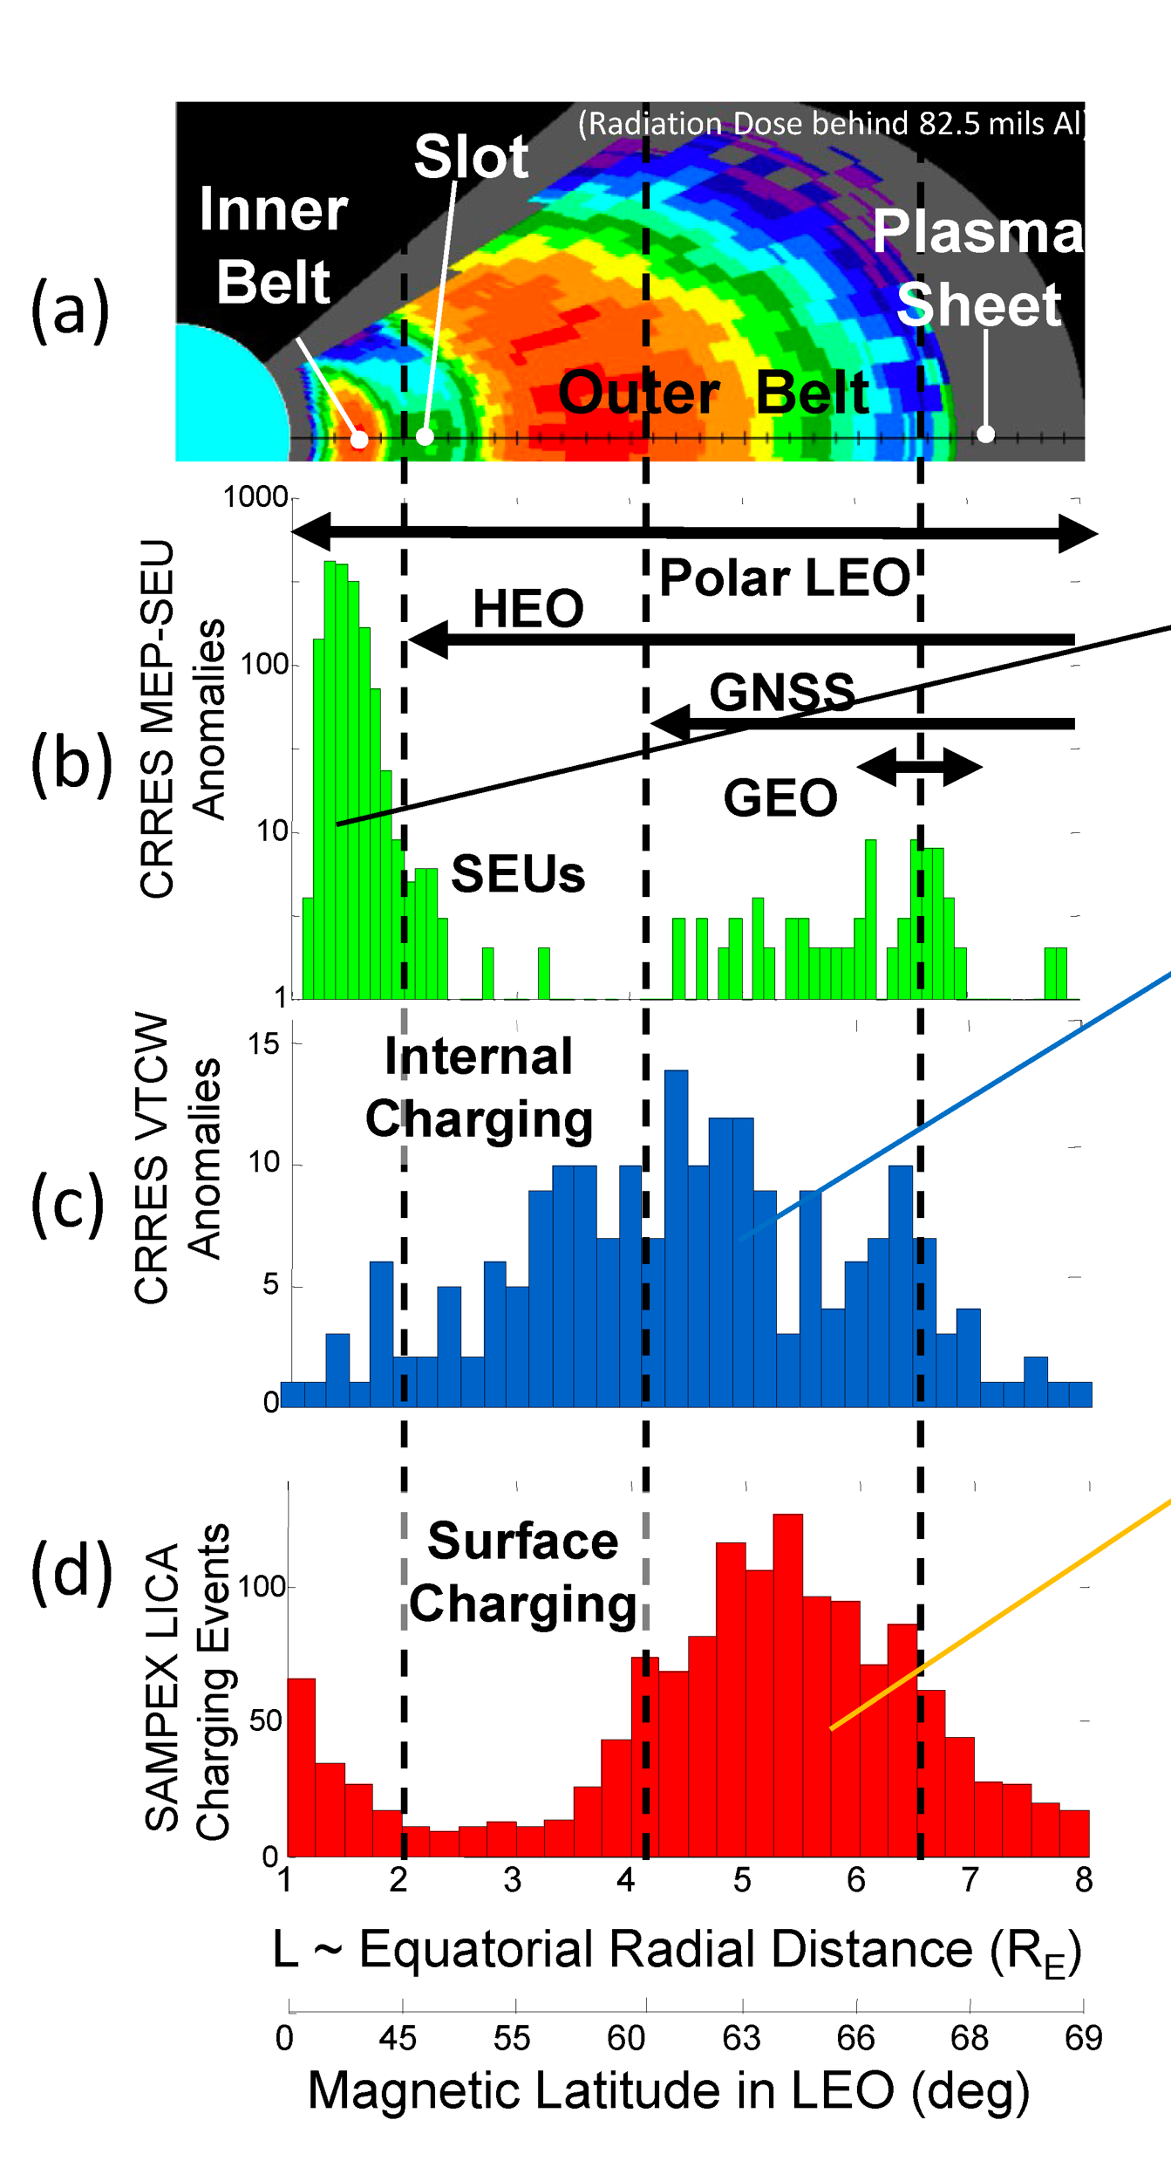
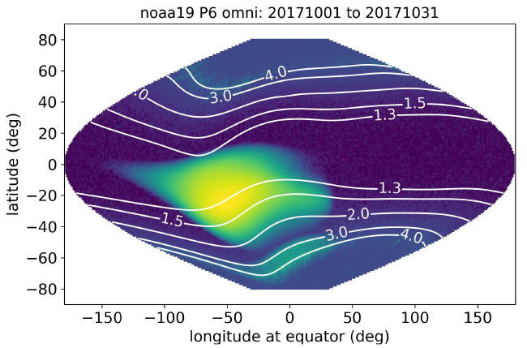
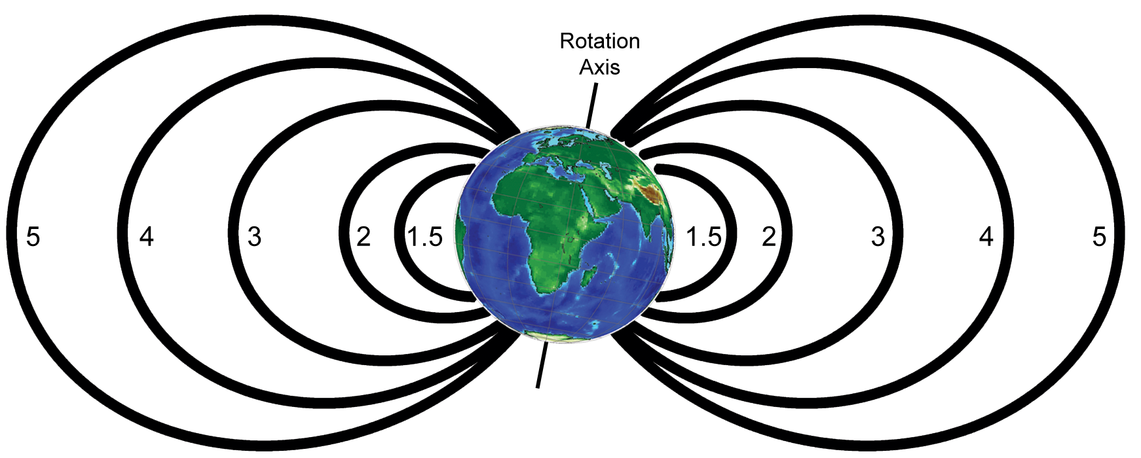
Space weather radiation and charging hazards to spacecraft in LEO
Meridional view of total dose
SEEs on CRRES
Internal charging on CRRES
Surface charging on SAMPEX
>16 MeV protons (inner belt) and >3 MeV electrons (outer belt) at 850 km
1.5
2
3
4
5
Figure 2 from O’Brien, Aerospace Report No. ATR-2021-01168, 2021
L coordinates: radial distance (Re) of magnetic field line equatorial crossing

Slide 4
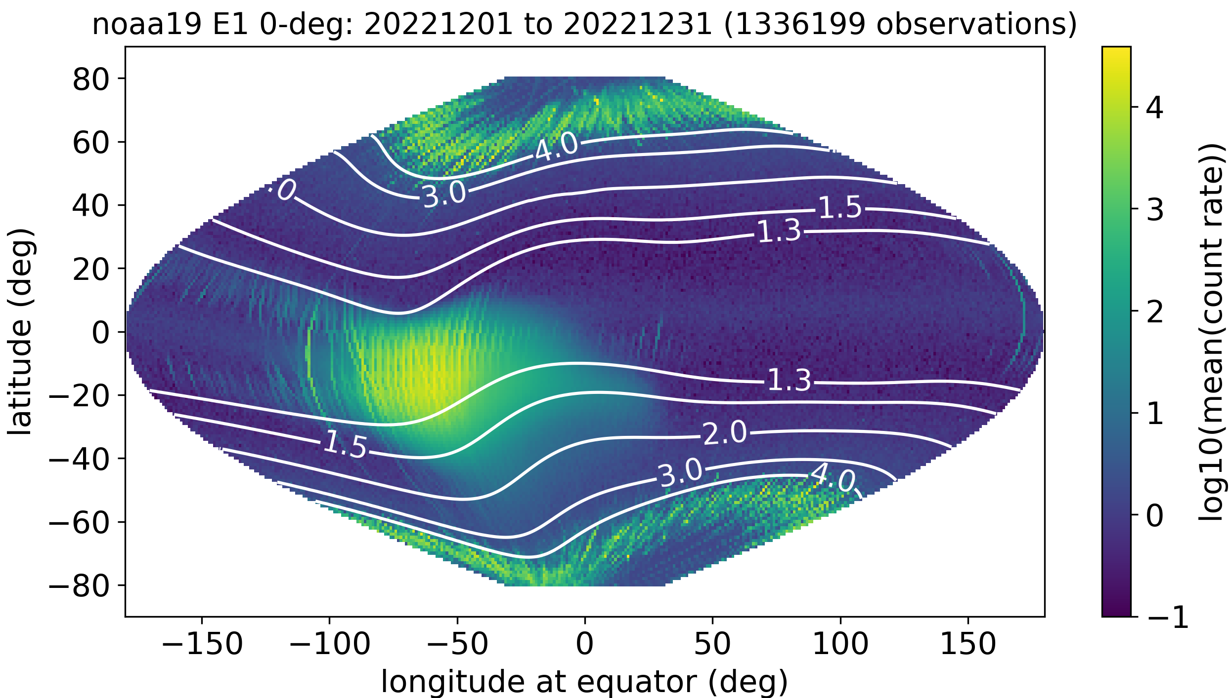
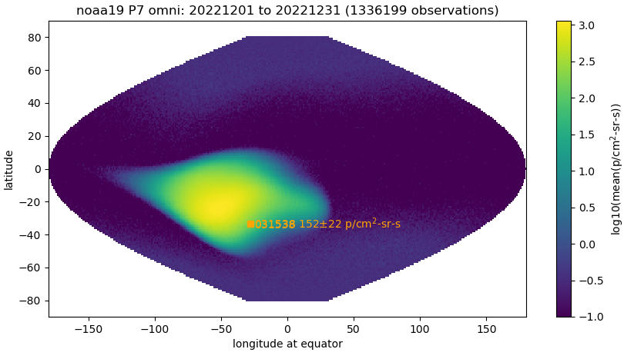
LEO: location, location, location……
….and direction!
L contours: radial distance (Re) of field line equatorial crossing
aurora, outer belt
galactic cosmic rays in polar cap
drift loss cone
inner belt (SAA)
>30 keV electrons: surface charging
>35 MeV protons: dose, SEEs
NOAA-19 (870 km), December 2022 monthly averages

Slide 5
SWPC’s Radiation Alerts Are Based on GEO Observations
Solar radiation storm warnings and alerts:
https://www.swpc.noaa.gov/products/goes-proton-flux
Based on GEO observations of >10 MeV and >100 MeV solar energetic particles (SEPs)
Radiation belt electron alert:
https://www.swpc.noaa.gov/products/goes-electron-flux
Based on observations of >2 MeV electrons in GEO
Spacecraft Environmental Anomalies Expert System – Real Time (SEAESRT)
https://www.swpc.noaa.gov/products/seaesrt
Three hazard types based on GEO observations
One hazard type based on correlation of geomagnetic activity index (Kp) with GEO observations of surface charging
SWPC’s radiation alerts provide useful generalized space weather awareness.
They should not be applied to LEO without additional information.

Slide 6
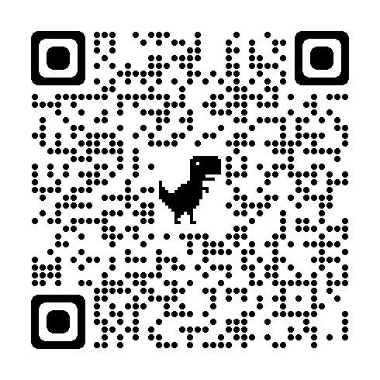
Belt Indices from LEO Observations
POES belt indices:
Calculated by NOAA NCEI every day from 5 satellites (807-870 km); publicly available
Calculated from MEPED electron and proton fluxes in several bands above 30 keV
4 indices: total, inner belt, slot region, outer belt
Three channels used in decision tool developed by The Aerospace Corporation
>300 keV electrons: internal charging
>7 MeV protons: event total dose
>35 MeV protons: single event effects
REACH belt indices:
Produced by The Aerospace Corporation
Based on two dosimeter ‘flavors’
Inner belt, slot, outer belt, polar cap
Figure 7 from O’Brien et al., ‘A Human-in the Loop Decision Tool for Preliminary Assessment…’, Aerospace Report No. TOR-2020-00349, 2020
Use of LEO-based belt indices improves LEO anomaly assessments over GOES-based indices alone

Slide 7
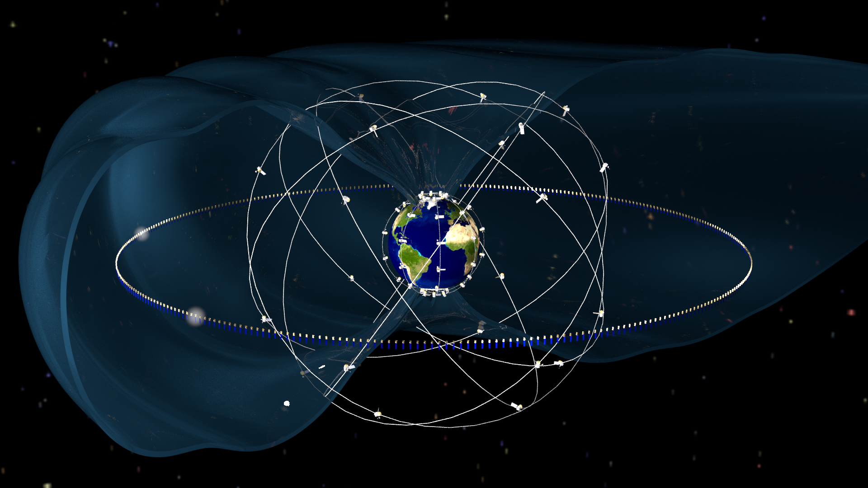
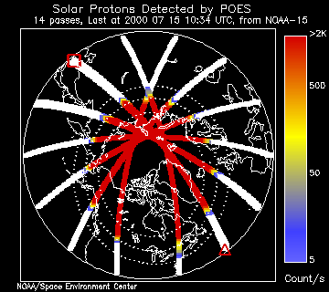
Solar Energetic Particles can access high latitudes and the outer magnetosphere

Slide 8
Single Event Effects
SWPC solar radiation storm warnings and alerts:
Based on observations of GOES >10 MeV solar energetic particle (SEP) events
Other solar proton energies also used as criteria (e.g. for launch vehicles)
Relevant to LEO above ~55 deg latitude, depending on geomagnetic activity
SEAESRT:
To be applied to LEO (above ~55 deg latitude), the SEE hazard quotient (based on GOES >30 MeV protons) may require scaling
POES belt indices + anomaly decision tool:
MEPED >35 MeV protons used to indicate whether slot region is filled
Otherwise, investigate SEE as possible anomaly cause if satellite location is above L = 3 (~55 deg lat) during SEP event, or is in SAA at any time
The SEE risk in SEP events is increased by the presence of energetic heavy ion fluxes (e.g., carbon, oxygen, iron), which are not present in the SAA

Slide 9
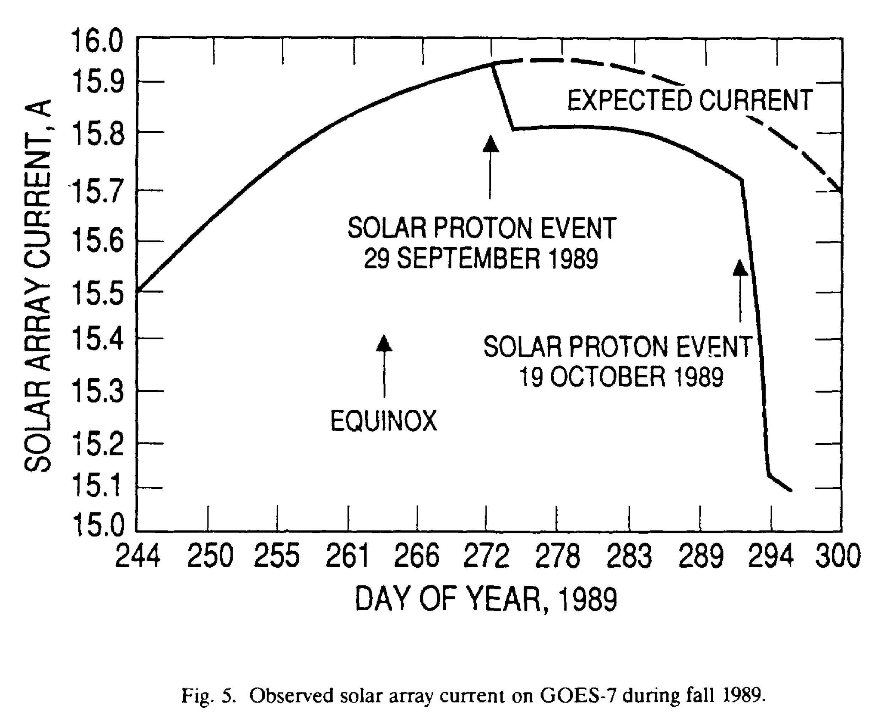
Dose: Mission-Accumulated and Large Event
Dose in LEO dominated by passage through stable inner belt (South Atlantic Anomaly) multiple orbits per day
Hazard indicators for large solar proton event
Assume <20 mil Al equiv. shielding
SEAESRT: >5 MeV GOES protons
Belt indices: >6.9 MeV POES (LEO) p+
A large solar proton event could reduce power margins
Marvin & Gorney, Aerospace Report No. TR-0091(6945-01)-2, 1992

Slide 10
Radiation Belt Electrons Responsible for Internal Charging

Slide 11
Internal Charging
SWPC >2 MeV radiation belt electron alert:
Based on GOES >2 MeV electron observations (L = 6.6-8.0)
Same observations used for SEAESRT internal charging hazard quotient
Maps to a latitudinally very narrow segment of polar LEO orbits
Correlation coefficient with >2 MeV fluxes in outer belt drops from 0.9 at L = 6.0 to 0.15 at L = 3.0 (Baker et al. 2019, 10.1029/2019JA027331)
POES belt indices + anomaly decision tool:
Based on >300 keV electrons in LEO
Use if satellite location below L = 6, otherwise use GOES >2 MeV electron fluxes
(a) Correlation coefficients between the log of E > 0.8 MeV electron fluxes measured by Van Allen Probes and the log of such fluxes measured by GOES‐15 at L = 6.6±0.05 (September 2012 to August 2018). (b) Similar to (a) but for electrons with E > 2 MeV. From Baker et al. 2019

Slide 12
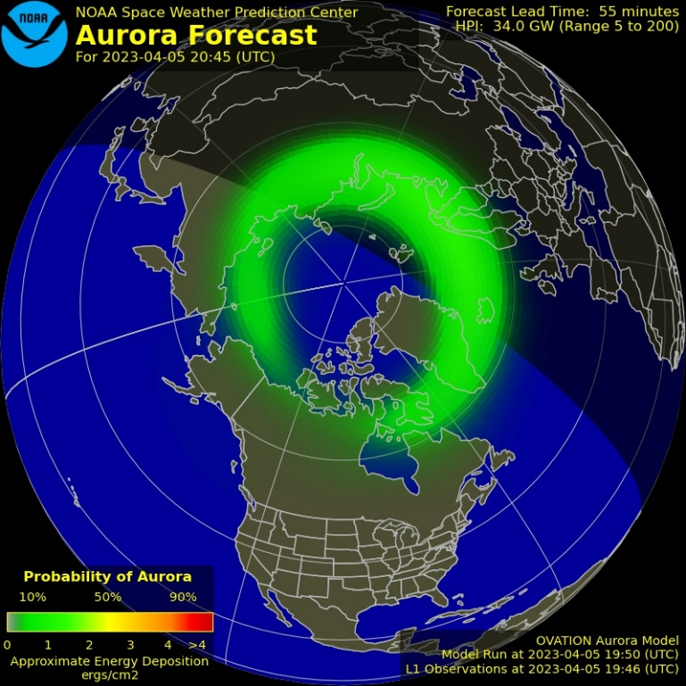
Low Energy Electrons Responsible for Surface Charging

Slide 13
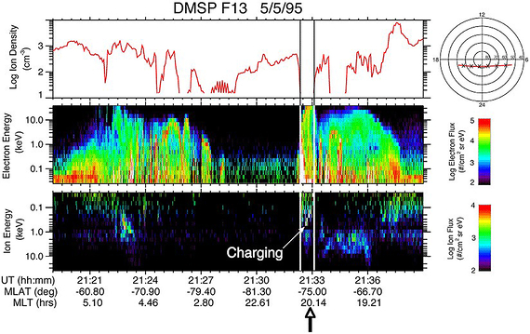
Surface Charging
Auroral ion energy-time spectrogram shows frame charging signature.
DMSP F13 microwave imager anomaly occurred due to discharge of differentially-charged thermal blankets. (Kp = 4+)
Differential charging on the spacecraft presents a hazard
Observed in regions of low plasma density
Dark polar ionosphere: DMSP
Satellite wake: SAMPEX LICA
Anomaly decision tool uses satellite location (magnetic latitude, local time - MLT) and geomagnetic indices (AE, Kp)
SEAESRT hazard quotient (Kp, MLT) provides context
Must be augmented with location and direction of flight
Ion density and ion and electron energy-time spectrograms associated with a charging event on DMSP F13. The time of the SSM/I instrument anomaly is indicated by the arrow. (The density depletions associated with auroral arcs during this pass are probably instrumental artifacts.)
From Anderson 2012, 10.1029/2011JA016875

Slide 14
The Charging Hazard is Present at All Phases of the Solar Cycle
Auroral frame charging occurrence increases at solar minimum due to low-density dark ionosphere encountered around winter solstices
Surface and internal charging hazards in radiation belts are enhanced following storms. Solar wind high-speed stream occurrence lags the solar cycle.
From Anderson 2012, 10.1029/2011JA016875
From Mazur et al. 2012, 10.1109/TPS.2011.2174656

Slide 15
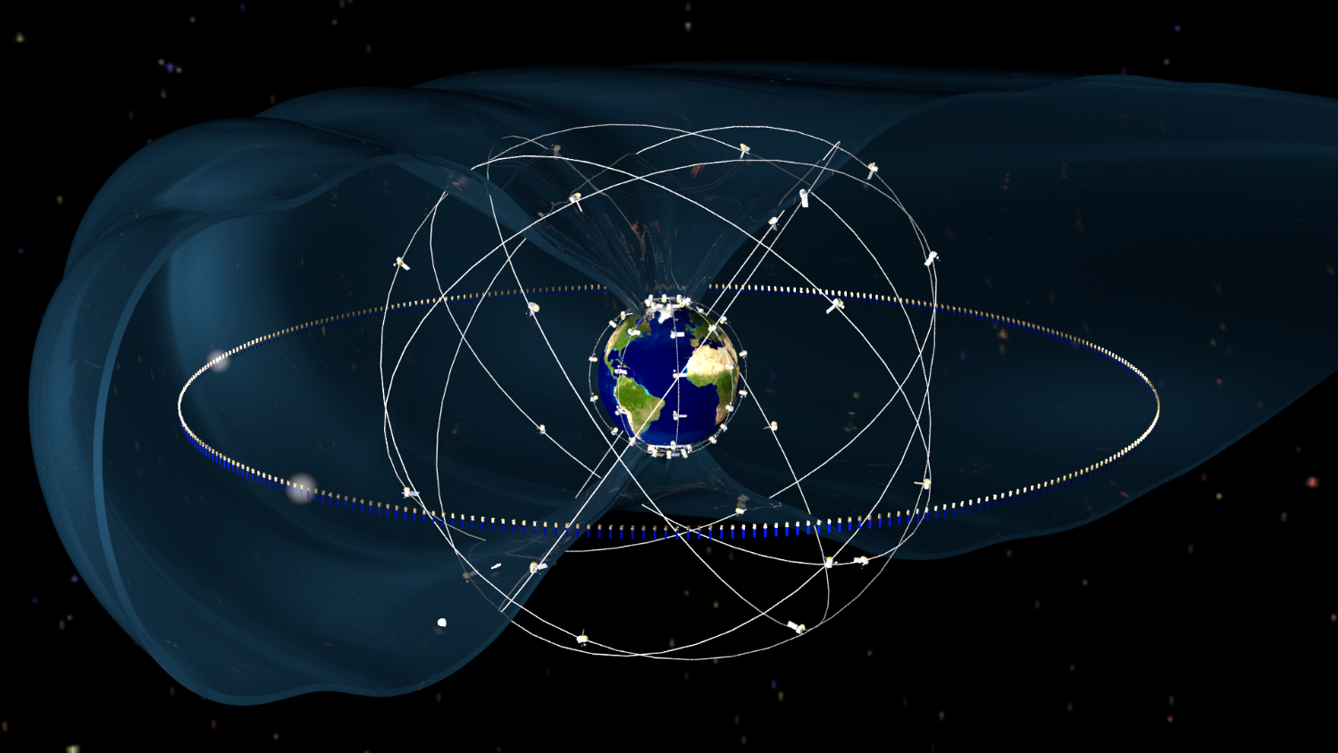
Space Weather Radiation and Charging Hazards to Spacecraft
Single-Event Effects
Surface Charging
Internal Charging
Total Dose
For LEO anomaly assessment, belt indices derived from LEO measurements plus knowledge of spacecraft location and direction of flight are more reliable than GEO-based alerts alone
We are here to listen to your feedback on how NOAA can improve its services in support of mitigating radiation and charging hazards in LEO

