Slide 1
CME Arrival and Geomagnetic Storm
(Session Time: 50 minutes) 25 October 2023
Module 3
Notes:
3:35pm - 75mins

Slide 2
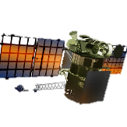
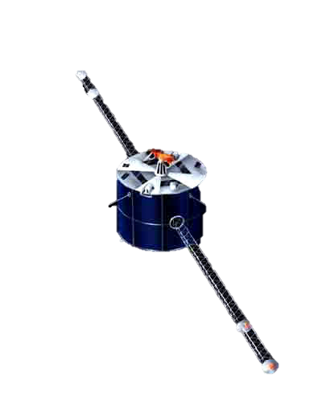
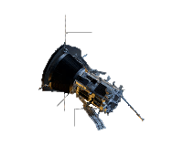
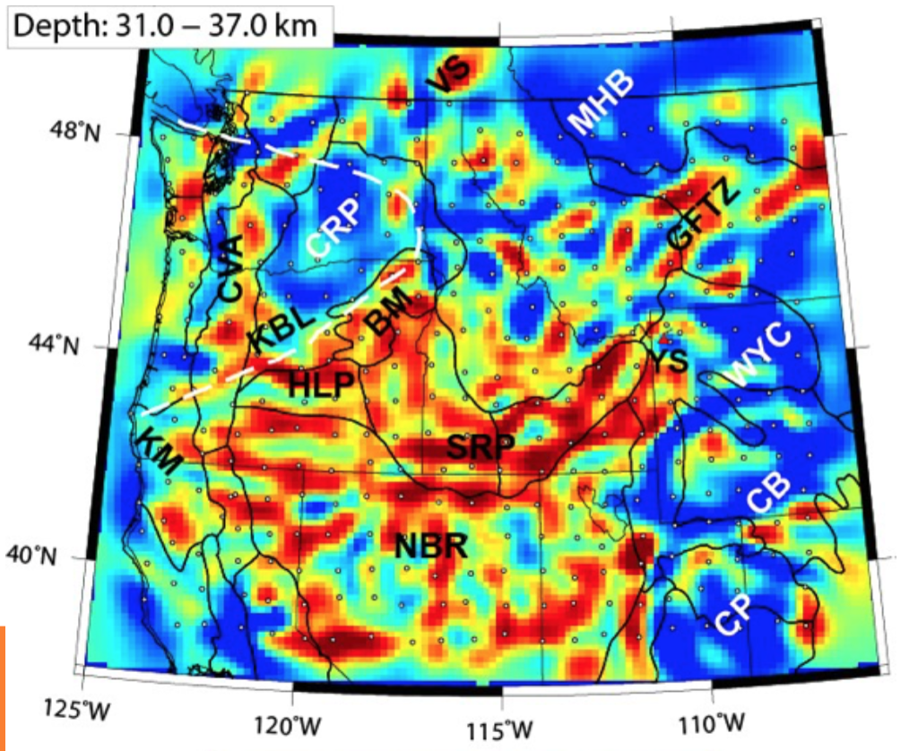
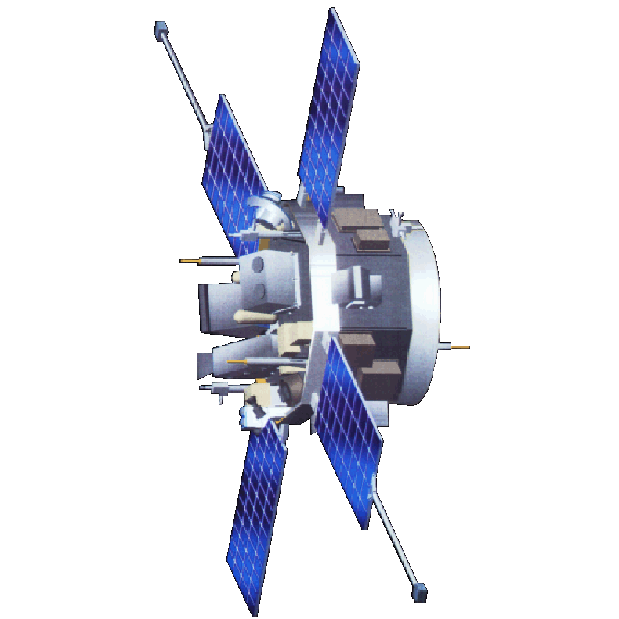
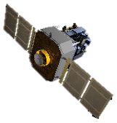
Solar Wind Travel Time: 36 Hours
91M miles

Slide 3
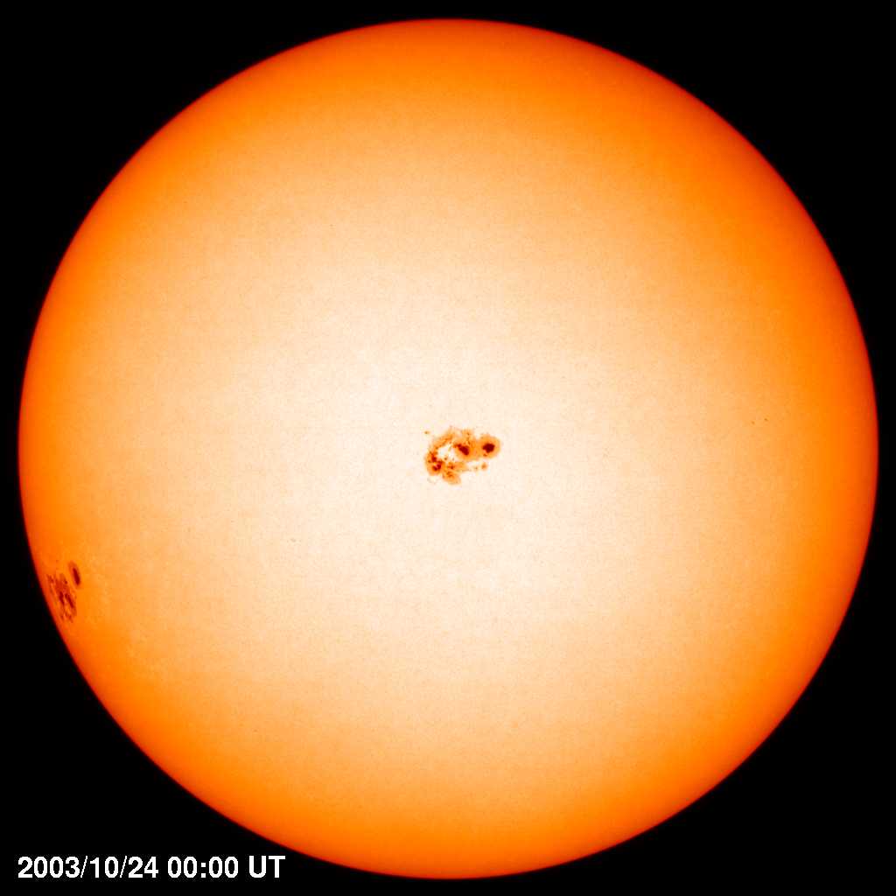
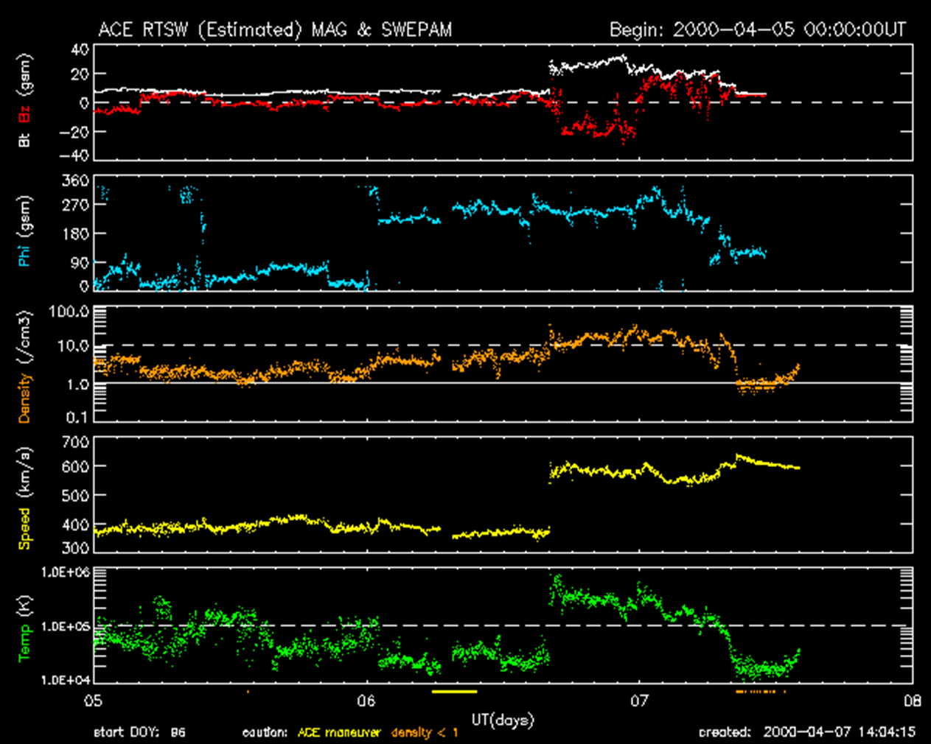
25 Oct - CME impacts Earth - Severe Geomagnetic Storm
CME Shock Arrival at L1

Slide 4
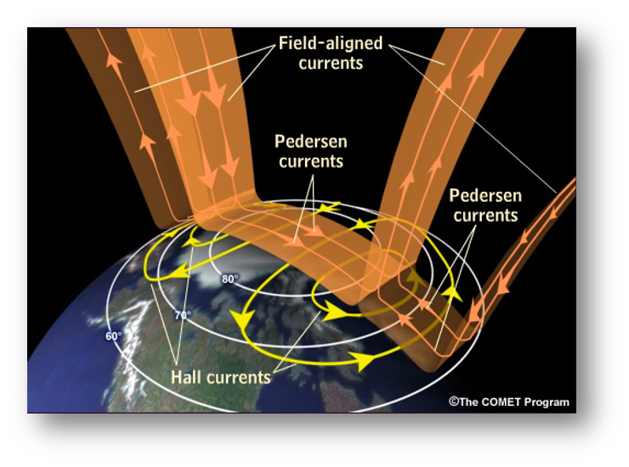
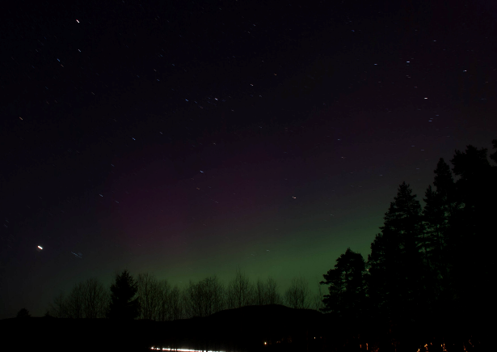
25 Oct - CME impacts Earth - Severe Geomagnetic Storm
Solar wind kinetic and electromagnetic energy is converted within the magnetosphere and upper atmosphere

Slide 5
A CME-Driven Geomagnetic Storm Drives the SEP Cutoff in LEO to Lower Latitudes
Cutoff latitude moves equatorward ~10 degrees as geomagnetic activity increases from lowest to highest levels
International Space Station endures large increase in >30 MeV solar protons as cutoff latitude moves equatorward.
From Leske et al. 2001, JGR, v106, p. 30,011

Slide 6
25 Oct - CME impacts Earth - Severe Geomagnetic Storm
Through joule heating, energy source from the magnetosphere impacts the thermospheric dynamics

Slide 7
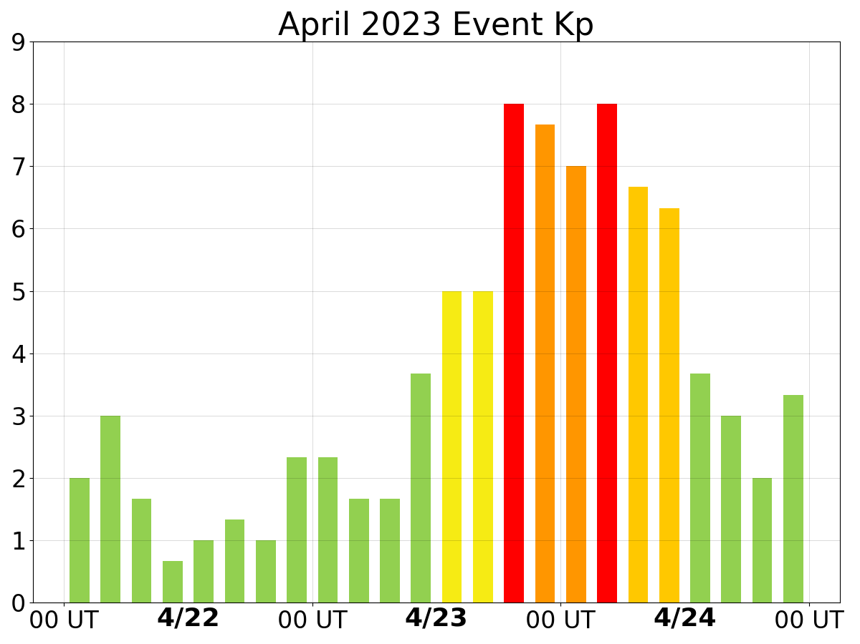
25 Oct - CME impacts Earth - Severe Geomagnetic Storm
WAM 400km Neutral Density and Wind
Kp Index
10/24
10/25
10/26

Slide 8
How would this G4 storm look with the WAM CONOPS?
Notes:
3:35pm - 75mins

Slide 9
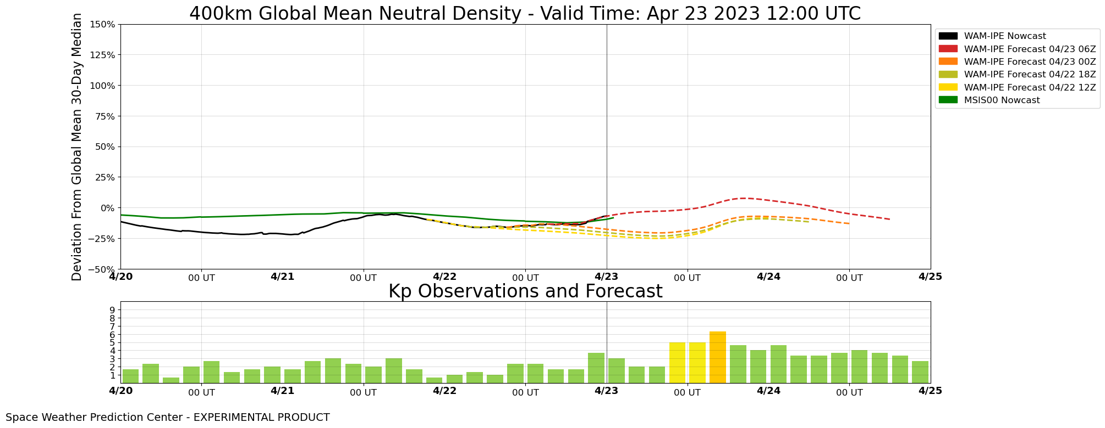
WAM Global Mean Density at 400 KM
CONOPS2
WAM-IPE Realtime System (WRS)
Observed Solar Wind Driven
Forecast Kp Driven
Current time
CONOPS1
WAM-IPE Forecast System (WFS)

Slide 10
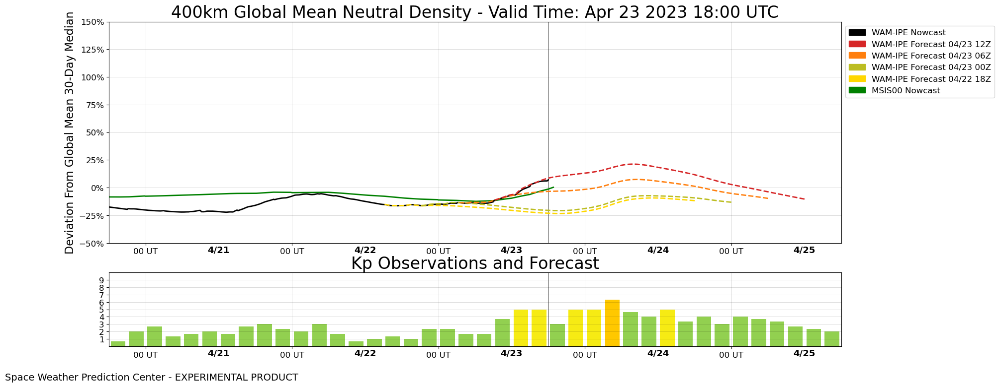
WAM Global Mean Density at 400 KM
Observed Solar Wind Driven
Forecast Kp Driven
Current time

Slide 11
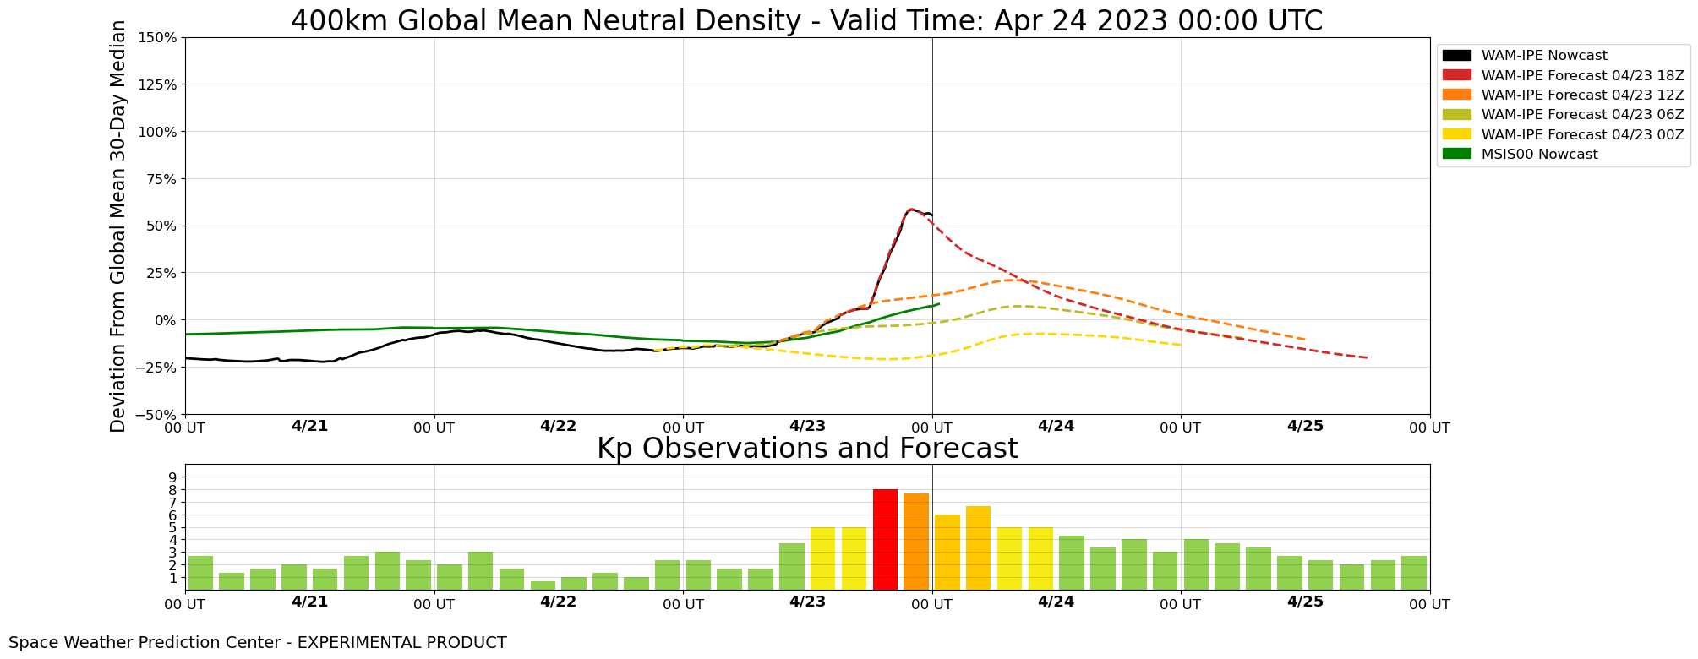
WAM Global Mean Density at 400 KM
Observed Solar Wind Driven
Forecast Kp Driven

Slide 12
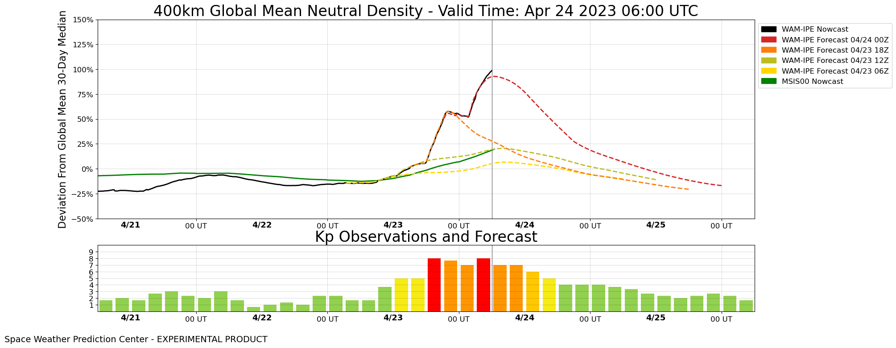
WAM Global Mean Density at 400 KM
Observed Solar Wind Driven
Forecast Kp Driven

Slide 13
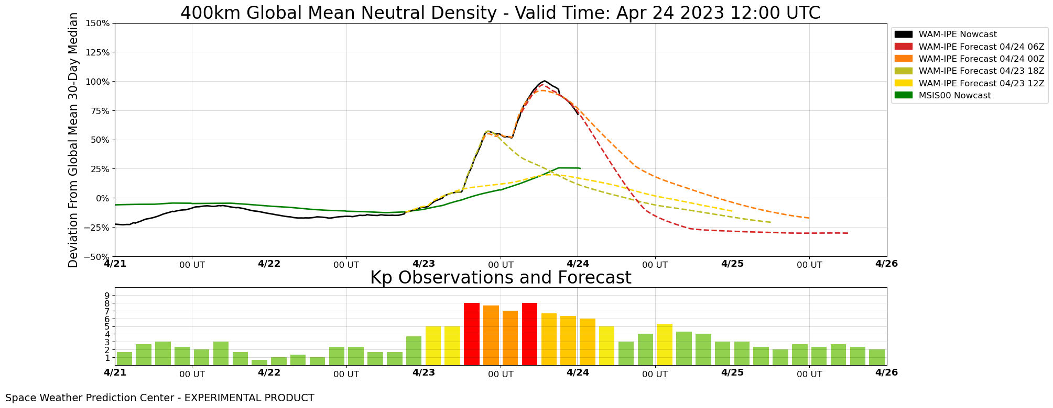
WAM Global Mean Density at 400 KM
Observed Solar Wind Driven
Forecast Kp Driven

Slide 14
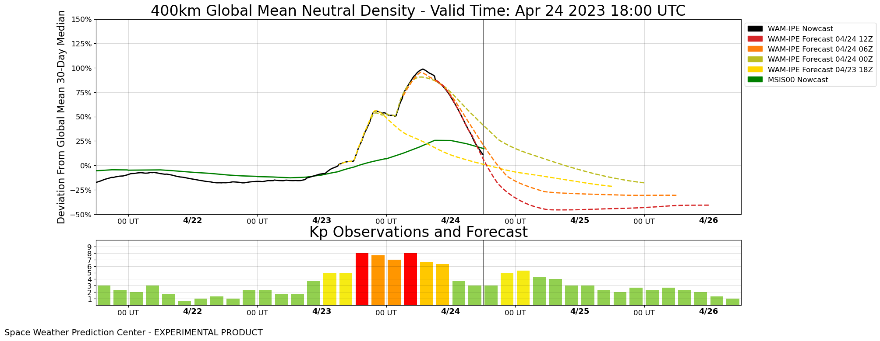
WAM Global Mean Density at 400 KM
Observed Solar Wind Driven
Forecast Kp Driven

Slide 15
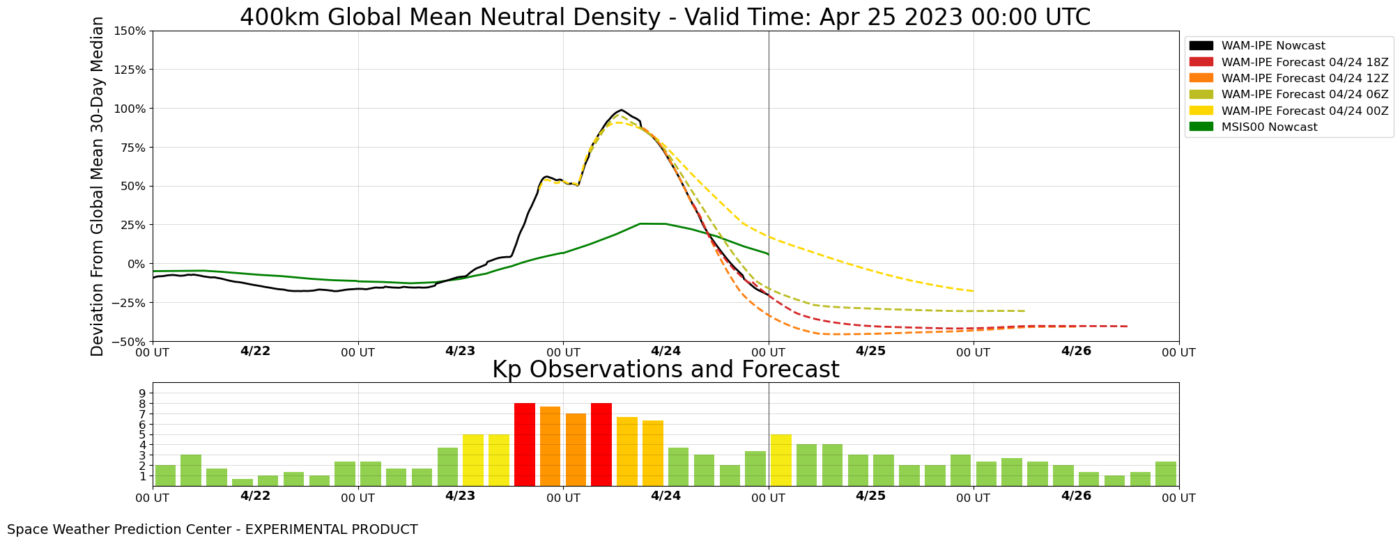
WAM Global Mean Density at 400 KM
Observed Solar Wind Driven
Forecast Kp Driven

Slide 16
What if this is a forecast “Extreme G5 Storm”?
Observed Solar Wind Driven
Forecast Kp Driven

Slide 17
Discussion
Is the current WAM outputs useful and usable? For the new graphic product, should we use neutral density or percentage change? How about the uncertainties?
How does the knowledge of impending storm alter your operational processes? How does this impact the launch decision, insertion orbit, VLEO missions or re-entry?
How much lead-time of the onset of geomagnetic storm do you need to make the most effective decisions?
What other actionable information should SWPC provide?
How can the US Government provide or improve on the adequate measurement of the space environment in support of the satellite industry?

